Slide 1
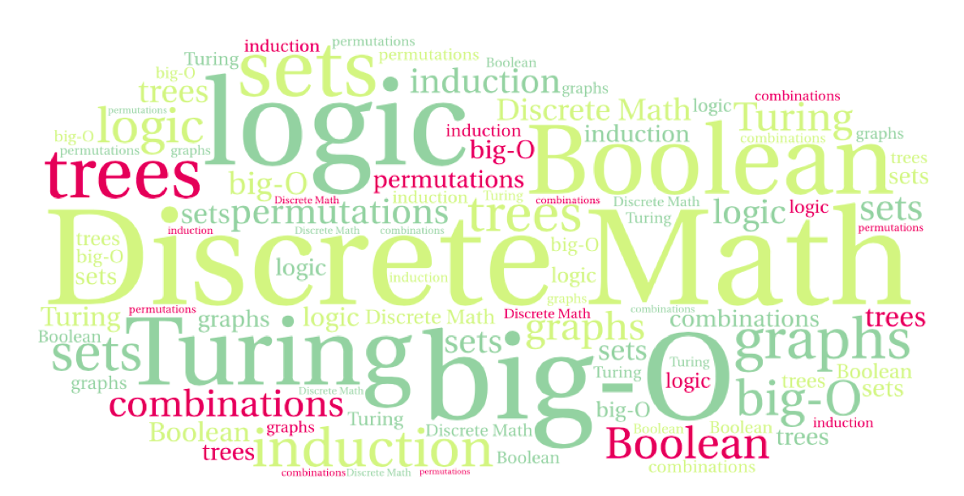
CS 220: Discrete Structures and their Applications
Logical inference
Section 1.11-1.13 in zybooks

Slide 2
Valid arguments in propositional logic
Consider the following argument:
You need a current password to access department machines
You have a current password
Therefore:
You can access department machines

Slide 3
Valid arguments in propositional logic
We’ll write it in a more formal way:
You need a current password to access department machines
You have a current password
∴You can access department machines

Slide 4
Valid arguments in propositional logic
This is an example of a logical argument that has the form:
p → q
p
∴q
This is an inference rule is called Modus ponens

Slide 5
Valid arguments in propositional logic
And more generally:
p₁
p₂
....
p_{n}
∴ c
An argument is valid whenever ( p₁ ∧ p₂ ∧ ... ∧ p_{n} ) → c is a tautology.
arguments or hypotheses
conclusion
Notes:
An argument is valid whenever ( p₁ ∧ p₂ ∧ ... ∧ p_{n} ) → c is a tautology.

Slide 6
Verifying argument validity using truth tables
Let’s verify the validity of modus ponens:
p → q
p
∴ q
p | q | p → q
T | T | T
T | F | F
F | T | T
F | F | T

Slide 7
Verifying argument validity using truth tables
Let’s verify the validity of modus ponens:
p → q
p
∴ q
p | q | p → q
T | T | T
T | F | F
F | T | T
F | F | T

Slide 8
Verifying argument validity using truth tables
Consider the following argument:
p → q
p ∨ q
∴ q
p | q | p ∨ q | p → q
T | T | T | T
T | F | T | F
F | T | T | T
F | F | F | T

Slide 9
Verifying argument validity using truth tables
Consider the following argument:
p → q
p ∨ q
∴ q
The argument is valid
because whenever the
hypotheses are true,
the conclusion is true as well.
p | q | p ∨ q | p → q
T | T | T | T
T | F | T | F
F | T | T | T
F | F | F | T

Slide 10
Verifying argument validity using truth tables
Consider the following argument:
¬p
p → q
∴ ¬q
Is it valid?
p | q | ¬q | ¬p | p → q
T | T | F | F | T
T | F | T | F | F
F | T | F | T | T
F | F | T | T | T

Slide 11
Verifying argument validity using truth tables
Consider the following argument:
¬p
p → q
∴ ¬q
Is it valid?
p | q | ¬q | ¬p | p → q
T | T | F | F | T
T | F | T | F | F
F | T | F | T | T
F | F | T | T | T

Slide 12
Example
Let’s prove the validity of the following argument using inference rules:
If it is raining or windy, the game will be cancelled.
The game will not be cancelled.
Therefore, it is not windy.

Slide 13
Example
In propositional logic:
w: It is windy
r: It is raining
c: The game will be cancelled
(r ∨ w) → c
¬c
∴ ¬w

Slide 14
Example
In propositional logic:
w: It is windy
r: It is raining
c: The game will be cancelled
(r ∨ w) → c
¬c
∴ ¬w
Proof:
1. (r ∨ w) → c Hypothesis
2. ¬c Hypothesis
3. ¬(r ∨ w) Modus tollens, 1, 2
4. ¬r ∧ ¬w De Morgan's law, 3
5. ¬w Simplification, 4
Modus tollens
¬q
p → q
∴ ¬p

Slide 15
Inference rules
p
p → q Modus ponens
∴ q
¬q
p → q Modus tollens
∴ ¬p
p Addition
∴ p ∨ q
p ∧ q Simplification
∴ p
p
q Conjunction
∴ p ∧ q
p → q
q → r Hypothetical syllogism
∴ p → r
p ∨ q
¬p Disjunctive syllogism
∴ q
p ∨ q
¬p ∨ r Resolution
∴ q ∨ r

Slide 16
Validity of inference rules
We can prove the validity of inference rules as well. Consider Modus Tollens for example:
1. p → q Hypothesis
2. ¬p ∨ q Conditional expressed with with disjunction
3. ¬q Hypothesis
4. ¬p Disjunctive syllogism, 2, 3
Notes:
Hmm, you use 1 inference to prove the other ….

