Slide 1
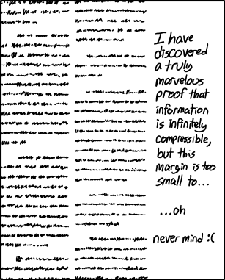
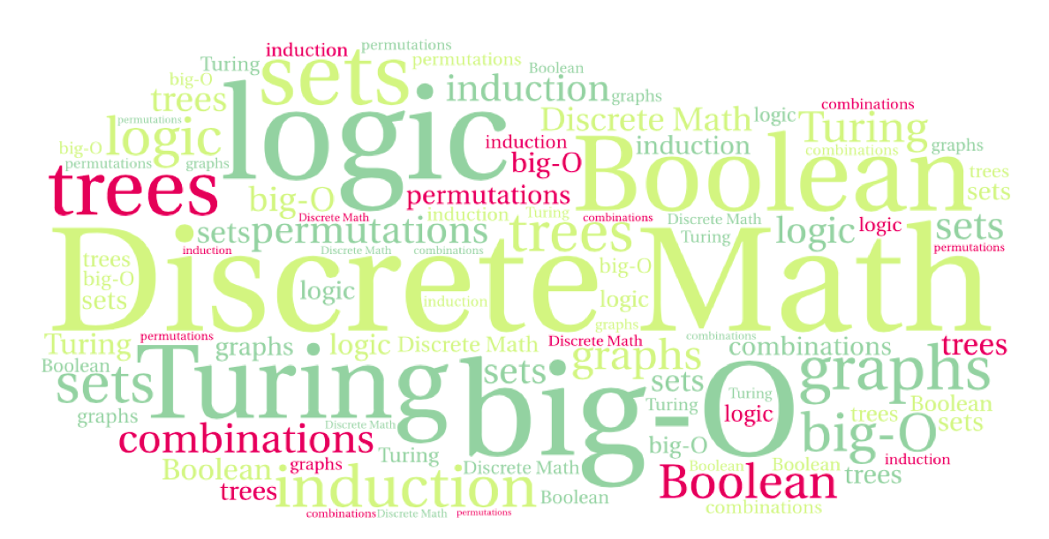
CS 220: Discrete Structures and their Applications
Proofs
sections 2.4 – 2.5 in zybooks
https://xkcd.com/1381/

Slide 2
Terminology
Theorem: statement that can be shown to be true
Proof: a valid argument that establishes the truth of a theorem
Conjecture: statement believed to be a true

Slide 3
Proof techniques
Proof techniques:
Direct proof
Proof by contrapositive
Proof by contradiction
Proof by cases
Proof by induction – later in the course

Slide 4
Proof by contradiction
Prove: “If n=ab where a and b are positive integers, then a ≤ √n or b ≤ √n.”
Proof by contradiction.
Assume the conclusion is false.
i.e. the statement “a ≤ √n or b ≤ √n” is false.
Hence, using DeMorgan’s law, a > √n and b > √n
Hence ab > n, which contradicts n=ab

Slide 5
Proof by contradiction
The process:
Assume that the theorem is false.
Show that some logical inconsistency arises as a result.
If t is the statement of the theorem, the proof begins with the assumption ¬t and leads to a conclusion that ¬r ∧ r, for some proposition r.

Slide 6
Proof by contradiction
The process:
Assume that the theorem is false.
Show that some logical inconsistency arises as a result.
If t is the statement of the theorem, the proof begins with the assumption ¬t and leads to a conclusion that ¬r ∧ r, for some proposition r.
In other words, we get that ¬t → (¬r ∧ r)
The only way for this to be true is for ¬t to be false, showing that t is true.

Slide 7
Example
Theorem: Every triangle has at least one acute (less than 90 degrees) angle.
Notes:
Easy: if all 3 >=90 then sum >180
Stronger: every triangle has at most one angle >=90

Slide 8
√2 is irrational
Theorem: √2 is irrational.
Proof.
Assume that “√2 is irrational” is false, that is, √2 is rational.
Hence, √2 = a/b such that a and b have no common factors (if they have then we can divide these out)
So 2b² = a², which means a² must be even
a² is even therefore a is even
Hence, a = 2c
Therefore b² = 2c² so b² must be even.
Therefore, according to the lemma, b is even, which means a and b have common factor 2, which is a contradiction.

Slide 9
Proof by cases
Prove: For every integer x, x²-x is an even integer.
Idea:
Let’s reason about the parity of x²-x for two cases:
Case 1: x is even.
Case 2: x is odd

Slide 10
Proof by cases
Prove: For every integer x, x²-x is an even integer.
Let’s reason about the parity of x²-x for two cases:
Case 1: x is even, i.e. x = 2k for some integer k
x² - x = (2k)² - 2k = 4k² – 2k = 2(2k² – k)
Notes:
Or direct: x * (x-1) one of these is even

Slide 11
Proof by cases
Prove: For every integer x, x²-x is an even integer.
Let’s reason about the parity of x²-x for two cases:
Case 2: x is odd, i.e. x = 2k+1 for some integer k
x² - x = (2k+1)² – (2k + 1) = 4k² + 4k + 1 – 2k - 1 = 2(2k² – k)

Slide 12
Example
Theorem: Consider a group of six people. Each pair of people are either friends or enemies with each other. Then there are three people in the group who are all mutual friends or all mutual enemies.
x has friend/enemy relationship with 5 people,
either more friends or more enemies
Case1: more friends, x has >=3 friends p,q,r
either p,q,r mutual enemies (Check)
or not, then two are friends and x is also their
friend hence 3 mutual friends (Check)
Case2: ?

Slide 13
Proof by cases
Theorem: Given two real numbers x and y,
|x*y| = |x|*|y|
What are the cases?

Slide 14
Proof by cases
Theorem: Given two real numbers x and y,
|x*y| = |x|*|y|
Case 1: x≥0, y≥0
Case 2: x<0, y≥0
Case 3: x≥0, y<0
Case 4: x<0, y<0

Slide 15
Proof by cases
Theorem: Given two real numbers x and y,
|x*y| = |x|*|y|
Case 1: x≥0, y≥0
In this case x*y≥0; so |x*y|=x*y
|x|=x and |y|=y; so |x|*|y|=x*y.

Slide 16
Proof by cases
Theorem: Given two real numbers x and y,
|x*y| = |x|*|y|
Case 2: x<0, y≥0
In this case |x*y|= -x*y
|x|=-x and |y|=y; so |x|*|y|=-x*y.

Slide 17
Proof by cases
Theorem: Given two real numbers x and y,
|x*y| = |x|*|y|
Case 1: x≥0, y≥0 ✓
Case 2: x<0, y≥0 ✓
Case 3: x≥0, y<0 ✓
This is analogous to case 2 with the roles of x and y reversed.

Slide 18
Proof by cases
Theorem: Given two real numbers x and y,
|x*y| = |x|*|y|
Case 4: x<0, y<0
In this case x*y>0; so |x*y|=x*y
|x|=-x and |y|=-y; so |x|*|y|=x*y.

Slide 19
Example
Prove: For integers x and y, if xy is odd, then x is odd and y is odd.
Which proof technique would be best?
Notes:
Contrapositive: x even or y even therefore xy even
Cases: odd odd, odd even, even odd, even even
only odd odd gets to odd product

