Slide 1
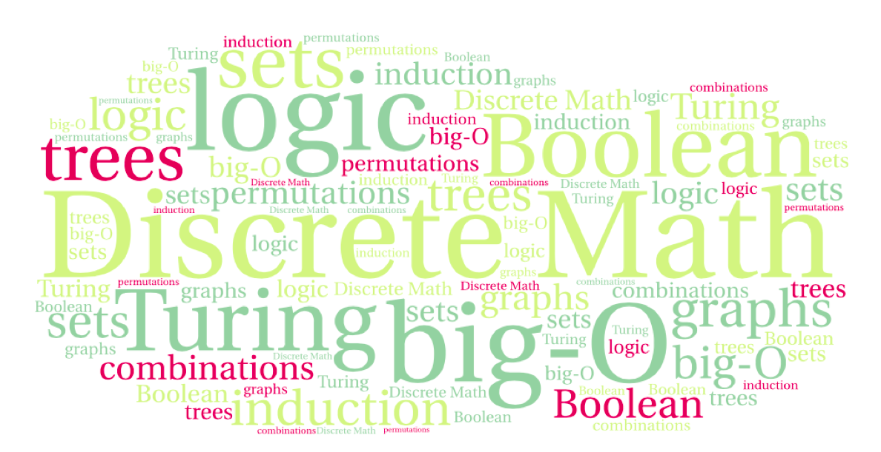
CS 220: Discrete Structures and their Applications
Strong induction, Recursive algorithms and induction
6.8 in zybooks

Slide 2
Strong induction
Induction:
P(1) is true.
∀n ∈N, P(n) → P(n + 1).
Implies ∀n ∈N, P(n)
Strong induction:
P(1) is true.
∀n ∈N, (P(1) ∧ P(2)∧…∧P(n)) → P(n + 1).
Implies ∀n ∈N, P(n)

Slide 3
Example
Prove that all natural numbers ≥ 2 can be represented as a product of primes.
Basis: n=2: 2 is a prime.

Slide 4
Example
Inductive step: show that n+1 can be represented as a product of primes.
If n+1 is a prime: It can be represented as a product of 1 prime, itself.
If n+1 is composite: Then, n + 1 = ab, for some a,b < n + 1.
Therefore, a = p₁p₂ . . . p_{k} & b = q₁q₂ . . . q_{l}, where the p_{i}s & q_{i}s are primes.
Represent n+1 = p₁p₂ . . . p_{k}q₁q₂ . . . q_{l.}
Notes:
Where did we use the IH?

Slide 5
Induction and the well ordering principle
The well-ordering principle:
any non-empty subset of the non-negative integers has a smallest element.
Surprising fact:
Well-ordering implies the principle of mathematical induction
Smallest element: base
Next element: step

Slide 6
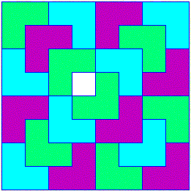
Induction and Recursion
Several of the inductive proofs we looked at lead to recursive algorithms:
The triomino tiling problem
Making postage using 3 and 5 cent stamps
Generating all subsets of a set recursively
E.g., all entries of a truth table with n variables
Induction is useful for designing and proving the correctness of recursive algorithms

Slide 7
String reversal
Consider the following recursive algorithm for reversing a string:
reverse_string(s)
if s is the empty string:
return s
let c be the first character in s
remove c from s
s' = reverse_string(s)
return the string s' with c added to the end

Slide 8
String reversal
Proof of correctness of reverse_string
reverse_string(s)
if s is the empty string:
return s
let c be the first character in s
remove c from s
s' = reverse_string(s)
return the string s' with c added to the end
By induction on the length of the string
Base case: If s has length 0 the algorithm returns s which is its own reverse.

Slide 9
String reversal
Proof of correctness of reverse_string
reverse_string(s)
if s is the empty string:
return s
let c be the first character in s
remove c from s
s' = reverse_string(s)
return the string s' with c added to the end
Inductive step: assume that reverse_string works correctly for strings of length k and show that for k+1
Let s be a string of length k + 1. s = c₁c₂…c_{k}c_{k+1}.
reverse_string makes a recursive call whose input is c₂…c_{k}c_{k+1}.
By the induction hypothesis it returns the inverse: c_{k+1}c_{k}…c₂
It then adds c₁ at the end, returning c_{k+1}c_{k}…c₂c₁, which is the reverse of s

Slide 10
recursive power
def pow(x, n):
#precondition: x and n are positive integers
if (n == 0):
return 1
else :
return x * pow(x, n-1)
}
}

Slide 11
recursive power
def pow(x, n):
#precondition: x and n are positive integers
if (n == 0):
return 1
else :
return x * pow(x, n-1)
Claim: the algorithm correctly computes x^{n}.
Proof: By induction on n
Basis step: n = 0: it correctly returns 1
Inductive step: assume that for n the algorithm correctly returns x^{n}.
Then for n+1 it returns x x^{n} = x^{n+1}.

Slide 12
Egyptian Exponentiation
In PA3 you are implementing an iterative exponentiation algorithm, based on the following recursive definition:
def pow(x, n):
#precondition: x and n are positive integers
if n == 0:
return 1
else if not (n/2 == n//2):
return x * pow(x**2, n//2)
else:
return pow(x**2, n//2)
Does linear induction work for this algorithm? Why (not) ?
What do we need?

