Slide 1
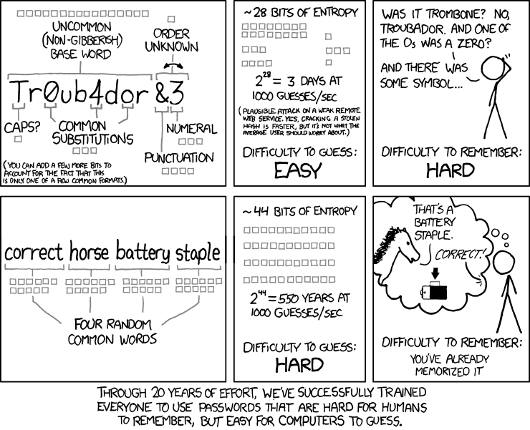
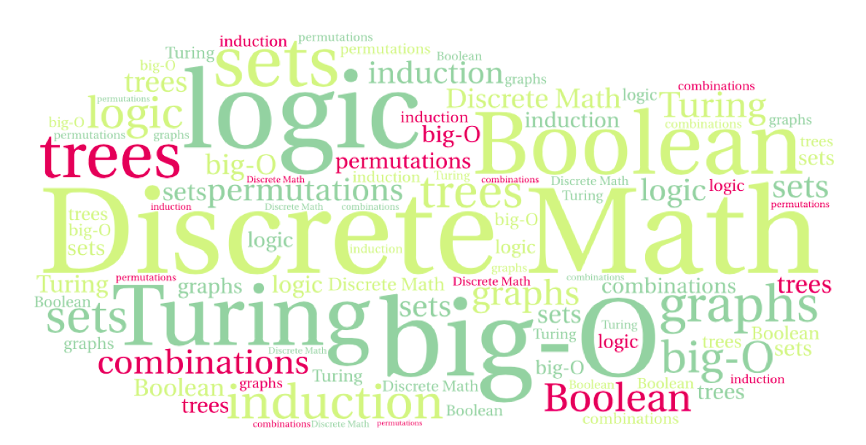
CS 220: Discrete Structures and their Applications
Counting: the sum and product rules
zybooks 7.1 – 7.2
http://www.xkcd.com/936/

Slide 2
Why count
Counting is an important aspect of algorithm design and complexity analysis. We need to count:
the number of loop iterations to establish the time complexity of our programs, and
the number of elements of our arrays / lists /dictionaries to establish the space complexity of our programs

Slide 3
A simple counting problem
You have 6 pairs of pants and 10 shirts. How many different outfits does this give?
Possible answers:
6 x 10
6 + 10

Slide 4
enumerating outfits
You have 6 pairs of pants and 10 shirts. How many different outfits does this give?
We can express the set of all outfits as:
{(s, p) | s ∈ shirts and p ∈ pants}

Slide 5
enumerating outfits
You have 6 pairs of pants and 10 shirts. An outfit is a pair of pants AND a shirt. How many different outfits does this give?
How would you write a program that prints out all the possible outfits? (Assume you have an array of shirts and an array of pants).
Notes:
Assume that shirts and pants are stored in two arrays

Slide 6
relation to Cartesian products
The Cartesian product of sets A and B is denoted by A x B and is defined as:
A x B = { (a,b) | a ∈ A and b ∈ B}
The product rule is simply a statement about the cardinality of a Cartesian product:
| A x B | = | A | * | B |

Slide 7
the product rule
The general statement of the product rule:
Let A₁, A₂,...,A_{n} be finite sets. Then,
|A₁ × A₂ × … × A_{n}| = |A₁| · |A₂| · … · |A_{n}|

Slide 8
the product rule
Example: counting strings
Let Σ is a set of characters (i.e. an alphabet);
Σ^{n} is the set of all strings of length n whose characters come from the set Σ.
Applying the product rule:
|Σ^{n}|=|Σ×Σ×⋯×Σ|=|Σ|⋅|Σ|⋯|Σ|=|Σ|^{n}
Therefore, there are 2^{n} binary strings

Slide 9
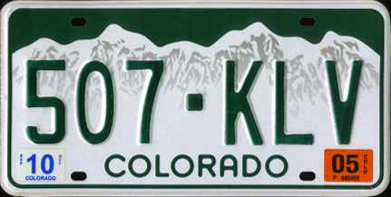
the product rule
Colorado assigns license plates numbers as three digits followed by three uppercase letters. How many license plate numbers are possible?

Slide 10
the product rule
Colorado assigns license plates numbers as three digits followed by three uppercase letters. How many license plate numbers are possible?
3¹⁰ x 3²⁶
2 x 3¹⁰ x 3²⁶
10³ x 26³

Slide 11
more examples
How many bit strings of length 7 are there?
A) 7 x 6 B) 7² C) 2⁷
How many functions are there from a set with m elements to a set with n elements?

Slide 12
another counting problem
Suppose you order a drink, and you can select either a hot drink or a cold drink. The hot drink selections are {coffee, hot cocoa, tea}. The cold drink selections are {milk, orange juice}. What is the total number of choices?
3 + 2
3 x 2
3! x 2!

Slide 13
another counting problem
Suppose you order a drink, and you can select either a hot drink or a cold drink. The hot drink selections are {coffee, hot cocoa, tea}. The cold drink selections are {milk, orange juice}. What is the total number of choices?
3 + 2
3 x 2
3! x 2!
The difference from the product rule: there is a single choice to be made.

Slide 14
the sum rule
The sum rule is also statement about set theory:
If two sets A and B are disjoint then
|A∪B| = |A| + |B|
If A and B are not disjoint, then
|A∪B| = ?
Notes:
|A| + |B| - |A ⋂ B|

Slide 15
the sum rule
The general form of the sum rule:
Consider n sets, A₁, A₂,...,A_{n}. If the sets are mutually disjoint (A_{i} ∩ A_{j} = ∅ for i ≠ j), then
|A₁ ∪ A₂ ∪ … ∪ A_{n}| = |A₁| + |A₂| + … + |A_{n}|

Slide 16
example
A student can choose a computer project from one of three lists. The three lists contain 23, 15, and 4 possible projects. No project is on more than one list. How many possible projects are there to choose from?
Notes:
The sum

Slide 17
example
The product and sum rule can be combined:
Suppose you need to pick a password that has length 6-8 characters, where each character is an uppercase letter or a digit. How many possible passwords are there?
P = P₆+P₇+P₈
P_{k}= 36^{k}
Notes:
P = P6 + P7 + P8.
Pk = 36^k

Slide 18
example
The product and sum rule can be combined:
How many license plates can be made using either two or three uppercase letters followed by two or three digits?
(26²+26³)*(10²+10³)

Slide 19
The generalized product rule
Consider the following counting problem:
In a race with 20 runners there is a first place, a second place and a third place trophy. An outcome of the race is defined to be who wins each of the three trophies, i.e. 3 distinct runners. How many outcomes are possible?
20*19*18 WHY?

Slide 20
The generalized product rule
Choosing sequences of items
Consider a set S of sequences of k items. Suppose there are:
n₁ choices for the first item.
For every possible choice for the first item, there are n₂ choices for the second item.
For every possible choice for the first and second items, there are n₃ choices for the third item.
⋮
For every possible choice for the first k-1 items, there are n_{k} choices for the kth item
Then |S| = n₁⋅n₂⋅⋅⋅n_{k}.

Slide 21
example
A family of five (2 parents and 3 kids) goes on a hiking trip. The trail is narrow and they must walk single file. How many ways can they walk with a parent in the front and a parent in the rear?

Slide 22
example
Consider the following definitions for sets of characters:
Digits = { 0, 1, 2, 3, 4, 5, 6, 7, 8, 9 }
Letters = { a, b, c, d, e, f, g, h, i, j, k, l, m, n, o, p, q, r, s, t, u, v, w, x, y, z }
Special characters = { *, &, $, # }
Compute the number of passwords that satisfy the following constraints:
(a) Strings of length 6. Characters can be special characters, digits, or letters, with no repeated characters.
(b) Strings of length 6. Characters can be special characters, digits, or letters, with no repeated characters. The first character cannot be a special character.

Slide 23
Making Change
Goal. Given integer coin values, e.g.: {1,5,10,25} compute in how many ways you can pay a certain amount:
Example: 29¢.
How many ways?
25, 1,1,1,1
10,10, 5, 1,1,1,1
10, 5,5, 5, 1,1,1,1
10, 5,5, 1,1,1,1,1, 1,1,1,1
. . .
1,1,1,1,1, 1,1,1,1,1, 1,1,1,1,1, 1,1,1,1,1, 1,1,1,1,1, 1,1,1,1

Slide 24
Making Change
Given a coin set c = {c₀, c₁, ..., c_{n-1}} and an amount M, how many different ways can M be paid?
Recursive solution: given coin value c_{d} , how many coins can I use ?
e.g., for eg 56 cents I can use 0, 1, or 2 quarters
Base:
if d == 0, how many ways? (is there always a way ?)
Step:
if d>0, go through all possible uses of coin d
at least how many c_{d} coins can be used
and which problem then remains to be solved?
...
at most how many c_{d} coins can be used
and which problem then remains to be solved?

Slide 25
Making Change
coins
d=3: Quarters [1, 5, 10, 25]
^
d=2: Dimes [1, 5, 10, 25]
^
d=1: Nickles [1, 5, 10, 25]
^
d=0: Cents [1, 5, 10, 25]
^
(29, 3)
0
1
(29, 2)
(4, 2)
0
1
2
0
(29, 1)
. . .
(19, 1)
(9, 1)
. . .
(4, 1)
0
0
1
2
3
(19, 0)
(14, 0)
(9, 0)
(4, 0)
(4, 0)
# code structure
mkCh( M, d):
if coin-index d==0:
# base case: does coin₀ divide amount M
else
# for I from 0 to # coins[d] “fitting in” M
sum results of mkCh(remaining amount, new coin-index)

Slide 26
Programming Assignment
Write a (recursive) function
mkCh()
that counts
the number ways a certain amount of money
can be paid with a coin set {1,5,10,25}

Slide 27
k out of n partitions
Given n distinct elements, we want to group these into k partitions. E.g. n=3 {b,c,d} How many 2 out of 3 partitions are there?
Enumerate . . .
{b} {c,d}
{c} {b,d}
{d} {b,c}
there are 3 2-out-of-3 partitions

Slide 28
Counting the number of k-out-of-n partitions
Now n=4 {a,b,c,d} How many 3-out-of-4 partitions are there?
Typical Divide and Conquer (hence recursive) approach: take element a
There are two possibilities:
1) either a is in its own partition or 2) not
We can apply the sum rule
1) a is in its own partition, then there are 2 more partitions
out of three elements {b,c,d}. We already solved how many 2 out
of 3 partitions there are:
{b} {c,d}
{c} {b,d}
{d} {b,c}
So for this case we get 3 solutions
{a} {b} {c,d}
{a} {c} {b,d}
{a} {d} {b,c}
or it is in a group with other elements

Slide 29
Second possibility
2) a is not in its own partition, then is it in 1 of the 3
3-out-of-3 partitions:
{b} {c} {d}
so in case 2) we have 3 possibilities
{a,b} {c} {d}
{b} {a,c} {d}
{b} {c} {a,d}
So in total there are 6 3-out-of-4 partitions

Slide 30
Do it yourself
How many 2-out-of-4 partitions are there?

Slide 31
Do it yourself
How many 2-out-of-4 partitions are there?
{a,b,c,d}
Option 1: a on its own
{a} {b,c,d}
Option 2: a joins one of:
{b} {c,d} → {a,b} {c,d}
{b} {a,c,d}
{c} {b,d} → {a,c} {b,d}
{c} {a,b,d}
{d} {b,c} → {a,d} {b,c}
{d} {a,b,c}
So in total 7 (1 + 2*3) 2_out_of_4 groups

Slide 32
Program structure
Recursive function
partitions(n,k) # k partitions out of n elements
Base:
k == 1 (all n elements in one partition)
k == n (each element in its own partition)
Step:
either a on its own: partitions(n-1,k-1)
or not: then form k partitions out of n-1
. a can join each: k* partitions(n-1,k)

Slide 33
Programming Assignment
Write a (recursive) function
partitions(n,k)
that counts
the number of k-out-of-n partitions

