Slide 1
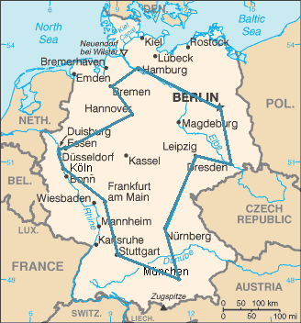
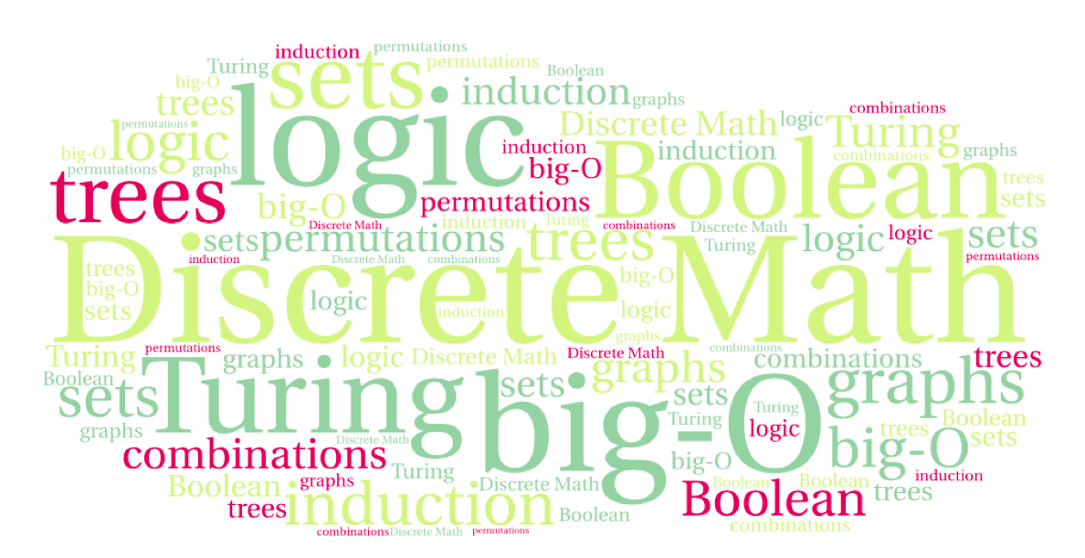
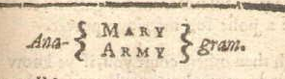
CS 220: Discrete Structures and their Applications
Permutations and combinations
zybooks 7.4-7.6

Slide 2
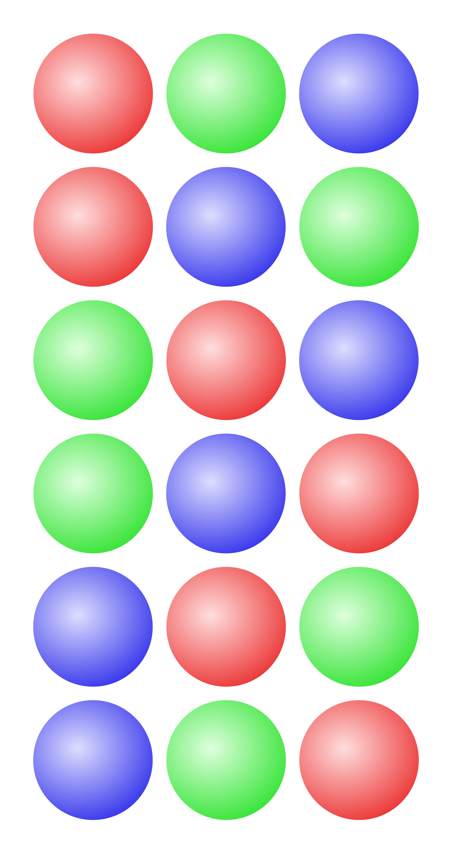
Motivating question
In a family of 3, how many ways are there to arrange the members of the family in a line for a photograph?
3 x 3
3!
3 x 3 x 3
2³

Slide 3
The Traveling Salesman Problem (TSP)
TSP: Given a list of cities and their pairwise distances, find a shortest possible tour that visits each city exactly once.
Objective: find a permutation a₁,…,a_{n} of
the cities that minimizes the tour length
where d(i, j) is the distance between
cities i and j
An optimal TSP tour through Germany’s 15 largest cities
Notes:
An optimal TSP tour through Germany’s 15 largest cities. It is the shortest among 43 589 145 600 possible tours visiting each city exactly once.
A lot of computer science problems involve finding the best ordering of a collection of objects. These are called permutations.

Slide 4
Permutations
A permutation of a set of distinct objects is an ordered arrangement of these objects.
  Example: (1, 3, 4, 2) is a permutation of the numbers 1, 2, 3, 4
How many permutations of n objects are there?

Slide 5
How many permutations?
How many permutations of n objects are there?
Using the product rule:
n .(n – 1) . (n – 2) ,…, 2 . 1 = n!

Slide 6

Anagrams
Anagram: a word, phrase, or name formed by rearranging the letters of another.
Examples:
“cinema” is an anagram of iceman
"Tom Marvolo Riddle” is an anagram of
"I am Lord Voldemort”
The anagram server: http://wordsmith.org/anagram/
Notes:
Games with anagrams, e.g. Clabbers: tiles may be placed in any order on the board as long as they anagram to a valid word.
Permutation city begins with a 20 line anagrammatic poem.

Slide 7
Example
How many permutations of {a,b,c,d,e,f,g} end with a?
5!
6!
7!
6 x 6!
a’s position is fixed

Slide 8
Example
You invite 6 people for a dinner party. How many ways are there to seat them around a round table? (Consider two seatings to be the same if everyone has the same left and right neighbors).
6!
5!
7!
because in a circle it doesn’t matter where you put
the first one (say a), so there are 5 others to arrange
Notes:
You can express this as 6!/6 (the book calls this the division rule). Or say 5! from the get go because in a circle it doesn’t matter where you put the first one, so there are 5 others to arrange.

Slide 9
Example
Count the number of ways to arrange n men and n women in a line so that no two men are next to each other and no two women are next to each other.
a) n!
b) n! n!
c) 2 n! n!
either mwmwmw or wmwmwm
Notes:
Either mwmwmw or wmwmwm

Slide 10
r-permutations
r-permutation:
An ordered arrangement of r elements of a set.
Example: List the 2-permutations of {a,b,c}.
(a,b), (a,c), (b,a), (b,c), (c,a), (c,b)
The number of r-permutations of a set of n elements: P(n,r) = n(n – 1)… (n – r + 1) (0 ≤ r ≤ n)
Example: P(4,2) = 4*3 = 12 = 4! / (4-2)!
Can be expressed as:
P(n, r) = n! / (n – r)!
Note that P(n, 0) = 1.

Slide 11
Combinations
Question : how many poker hands (five cards) can be dealt from a deck of 52 cards?
How is this different than r-permutations?

Slide 12
Combinations
How many poker hands (five cards) can be dealt from a deck of 52 cards?
How is this different than r-permutations?
In an r-permutation we cared about order (tuple). In this case we don’t {set}.

Slide 13
combinations
An r-combination of a set is a subset of size r
The number of r-combinations out of a set with n elements is denoted as C(n,r) or
  {1,3,4} is a 3-combination of {1,2,3,4}
  How many 2-combinations of {a,b,c,d}?
  4*3 / 2 Why?
  4*3 is the P(4,2)
  But in P(4,2) we count every pair (a,b) twice (a,b and b,a), so we divide by 2

Slide 14
Unordered versus ordered selections
Two ordered selections are the same if
  the elements chosen are the same
  the elements chosen are in the same order.
Ordered selections: r-permutations.
Two unordered selections are the same if
  the elements chosen are the same
  (regardless of the order in which the elements are chosen)
Unordered selections: r-combinations.

Slide 15
Permutations or combinations?
Determine if the situation represents a permutation or a combination:
  In how many ways can three student-council members be elected from five candidates?
  In how many ways can three student-council members be elected from five candidates to fill the positions of president, vice-president and treasurer?
combination
permutation

Slide 16
relationship between P(n,r) and C(n,r)
Constructing an r-permutation from a set of n elements can be thought as a 2-step process:
Step 1: Choose a subset of r elements;
Step 2: Choose an ordering of the r-element subset.
Step 1 can be done in C(n,r) different ways.
Step 2 can be done in r! different ways.
Product rule, P(n,r) = C(n,r) ∙ r!
Thus

Slide 17
r-combinations
How many r-combinations?
Note that C(n, 0) = 1
Note that C(n,r) = C(n,n-r) WHY?
Example: How many poker hands (five cards) can be dealt from a deck of 52 cards?
  C(52,5) = 52! / (5! * 47!)

Slide 18
r-combinations
How many r-combinations?
Note that C(n, 0) = 1
C(n,r) satisfies:
  We can see that easily without using the formula
  When you choose r, you implicitly choose n-r e.g. r out of n people in the committee, n-r lucky ones NOT in the committee
Notes:
Choose

Slide 19
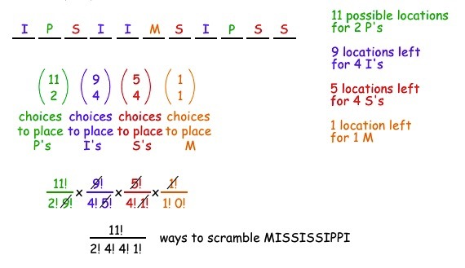
permutations with repetitions
Here we combine permutations with combinations:
How many ways are there to scramble the letters in the word MISSISSIPPI?

Slide 20
permutations with repetitions
The general statement of the principle:
The number of distinct sequences with n₁ 1's, n₂ 2's, ..., n_{k} k's, where n = n₁ + n₂ +...+ n_{k} is

Slide 21
combinations or permutations?
How many bit strings of length n contain exactly r ones?
P(n,r) or C(n,r)?
The positions of the r 1s form an r-combination, so C(n,r)
Notes:
The positions of the r 1s form an r-combination, so C(n,r)

Slide 22
Example
The faculty in biology and computer science want to develop a program in computational biology. A committee of 4 composed of two biologists and two computer scientists is tasked with doing this. How many such committees can be assembled out of 20 CS faculty and 30 biology faculty?
DIY, hint: 2 out of 20 AND 2 out of 30
does order in these matter?

Slide 23
Example
How many permutations of the letters ABCDEFGH contain the string ABC?
DIY, hint: rewrite ABC as X

