Slide 1
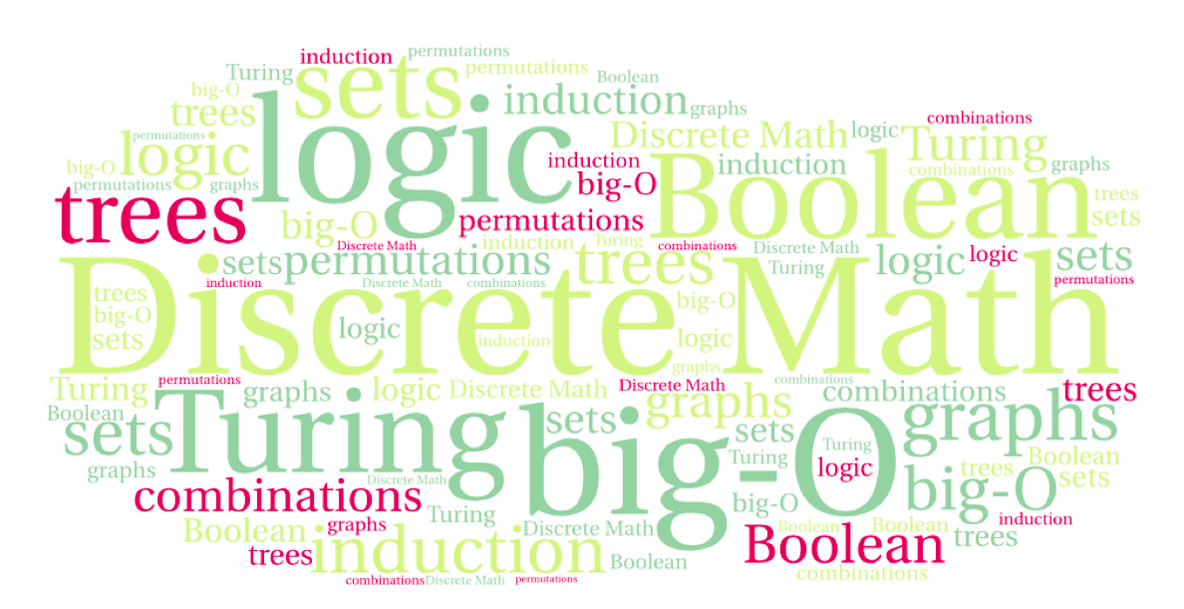
CS 220: Discrete Structures and their Applications
counting by complement, inclusion exclusion, the pigeonhole principle
zybooks 7.8 – 7.10

Slide 2
example problem
How many 6-bit strings have at least one 0?
You can count them directly:
Number of 6-bit strings with at least one 0 =
Number of 6-bit strings with one 0
+ Number of 6-bit strings with two 0s
+ Number of 6-bit strings with three 0s
+ Number of 6-bit strings with four 0s
+ Number of 6-bit strings with five 0s
+ Number of 6-bit strings with six 0s

Slide 3
counting by complement
How many 6-bit strings have at least one 0?
Or you can use the complement rule:
Number of 6-bit strings with at least one 0 =
Number of 6-bit strings
- Number of 6-bit strings with no 0s = 2⁶ – 1 WHY?
The complement rule: Let P be a subset of a set S, then:
Because there is only 1 bit string with no 0-s: 111111

Slide 4
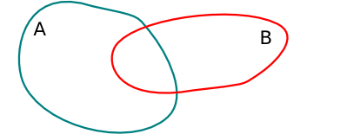
The inclusion exclusion principle
A more general statement than the sum rule:
|A ∪ B| = |A| + |B| - |A ∩ B| WHY?
Because |A|+|B| counts A ∩ B double

Slide 5
Example
How many numbers between 1 and 30 are divisible by 2 or 3?
30/2 + 30/3 - 30/6 = 15 + 10 - 5 = 20

Slide 6
The inclusion exclusion principle
How many bit strings of length eight start with a 1 or end with 00?
1 - - - - - - - how many?
- - - - - - 0 0 how many?
if I add these, how many have I counted twice?
2⁷ + 2⁶ - 2⁵ = 128 + 64 -32 = 160
Notes:
2^7 + 2^6 - 2^5

Slide 7
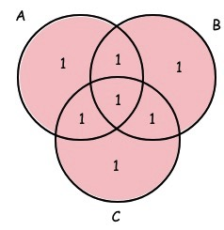
inclusion exclusion with three sets
To compute the cardinality of the union of three sets:
Let A, B and C be three finite sets, then
|A ∪ B ∪ C| = |A| + |B| + |C|
- |A ∩ B| - |B ∩ C| - |A ∩ C|
+ |A ∩ B ∩ C|
4 + 4 + 4 – 2 – 2 – 2 ?
NO! Why?
Because now we have counted the element of
A ∩ B ∩ C 3 times (|A|+|B|+|C|) and then we
subtracted it 3 times (-|A ∩ B|-|B ∩ C|-|A ∩ C|)
So we must add it back in (+ A ∩ B ∩ C|):
4 + 4 + 4 – 2 – 2 – 2 + 1

Slide 8
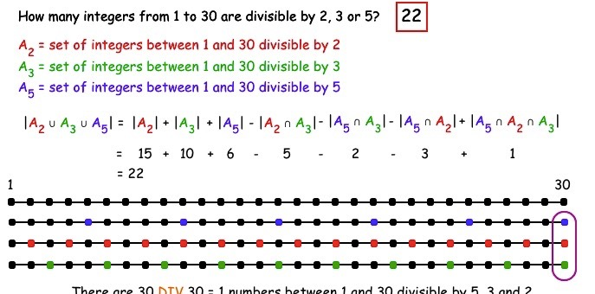
example
a

Slide 9
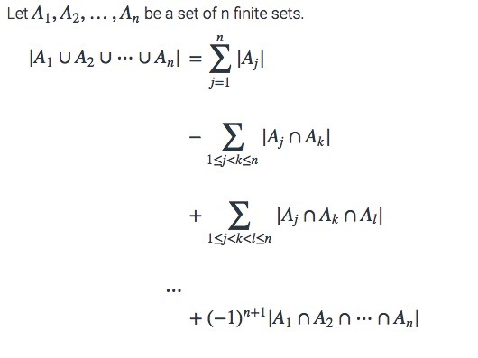
the inclusion exclusion principle
The general statement of the inclusion-exclusion principle:

Slide 10
Some advice about counting
Apply the multiplication rule if
  The elements to be counted can be obtained through a multistep selection process. Task1 and Task2 and …
  Each step is performed in a fixed number of ways regardless of how preceding steps were performed.
Apply the sum rule if
  The set of elements to be counted can be broken up into disjoint subsets. Task1 or Task2 or …
Apply the inclusion/exclusion rule if
  It is simple to over-count and then to subtract duplicates

Slide 11
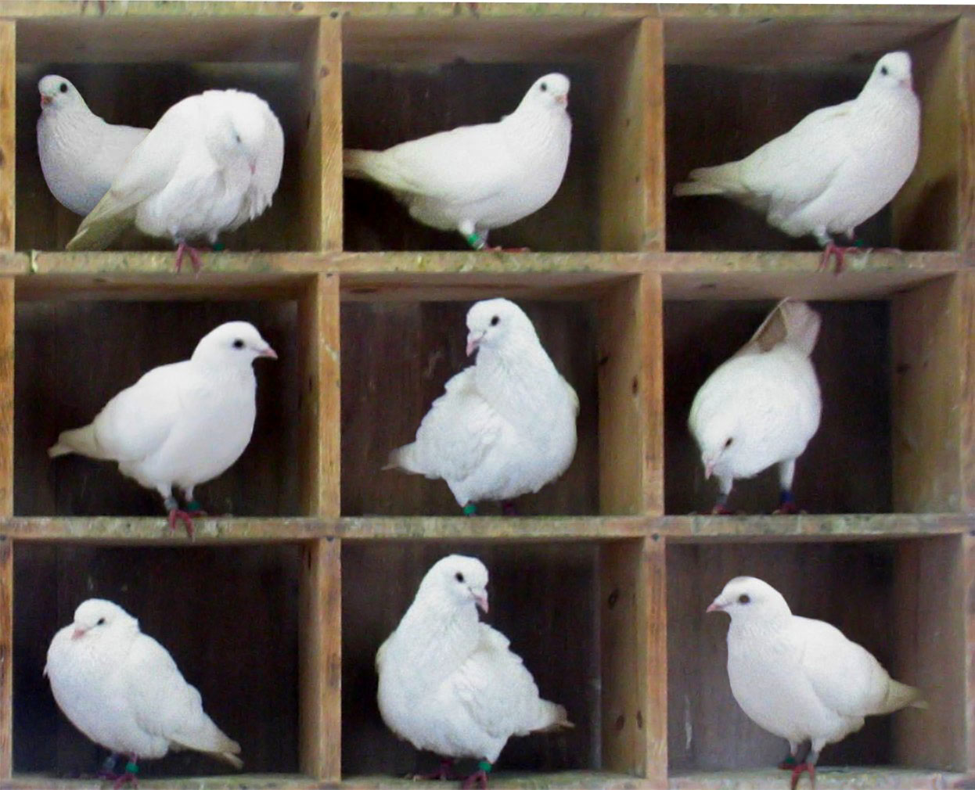
The pigeonhole principle
If k is a positive integer and k+1 or more objects are placed into k boxes, then there is at least one box containing two or more objects.
Image: http://en.wikipedia.org/wiki/File:TooManyPigeons.jpg
Notes:
Proof by contradiction

Slide 12
Examples
In a group of 367 people, there must be at least two with the same birthday
A drawer contains a dozen brown socks and a dozen black socks. A guy takes socks out at random in the dark.
  How many socks must he take out to be sure that he has at least two socks of the same color?
  A) 14 B) 3 C) 12

Slide 13
Examples
In a group of 367 people, there must be at least two with the same birthday
A drawer contains a dozen brown socks and a dozen black socks, all unmatched. A guy takes socks out at random in the dark.
  How many socks must he take out to be sure that he has at least two socks of the same color?
  A) 14 B) 3 C) 12
  How many socks must he take out to be sure that he has at least two black socks?
  A) 14 B) 3 C) 12

