Slide 1
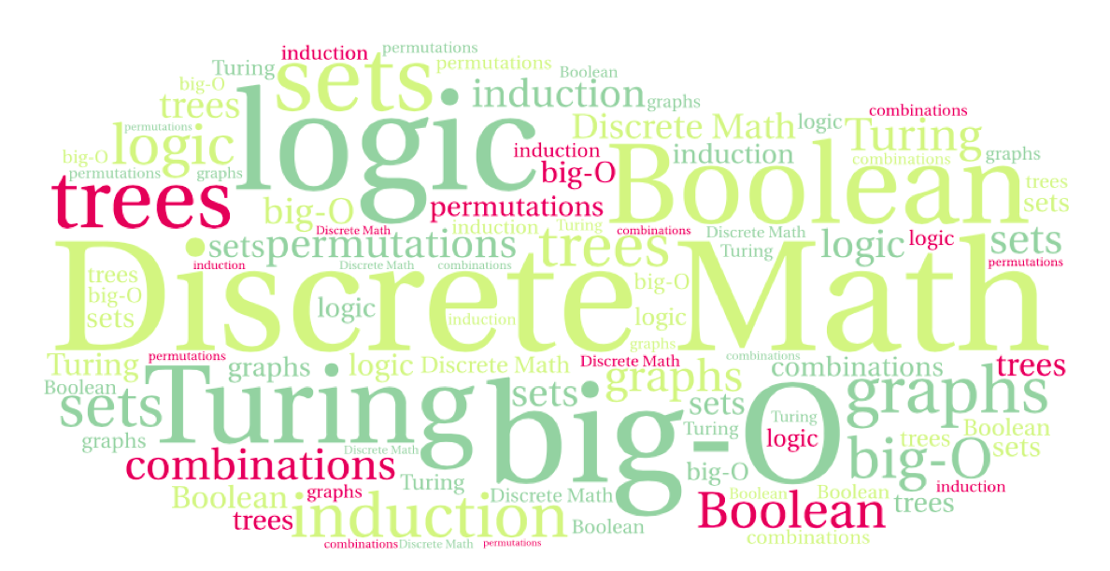
CS 220: Discrete Structures and their Applications
graphs
zybooks chapter 10

Slide 2
directed graphs
A collection of
vertices and directed edges
What can this represent?
Any binary relation
Notes:
Any binary relation

Slide 3
undirected graphs
A collection of
vertices and edges
What can this represent?
A computer network, a map, . . .
Notes:
A computer network
Abstraction of a map
Social network

Slide 4
terminology
Two vertices are adjacent if they are connected by an edge.
The vertices are the endpoints of an edge
An edge is incident on two vertices.
Two vertices are neighbors if they are connected by an edge
The number of neighbors of a vertex is its degree.
G=(V, E)
Vertices Edges
Edges
u
e
Vertices/
Nodes
v
Notes:
Note that degree as the number of neighbors applies to simple graphs (without self loops)

Slide 5
Graph definitions
Path: sequence of nodes (v₀..v_{n}) s.t. ∀i: (v_{i} ,v_{i+1}) is an edge. Path length: number of edges in the path, or sum of weights. Simple path: all nodes distinct.
Cycle: path with first and last node equal.
Acyclic graph: graph without cycles. DAG: directed acyclic graph.
In a complete graph all nodes in the graph are adjacent.

Slide 6
more definitions
An undirected graph is connected if for all nodes v_{i} and v_{j} there is a path from v_{i} to v_{j} . An undirected graph can be partitioned in connected components: maximal connected sub-graphs.
A directed graph can be partitioned in strongly connected components: maximal sub-graphs C where for every u and v in C there is a path from u to v and there is a path from v to u.
In a weighted graph the edges have a weight (cost, length,..) associated with them.

Slide 7
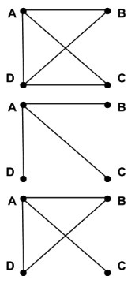
constraint graphs
Consider the problem of classroom scheduling: given a set of classes and their times, assign them to classrooms without conflicts. How many classrooms?
Example:
Class A: MWF, 3:00PM - 4:00PM
Class B: W, 2:00PM - 4:00PM
Class C: F, 3:30PM - 5:00PM
Class D: MWF, 2:30 - 3:30PM
What does an edge mean?
Which is the constraint graph for this scheduling
problem?

Slide 8
the handshake theorem
Can there be a graph with an odd number of odd degree nodes?
Try it . . .
Theorem: Let G=(V,E) be an undirected graph. Then
NO!:
Each edge contributes two to the sum of degrees because it is incident to two vertices.
Because the sum is even, the only way odd degree can work out is if there are
an even number of them.
Notes:
Each edge contributes two to the sum because it is incident to two vertices
because the sum is even, the only way odd degree can work out is if there are
an even number of them.
The book proves this by induction on the number of edges

Slide 9
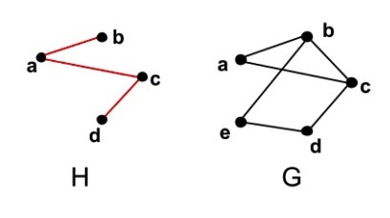
subgraphs
A graph H = (V_{H}, E_{H}) is a subgraph of a graph G = (V_{G}, E_{G}) if V_{H} ⊆ V_{G} and E_{H} ⊆ E_{G}.

Slide 10
complete graphs
A complete graph is a simple graph that has an edge between every pair of vertices.
The complete graph with n vertices is denoted by K_{n}
K₄:
Complete Graph
Notes:
is Kn unique?

Slide 11
cycles
The cycle C_{n}, n ≥ 3, consists of n vertices v₁, v₂, …, v_{n} and n edges {v₁, v₂}, {v₂, v₃},…, {v_{n-1}, v_{n}}, {v_{n}, v₁}.

Slide 12
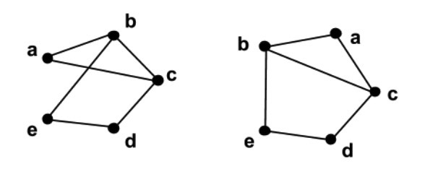
looks can be misleading
Consider the following two graphs:
Are they the same?

Slide 13
adjacency matrix of a graph
mapping of vertex
labels to array indices
A
 | 0 | 1 | 2 | 3 | 4
0 | 0 | 1 | 0 | 1 | 0
1 | 0 | 0 | 0 | 0 | 1
2 | 1 | 0 | 0 | 0 | 0
3 | 0 | 1 | 0 | 0 | 0
4 | 0 | 0 | 1 | 0 | 0
B
C
Label | Index
A | 0
B | 1
C | 2
D | 3
E | 4
D
E
Adjacency matrix: n x n matrix with entries that indicate if an edge between two vertices is present
For an undirected graph,
what would the adjacency
matrix look like?
Symmetric
Notes:
symmetric
In a weighted graph, cells would contain weights

Slide 14
adjacency list for a directed graph
A
Index | Label
0 | A
1 | B
2 | C
3 | D
4 | E
B
B
B
C
B
D
E
A
D
B
E
C

Slide 15
adjacency list for an undirected graph
A
Index | Label
0 | A
1 | B
2 | C
3 | D
4 | E
B
C
B
C
D
A
D
E
A
E
D
A
B
E
B
C
mapping of vertex
labels to list of edges

Slide 16
which implementation
Adjacency matrix
Edges are entries in a square matrix
size: |V|²
values:
1/0 to indicate presence/absence of edge in (un)directed graph
useful for dense graphs
Adjacency list
linked-list of out-going edges per vertex
useful for sparse graphs

Slide 17
walks
A walk from v₀ to v_{l} in an undirected graph G is a sequence of alternating vertices and edges that starts and ends with a vertex:
⟨v₀,{v₀,v₁},v₁,{v₁,v₂},v₂,...,v_{l−1},{v_{l−1},v_{l}},v_{l}⟩
A walk can also be denoted by the sequence of vertices:
⟨v₀,v₁,...,v_{l}⟩.
The sequence of vertices is a walk only if {v_{i-1}, v_{i}} ∈ E
for i = 1, 2,...,l.
The length of a walk is the number of edges in the walk.
v₀
e₁
v₁
v₃
e₂
e₃
v₂

Slide 18
walks, circuits, paths, cycles
A sequence of one vertex, denoted <a>, is a circuit of length 0.
A walk is a path if no vertex is repeated in the walk.
A circuit is a walk in which the first vertex is the same as the last vertex.
A circuit is a cycle if there are no other repeated vertices, except the first and the last.
Same as in directed graphs.
v₀
e₁
v₁
v₃
e₂
e₃
v₂

Slide 19
walks, circuits, paths, cycles
A walk can also be denoted by the sequence of vertices:
⟨v₀,v₁,...,v_{l}⟩. A circuit is a walk in which the first vertex is the same as the last vertex. A walk is a path if no vertex is repeated in the walk. A circuit is a cycle if there are no other repeated vertices, except the first and the last.
What is the length of the longest possible walk in a graph with n vertices?
What is the length of the longest possible path in a graph with n vertices?
What is the length of the longest possible circuit in a graph with n vertices?
What is the length of the longest possible cycle in a graph with n vertices?
infinite
n-1
infinite
n
Notes:
inf, n-1, inf, n

Slide 20
Graph Traversal
What can cause problems when walking graphs?
you can visit the same node more than once
you can get in a cycle
What to do about it:
mark the nodes
-White: unvisited
-Grey: (still being considered) on the frontier: not all adjacent nodes have been visited yet
-Black: off the frontier: all adjacent nodes visited (not considered anymore)

Slide 21
BFS: Breadth First Search
Like level traversal in trees, BFS(G,s) explores the edges of G and locates every node v reachable from s in a level order using a queue.

Slide 22
BFS: Breadth First Search
Like level traversal in trees, BFS(G,s) explores the edges of G and locates every node v reachable from s in a level order using a queue.
BFS also computes the distance: number of edges from s to all these nodes, and the shortest path (minimal #edges) from s to v.

Slide 23
BFS: Breadth First Search
Like level traversal in trees, BFS(G,s) explores the edges of G and locates every node v reachable from s in a level order using a queue.
BFS also computes the distance: number of edges from s to all these nodes, and the shortest path (minimal #edges) from s to v.
BFS expands a frontier of discovered but not yet visited nodes. Nodes are colored white, grey or black. They start out undiscovered or white.
Notes:
White: not considered
Grey: in consideration (means: in the queue)
Black: done with, no need for further consideration

Slide 24
BFS(G,s)
#d: distance, c: color, p: parent in BFS tree
forall v in V-s {c[v]=white; d[v]=∞,p[v]=nil}
c[s]=grey; d[s]=0; p[s]=nil;
Q=empty;
enque(Q,s);
while (Q != empty)
u = deque(Q);
forall v in adj(u)
if (c[v]==white)
c[v]=grey; d[v]=d[u]+1; p[v]=u;
enque(Q,v)
c[u]=black;
# don’t really need grey here, why?
Notes:
Do this for some graphs.
We don’t use it, we just test for not visited (white) so can paint v black immediately

Slide 25
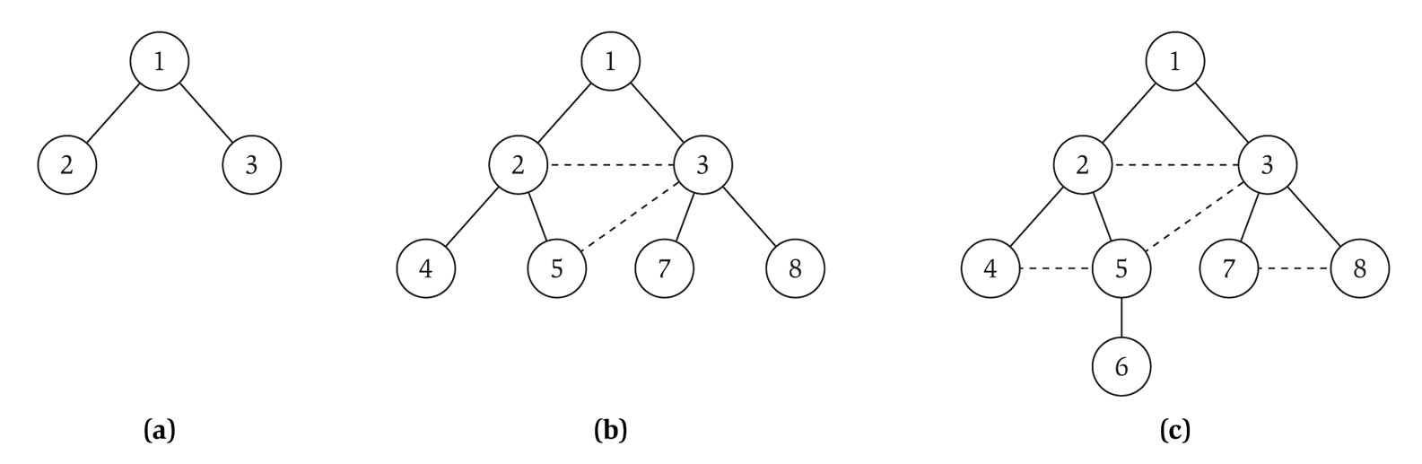
Do it: Breadth First Search, s = 1
BFS produces a Breadth First Tree rooted at s: when a node v in L_{i+1} is discovered as a neighbor of node u in L_{i} we add edge (u,v) to the BF tree
Property. Let T be a BFS tree of G, and let (x, y) be an edge of G. Then the level of x and y differ by at most 1.
L₀
L₁
L₂
L₃

Slide 26
Complexity BFS
Each node is painted white once, and is enqueued and dequeued at most once.

Slide 27
Complexity BFS
Each node is painted white once, and is enqueued and dequeued at most once.
Why?
See code
Notes:
see code

Slide 28
Complexity BFS
Each node is painted white once, and is enqueued and dequeued at most once.
Enque and deque take constant time. The adjacency list of each node is scanned only once: when it is dequeued.

Slide 29
Complexity BFS
Each node is painted white once, and is enqueued and dequeued at most once.
Enque and deque take constant time. The adjacency list of each node is scanned only once, when it is dequeued.
Therefore time complexity for BFS is
O(|V|+|E|) or O(n+m)

Slide 30
DFS: Depth First Search
Explores edges from the most recently discovered node; backtracks when reaching a dead-end. The algorithm below does not use white, grey, black, but uses explored (and implicitly unexplored). Recursive code:
DFS(u):
mark u as Explored and add u to R
for each edge (u,v) :
if v is not marked Explored :
DFS(v)

Slide 31
Recursive / node coloring version
DFS(u):
#c: color, p: parent
c[u]=grey
forall v in Adj(u):
if c[v]==white:
p[v]=u
DFS(v)
c[u]=black
The above implementation of DFS runs in O(m + n) time if the graph is given by its adjacency list representation.
Proof:
Same as in BFS ▪

Slide 32
Connectivity
s-t connectivity problem. Given two node s and t, is there a path between s and t?
s-t shortest path problem. Given two nodes s and t, what is the length of the shortest path between s and t? Length: either in terms of number of edges,
or in terms of sum of weights.

Slide 33
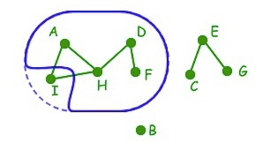
connected components
An undirected graph is called connected if there is a path between every pair of vertices.
A connected component is a maximal set of vertices that is connected.
The word "maximal" means that if any vertex is added to a connected component, then the set of vertices will no longer be connected.

Slide 34
Connected Components
Connected graph. There is a path between any pair of nodes.
Connected component of a node s. The set of all nodes reachable from s.
Connected component containing node 1 = { 1, 2, 3, 4, 5, 6, 7, 8 }.

Slide 35
Connected Components
Connected component of a node s. The set of all nodes reachable from s.
Given two nodes s, and t, their connected components are either identical or disjoint. WHY?

Slide 36
Connected Components
Connected component of a node s. The set of all nodes reachable from s.
Given two nodes s, and t, their connected components are either identical or disjoint.
Two cases – either there is a path between the two nodes, or there isn’t.
If there is a path: take a node u in the connected component of s, and
construct a path from t to u: t to s, then s to u, so CC_{s} = CC_{t}
If there is no path: assume that the intersection contains a node u. Use
it to construct a path between s and t: s to u, then u to t – contradiction.

Slide 37
Connected Components
R
s
A generic algorithm for finding
connected components:
Upon termination, R is the connected component containing s.
BFS: explore in order of distance from s.
DFS: explores edges from the most recently discovered node; backtracks when reaching a dead-end.
u
v
R = {s} # the connected component of s is initially s.
while there is an edge (u,v) where u is in R and v is not in R:
add v to R

