Slide 1
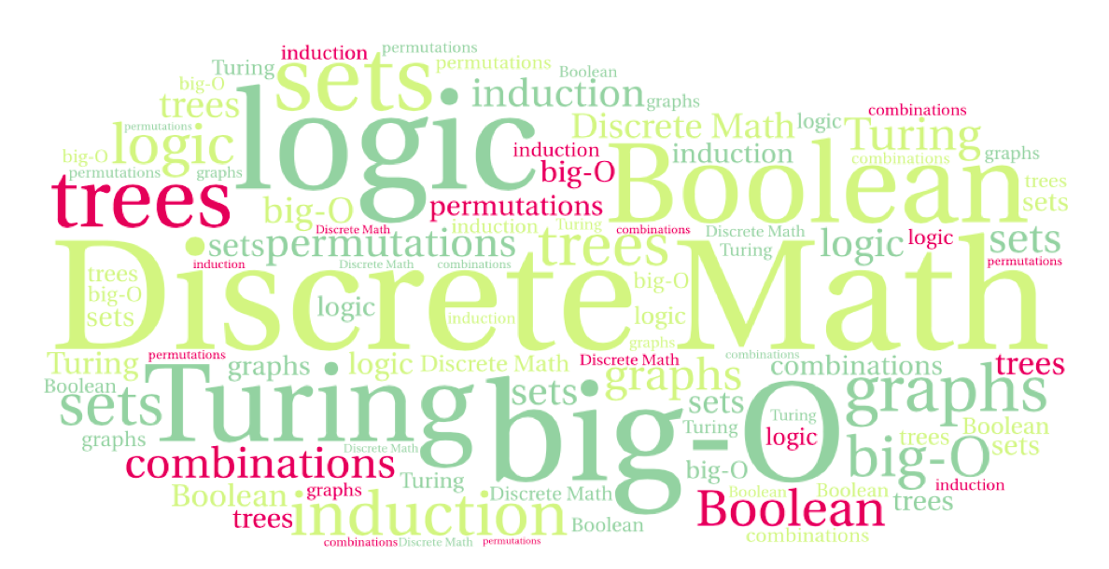
CS 220: Discrete Structures and their Applications
Trees
Chapter 11 in zybooks

Slide 2
trees
We tend to think of trees as rooted trees, but graph theory also allows unrooted trees.
A tree is an undirected graph that is connected and has no cycles.

Slide 3
properties of trees
A leaf of an unrooted tree is a vertex of degree 1.
If a tree has only one vertex, then that vertex is a leaf.
A vertex is an internal vertex if the vertex has degree at least two.
leaf
internal vertex

Slide 4
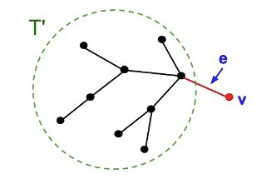
properties of trees
Theorem: Let T be a tree with n vertices and m edges, then m = n - 1.
Proof. By induction on the number of vertices.
Base case: is where n = 1. If T has one vertex, then it is has no edges, i.e. m = 0 = n - 1.

Slide 5
properties of trees
Inductive step: assume the theorem holds for trees with n-1 vertices and prove that it holds for trees with n vertices.
Consider an arbitrary tree T with n vertices. Let v be one of the leaves. Remove v from T along with the edge e incident to v. The resulting graph (call it T') is also a tree and has n-1 vertices.
By the induction hypothesis, the number of edges in T' is n - 2.
T has exactly one more edge (e) than
T’ . So T has n-1 edges. ■
Think of it as a rooted tree:
every node except the root
has 1 edge to its parent

Slide 6
rooted trees
Rooted trees. Given a tree T, choose a root node r and orient each edge away (down) from r.
root r
parent of v
v
child of v
a tree
the same tree, rooted at 1

Slide 7
rooted trees
Rooted trees model hierarchical structure.
The file system as a rooted tree:

Slide 8
game trees
games can be represented by trees:
The root is the initial configuration.
The children of a state c are all the configurations that can be reached from c by a single move.
A configuration is a leaf in the tree if the game is over.
initial configuration
player X
player O

Slide 9
rooted trees
Rooted trees. Given a tree T, choose a root node r and orient each edge away from r.
The level of a node is its distance from the root
The height of a tree is the highest level of any vertex.
root
level = 1
level = 2

Slide 10
rooted trees
Every vertex in a rooted tree has a unique parent, except for the root which does not have a parent.
Every vertex along the path from v to the root (except for the vertex v itself) is an ancestor of v.
A leaf is a vertex which has no children.
u
ancestor of v
child of u
parent of v
descendant of u
leaf
v

Slide 11
rooted trees
Two vertices are siblings if they have the same parent.
A subtree rooted at vertex v is the tree consisting of v and all v's descendants.
v
subtree
siblings

Slide 12
traversal of a rooted tree
A
Pre order
Process the node
Visit its children
B
C
A B D G H C E F I
D
E
F
Post order
Visit the children
Process the node
G
H
I
G H D B E I F C A

Slide 13
traversal of a rooted tree
Pre order
Process the node
Visit its children
A
B
C
A B D G H C E F I
D
E
F
Post order
Visit the children
Process the node
G
H
I
G H D B E I F C A
which node gets processed first/last in each of these traversals?
Pre: first root, last right-most leaf
Post: first left-most leaf, last root
Notes:
Pre: first root, last right-most leaf
Post: first left-most leaf, last root

Slide 14
traversal of a rooted tree
pre-order(v)
process(v)
for every child w of v:
pre-order(w)
post-order(v)
For every child w of v:
post-order(w)
process(v)
A
B
C
D
E
F
G
H
I
Notes:
Queue

Slide 15
computing properties of trees using post-order
post-order-leaf-count(v)
for every child w of v:
post-order-leaf-count(w)
if v is a leaf:
leaf-count(v) = 1
else :
leaf-count(v) = sum of leaf counts of children
Other properties that can be computed similarly:
the total number of vertices in the tree.
the height

Slide 16
traversal of a rooted binary tree
pre-order
process the vertex
go left
go right
in-order
go left
process the vertex
go right
post-order
go left
go right
process the vertex
level order / breadth first
for d = 0 to height
process vertices at level d

Slide 17
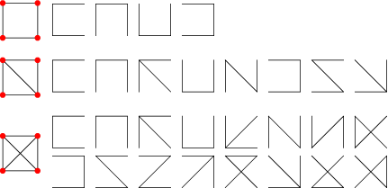
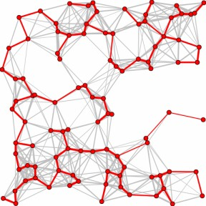
spanning trees
A spanning tree of a connected graph G is a subgraph of G which contains all the vertices in G and is a tree.
http://mathworld.wolfram.com/SpanningTree.html

Slide 18
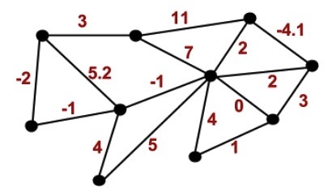
weighted graphs
A weighted graph is a graph G = (V ,E), along with a function
w: E → R. The function w assigns a real number to every edge.

Slide 19
minimum spanning trees
Motivating example: each house in the neighborhood needs to be connected to cable
Graph where each house is a vertex.
Need the graph to be connected, and minimize the cost of laying the cables.
Model the problem with weighted graphs
Minimum spanning tree
Spanning tree minimizing the sum of edge weights
Incrementally build spanning tree by adding the least-cost edge to the tree
A
4
B
3
C
2

Slide 20
Prim's algorithm
8
7
a
b
c
a
b
c
4
9
2
11
h
7
h
i
d
i
d
4
7
6
8
10
g
g
f
f
e
e
unique?
1
2
{(d,c),(c,b), (b,i), (b,e), (e,f), (f,g), (g,h), (h,a) }

Slide 21
Prim's algorithm
prims(G):
Input: An undirected, connected, weighted graph G
Output: T, a minimum spanning tree for G.
T = ∅
pick any vertex in G and add it to T.
for j = 1 to n-1 :
let C be the set of edges with one endpoint
in T and one endpoint outside T
let e be a minimum weight edge in C
add e to T.
add the endpoint of e not already in T to T

Slide 22
The cut property
Simplifying assumption. All edge costs are distinct.
Cut property. Let S be a subset of nodes, S neither empty nor equal V, and let e be the minimum cost edge with exactly one endpoint in S.
Then the MST contains e.
The cut property establishes the correctness of Prim’s algorithm.
S
e
e is in the MST
Notes:
Note: simplifying assumption guarantees that MST is unique so it makes sense to refer to "the MST”
If two minimum costs edges, just pick one

Slide 23
The cut property
Cut property. Let S be a subset of nodes, and let e be the min cost edge with exactly one endpoint in S. Then the MST T contains e.
Proof. (exchange argument)
If e =(v,w) is the only edge connecting S and V-S it must be in T, else e is on a cycle in the graph (not the MST). Now suppose e does not belong to T.
Let e’= (v',w') be the first edge between S and V-S on the path from v'. T' = T ∪ { e } - { e’ } is also a spanning tree.
Since c_{e} < c_{e’}, cost(T') < cost(T).
This is a contradiction. ▪
v’
e’
w’
S
v
e
w

Slide 24
Shortest Paths Problems
Given a weighted directed graph G=(V,E)
find the shortest path
path length is the sum of its edge weights.
The shortest path from u to v is ∞ if there is no path from u to v.
Variations:
1) SSSP (Single source SP): find the SP from some node s to all nodes in the graph.
2) SPSP (single pair SP): find the SP from some u to some v.
We can use 1) to solve 2), also there is no asymptotically faster algorithm for 2) than that for 1).
3) SDSP (single destination SP) can use 1) by reversing its edges.
4) APSP (all pair SPs) could be solved by |V| applications of 1), but can be solved faster (cs420).

Slide 25
Dijkstra SSSP
Dijkstra's (Greedy) SSSP algorithm only works for graphs with only positive edge weights.
S is the set of explored nodes
For each u in S, d[u] is a distance
Init: S = {s} the source, and d[s]=0
while S≠V:
select a node v in V-S with at least one edge
from S, for which d'[v]=min_{e=(u,v),u in S}d[u]+w_{e}
add v to S (S=S+v)
d[v]=d'[v]
To compute the actual minimum paths, maintain an array p[v]
of predecessors.
Dijkstra is very similar to Primm's MST algorithm,
difference?
the minimum path extending out of S
In Primm you add the minimum edge,
In Dijkstra you add the edge that leads
to the minimum path
Notes:
When d[v] is set to d'[v], set p[v] to u

Slide 26
Minimum spanning tree
A
4
B
3
A
4
C
2
B
3
C
2
Shortest paths from A

