Slide 1
Peer Instruction #11:
Logic and State Machines
Notes:
CS160 - Intro
1
CS160 - Intro
1

Slide 2
If implemented as discussed in lectures what type of state machine could have the output vary during one clock cycle?
Mealy
Moore
All of the above
None of the above
Notes:
CS160 - Intro
2
Answer is A) Mealy output is based on state and input if input changes within one clock cycle output could also change

Slide 3
How many bits of information does a D latch store? When will the input to a D latch become the output, assuming the WE line is asserted?
2 bits, in the current clock cycle
1 bit, in the next clock cycle
1 bit, after some propagation delay
2 bits, in the next clock cycle
None of the above
Notes:
CS160 - Intro
3
Answer is C) D latch stores one bit and if WE is asserted input becomes output after some propagation delay

Slide 4
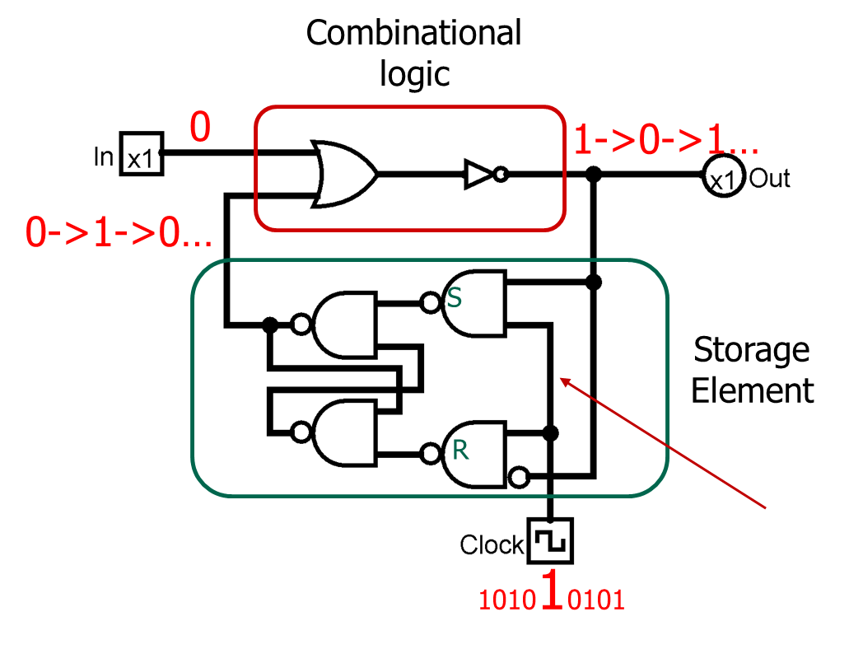
How many bits of information does a D latch store? When will the input to a D latch become the output, assuming the WE line is asserted?
Notes:
CS160 - Intro
4
Answer is C) D latch stores one bit and if WE is asserted input becomes output after some propagation delay

Slide 5
A sequential circuit has two flip-flops with inputs DA and DB. The combinational logic is described by the equations:
DA = AB’X + A’X’ + A’B’,
DB = A’X + BX’
and is currently in state A,B = 0,0 if the input x is 1, the next state will be
A=0, B=0
A=0, B=1
A=1, B=0
A=1, B=1
None of the above
Notes:
CS160 - Intro
5
Answer is D) Term A’B’ evaluates to True, term A’X evaluates to True

Slide 6
The third cycle of the Fetch phase moves data between which registers
IR <- PC
PC <- MAR
IR <- MDR
MDR <- MAR
None of the above
Notes:
CS160 - Intro
6
Answer is D) Term A’B’ evaluates to True, term A’X evaluates to True

Slide 7
Is it possible for the LC3’s Global Data Bus to have multiple input sources in the same clock cycle? How about multiple output destinations?
No, No
No, Yes
Yes, No
Yes, Yes
None of the above
Notes:
CS160 - Intro
7
Answer is D) Both are possible multiple inputs will most likely cause an error, multiple destinations is normal loading of data to destination registers is controlled by registers write enable line

Slide 8
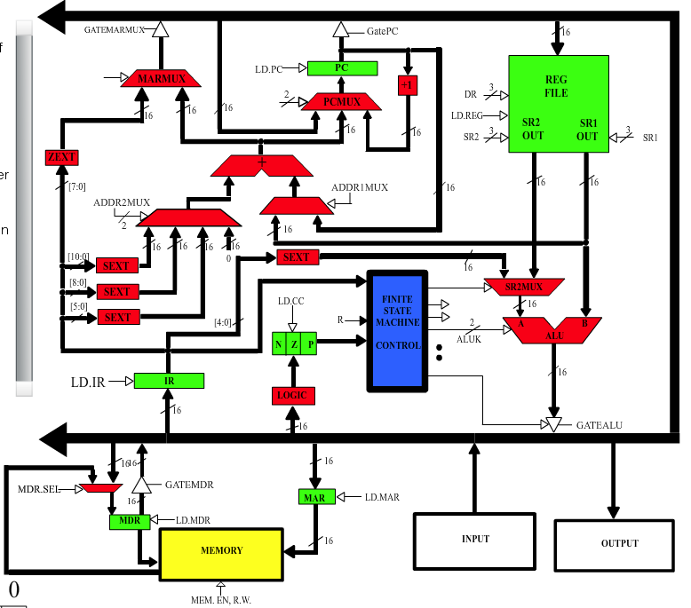
Notes:
CS160 - Intro
8
Answer is D) Both are possible multiple inputs will most likely cause an error, multiple destinations is normal loading of data to destination registers is controlled by registers write enable line

Slide 9
What is the result of adding the following 2s comp values in Hex
0x81FA + 0x78
Assume the second value is stored in 8 bits and use sign extension if necessary
0x78FA
0x8272
0x8172
0x181F2
None of the above
Notes:
CS160 - Intro
9
Answer is B) Sign bit is 0 so just add the two values together in binary

Slide 10
A Control Store is used in the LC3 to generate the outputs of a current state and data related to the next state.
If implemented in memory a Control Store cannot be updated
False, False
False, True
True, False
True, True
Notes:
CS160 - Intro
10
Answer is C)

Slide 11
A D flip-flop is composed of how many D latches. What is the advantage of a D flip-flop over a D latch
.5, input value is available immediately as output
2, input value does not become the output until the next clock cycle
1, no advantage they are just two words that describe the same device
2, input value is available immediately as output
None of the above
Notes:
CS160 - Intro
11
Answer is B)

Slide 12
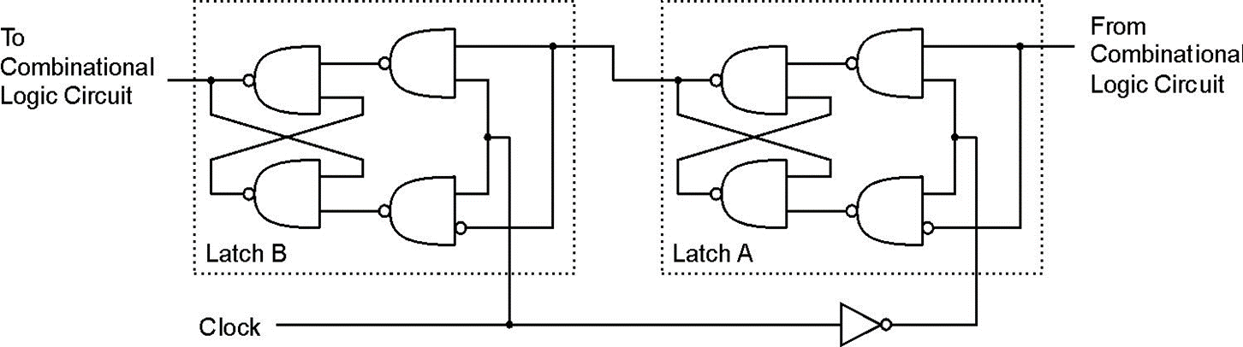
A D flip-flop is composed of how many D latches. What is the advantage of a D flip-flop over a D latch
Notes:
CS160 - Intro
12

Slide 13
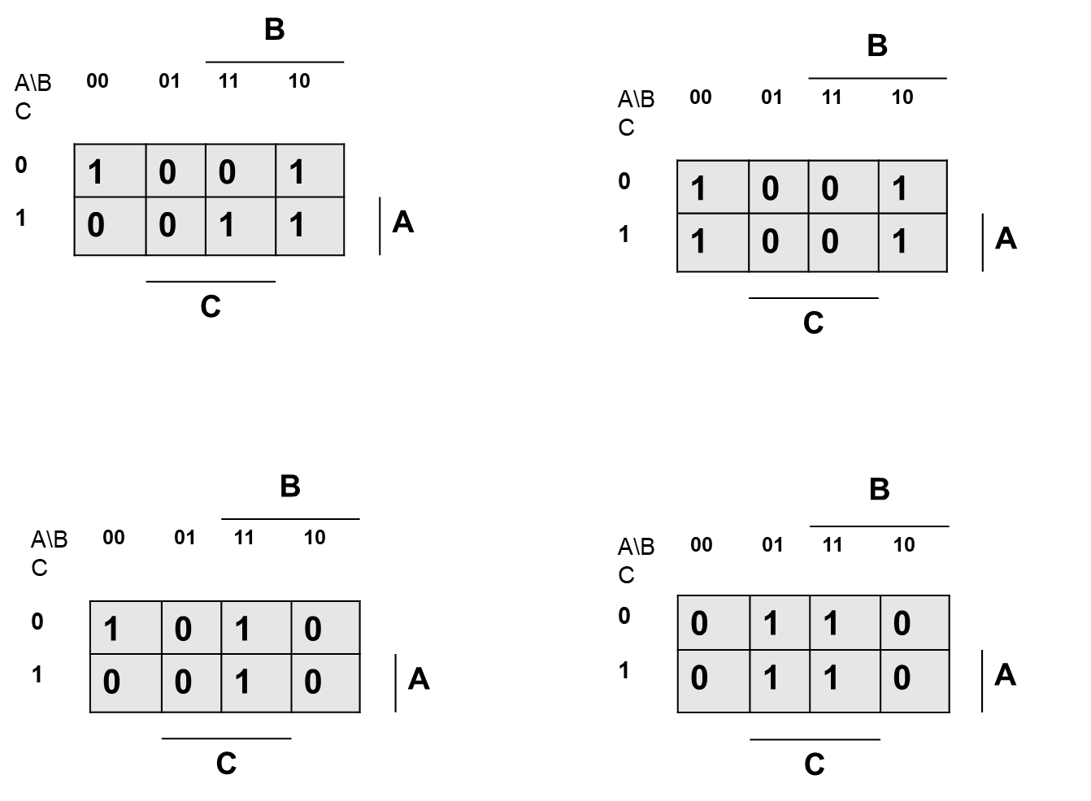
What Karnaugh Map corresponds to the following truth table
A
B
A | B | C | X
0 | 0 | 0 | 1
0 | 0 | 1 | 0
0 | 1 | 0 | 1
0 | 1 | 1 | 0
1 | 0 | 0 | 0
1 | 0 | 1 | 0
1 | 1 | 0 | 1
1 | 1 | 1 | 1
C
D
X
Notes:
CS160 - Intro
13

Slide 14
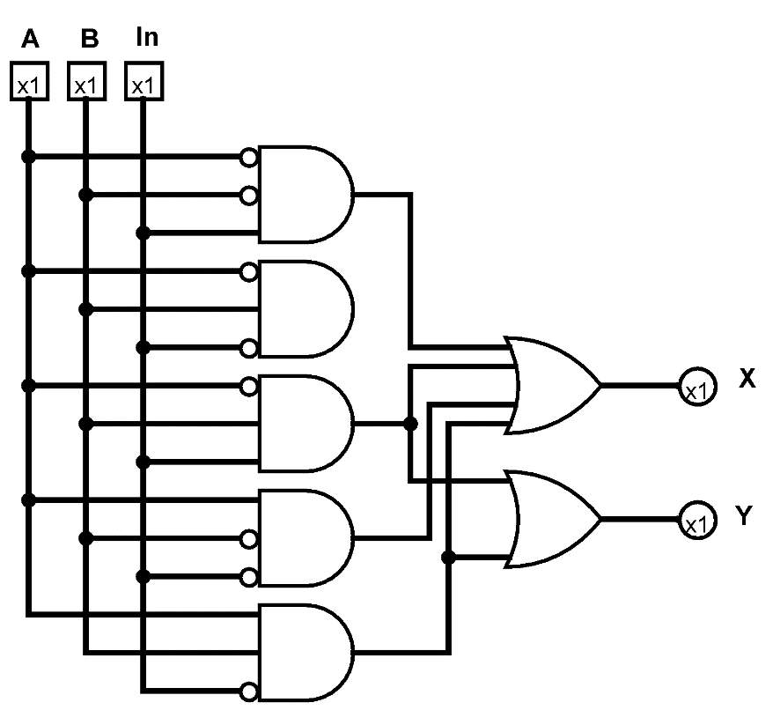
What truth table corresponds to the circuit?
A
B
A | B | C | X | Y
0 | 0 | 0 | 0 | 0
0 | 0 | 1 | 1 | 0
0 | 1 | 0 | 0 | 0
0 | 1 | 1 | 0 | 0
1 | 0 | 0 | 1 | 0
1 | 0 | 1 | 1 | 1
1 | 1 | 0 | 1 | 1
1 | 1 | 1 | 0 | 0
A | B | C | X | Y
0 | 0 | 0 | 0 | 0
0 | 0 | 1 | 1 | 0
0 | 1 | 0 | 0 | 0
0 | 1 | 1 | 1 | 1
1 | 0 | 0 | 1 | 0
1 | 0 | 1 | 0 | 0
1 | 1 | 0 | 1 | 1
1 | 1 | 1 | 0 | 0
C
D
X
A | B | C | X | Y
0 | 0 | 0 | 0 | 0
0 | 0 | 1 | 0 | 0
0 | 1 | 0 | 0 | 0
0 | 1 | 1 | 1 | 1
1 | 0 | 0 | 1 | 1
1 | 0 | 1 | 0 | 0
1 | 1 | 0 | 0 | 1
1 | 1 | 1 | 0 | 0
A | B | C | X | Y
0 | 0 | 0 | 1 | 0
0 | 0 | 1 | 1 | 0
0 | 1 | 0 | 0 | 1
0 | 1 | 1 | 1 | 1
1 | 0 | 0 | 1 | 0
1 | 0 | 1 | 0 | 0
1 | 1 | 0 | 1 | 1
1 | 1 | 1 | 0 | 0
Notes:
CS160 - Intro
14
Answer is B)

