Slide 1
Peer Instruction #5:
LC-3 Assembly Language
Notes:
CS160 - Intro
1
CS160 - Intro
1
This is the first peer instruction session!

Slide 2
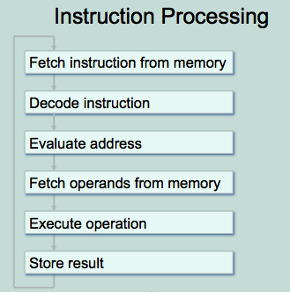
Which instructions require the “Evaluate Address” cycle during instruction processing on the LC-3?
Load (LD)
Store (ST)
Branch (BR)
Jump (JMP)
All of the above
Notes:
CS160 - Intro
2
Answer is E), all of these have an address field that must be evaluated, for different reasons

Slide 3
What is the address space (number of locations), addressability (number of bits), and number of registers on the LC-3.
2¹⁶, 8, 8
2¹⁶, 16, 16
2¹⁶, 32, 16
2³², 32, 8
None of the above
LC-3 Architecture
Notes:
CS160 - Intro
3
Answer is E), should be 2¹⁶ address space, 16-bits addressability, 8 registers.

Slide 4
Translate the LC-3 instruction 0x4840 into LC-3 assembly code:
JSR Label (Label at PC + 0x3F)
JSR Label (Label at PC + 0x40)
JSRR R3
JSRR R1
None of the above
LC-3 Instruction
Notes:
CS160 - Intro
4
Answer is B), but remember the PC has already been incremented. JSRR R1 would be 0x4040.

Slide 5
Translate the LC-3 instruction 0x1263 into LC-3 assembly code:
ADD R0,R1,#3
ADD R1,R1,#3
ADD R0,R1, R3
ADD R1,R0, R3
None of the above
LC-3 Instruction
Notes:
CS160 - Intro
5
Answer is B), ADD is obvious, 5-bit immediate value is positive, R1 in source and destination.

Slide 6
Translate ADD R3,R2,R1 from assembly code into an LC-3 instruction:
0x1681
0x1682
0x5681
0x5682
None of the above
LC-3 Instruction
Notes:
CS160 - Intro
6
Answer is A) first digit and last digit enough to decide which value is correct.

Slide 7
Translate LD R5, Label (where Label is four instructions after the instruction shown) from assembly code into an LC-3 instruction:
0x2A03
0x2A04
0x2503
0x2504
None of the above
LC-3 Instruction
Notes:
CS160 - Intro
7
Answer is A), remember the PC has already been incremented so only need to add 3 not 4.

Slide 8
DATA .FILL 0x1234
LD R5,DATA
AND R5,R5,#15
NOT R5,R5
What value is in R5 after the above code?
0x123F
0xEDCB
0xFFFB
0xFFFC
None of the above
LC-3 Instruction
Notes:
CS160 - Intro
8
Answer is C), ~(0x1234 & 0x000F) = 0xFFFB

Slide 9
.ORIG x3000
AND,R1,R1,#0
ADD R1,R0,#1
BRp MAIN
Is the branch taken in the above code?
Yes
No
Depends on initial value of R0
Depends on initial value of R1
None of the above
LC-3 Instruction
Notes:
CS160 - Intro
9
Answer is C), branch depends on R1, don’t know if R1 positive unless R0 is known, since R1 = R0 + 1

