Slide 1
Peer Instruction #8:
Transistors and Combinational Logic
Notes:
CS160 - Intro
1
CS160 - Intro
1
This is the first peer instruction session!

Slide 2
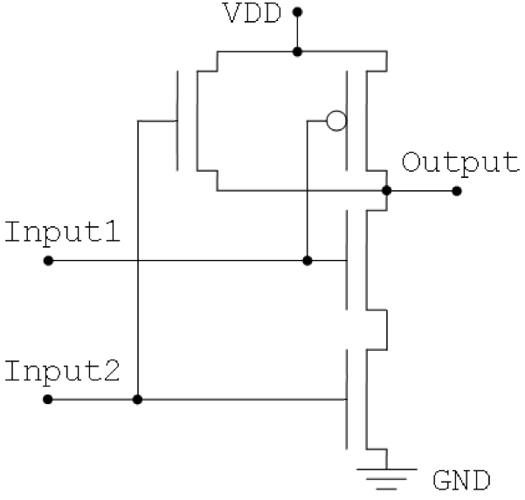
What will happen to the output of the gate shown below when Input1 is 1 and Input 2 is 1?
Connected to ground (0)
Connected to power (1)
Connected to both (!)
Disconnected (x)
None of the above
Notes:
CS160 - Intro
2
Answer is C), not a good thing because the gate would probably burn up or at least draw lots of power.

Slide 3
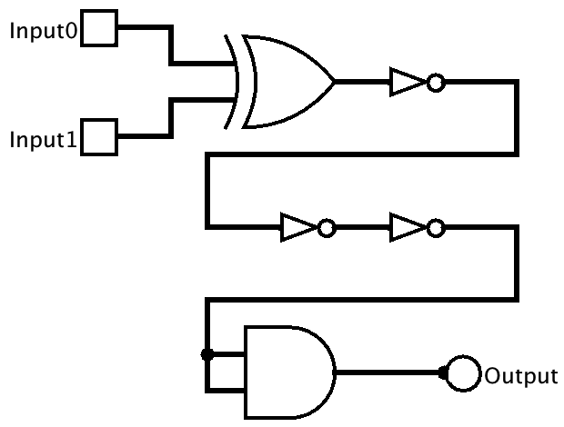
What is the column of the truth table for the Output signal, in binary order for Input1 and Input0 of 00, 01, 10, 11?
0, 1, 1, 0
1, 0, 0, 1
1, 1, 1, 0
0, 0, 0, 1
None of the above
Notes:
CS160 - Intro
3
Answer is B), this is an equals or XNOR gate, note inverter chain, last gate is useless!

Slide 4
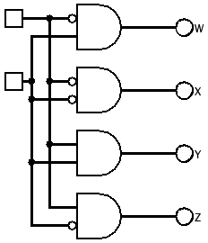
Which output signal is asserted for all possible values for for Input1 (most significant) and Input0 (least significant) in binary order 00, 01, 10, 11?
Input0
W, X, Y, Z
X, W, Z, Y
Y, Z, W, X
X, Z, W, Y
None of the above
Input1
Notes:
CS160 - Intro
4
Answer is D), the big problem with this decoder is that the values are out of order.

Slide 5
What logical operation does the following truth table represent
A | B | C
0 | 0 | 1
0 | 1 | 0
1 | 0 | 0
1 | 1 | 0
OR
NAND
XOR
NOR
None of the above
Notes:
CS160 - Intro
5
Answer is D) NOR

Slide 6
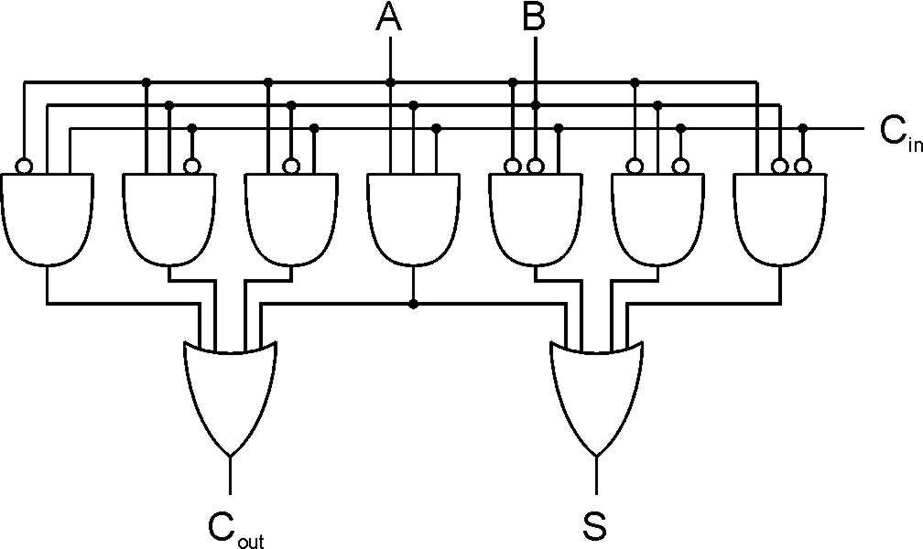
How many gate delays per bit does a full adder have, what is the Big O growth rate of gate delay vs number of bits added
1, O(n)
2, O(n²)
2, O(n)
3, O(n log(n))
None of the above
Notes:
CS160 - Intro
6
Answer is C), Carry lookahead adders have better performance but more complicatied

Slide 7
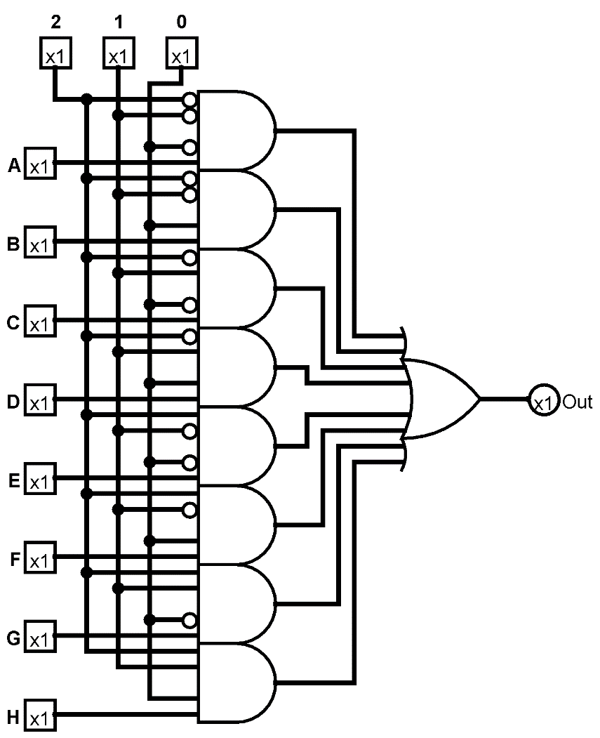
What is the device shown and given the following information what will its output be?
2 | 1 | 0 | A | B | C | D | E | F | G | H
1 | 1 | 0 | 1 | 1 | 1 | 0 | 0 | 1 | 0 | 1
Multiplexer, 0
Multiplexer, 1
Decoder, 1
Decoder, 0
None of the above
Notes:
CS160 - Intro
7
Answer is A) Multiplexer, Given selector value of 110 input G will be selected

Slide 8
What is the Boolean algebra formula that defines the following truth table?
A | B | C | X
0 | 0 | 0 | 0
0 | 0 | 1 | 1
0 | 1 | 0 | 1
0 | 1 | 1 | 0
1 | 0 | 0 | 0
1 | 0 | 1 | 1
1 | 1 | 0 | 1
1 | 1 | 1 | 0
B’C + BC
A’C + C
B’C + BC’
AB + CB’
None of the above
Notes:
CS160 - Intro
8
Answer is C) use a Karnaugh map

Slide 9
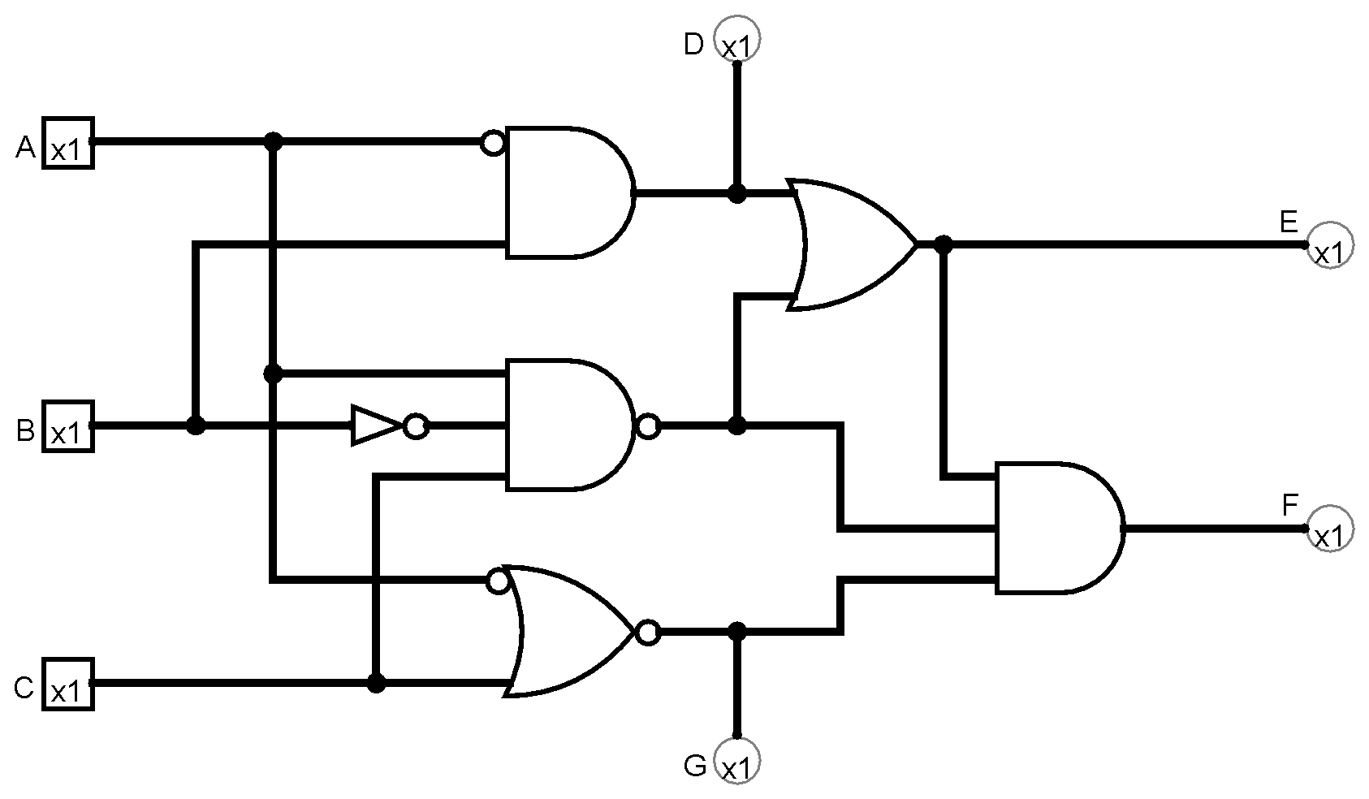
Given the following inputs what will the outputs of this circuit be
A | B | C
1 | 1 | 1
0 | 1 | 0
D | E | F | G
0 | 1 | 1 | 0
1 | 0 | 1 | 1
A
D | E | F | G
0 | 1 | 0 | 0
1 | 1 | 1 | 1
B
D | E | F | G
1 | 1 | 0 | 1
1 | 0 | 1 | 0
C
D None of the above
Notes:
CS160 - Intro
9
Answer is B)

Slide 10
Given a truth table with 4 inputs and 3 outputs what is the maximum number of AND gates needed? OR gates?
12, 4
16, 3
16, 8
8, 1
None of the above
Notes:
CS160 - Intro
10
Answer is B) number of AND gates is 2 raised to the power of the number of inputs, number of OR gates is number of outputs

