Slide 1
Peer Instruction Final Review
Notes:
CS160 - Intro
1
CS160 - Intro
1
This is the first peer instruction session!

Slide 2
The per bit cost of Cache is ____ than Main Memory, while the number of clock cycles to access Cache is _______
Higher | Higher
Higher | Lower
Lower | Higher
Lower | Lower
None of the above
Notes:
B

Slide 3
A cache hit means data from the requested memory address is in the cache, cache hits are slower to service that cache misses
True
False
Notes:
False. Should be A cache hit means data from the requested memory address is in the cache, cache hits are faster to service that cache misses

Slide 4
The output value of a D flipflop reflects the input value to the flipflop after some propagation delay
True
False
Notes:
False. Should be after the next clock cycle

Slide 5
A single D Latch can be used to store one bit of state in a sequential circuit based state machine
True
False
Notes:
False. Should be D flip flop. This is needed to prevent the output of a circuit becoming the input within the same clock cycle

Slide 6
With 5 flip flops how many states can a sequential circuit implement
5
Log₂ 5
16
32
64
Notes:
D: 32

Slide 7
For the combinational circuit described by this function
X = AB’C + A’C’ + A’B’ + A’BC
How many AND and OR gates will be needed to implement the function without any optimization
4 AND gates, 1 OR gate
1 AND gate, 4 OR gates
4 AND gates, 3 OR gates
3 AND gates, 4 OR gates
None of the above
Notes:
A

Slide 8
A Multiplexor uses the values of its select lines/bits to set the value of a single output line to 1.
A Decoder selects a single input line’s value to be passed on as the value on its output line
True
False
Notes:
False. Terms are switched

Slide 9
The following truth table represents what logical operation
A | B | X
0 | 0 | 0
0 | 1 | 1
1 | 0 | 1
1 | 1 | 0
OR
NOR
NAND
XOR
None of the above
Notes:
D: XOR

Slide 10
A ____adder has inputs A=0, B=1, and carry-in Cin=1. What would be the sum bit S and the carry-out bit Cout?
Half, S=0, Cout=1
Full, S=0, Cout=0
Half, S=1, Cout=1
Full, S=1, Cout=0
None of the above
Notes:
E. Should be Full, S=0, Cout=1

Slide 11
A Decoder with 7 outputs has ____ select lines.
A Mux/Multiplexor with 19 inputs has ____ select lines.
2, 5
5, 2
6, 3
3, 5
None of the above
Notes:
D

Slide 12
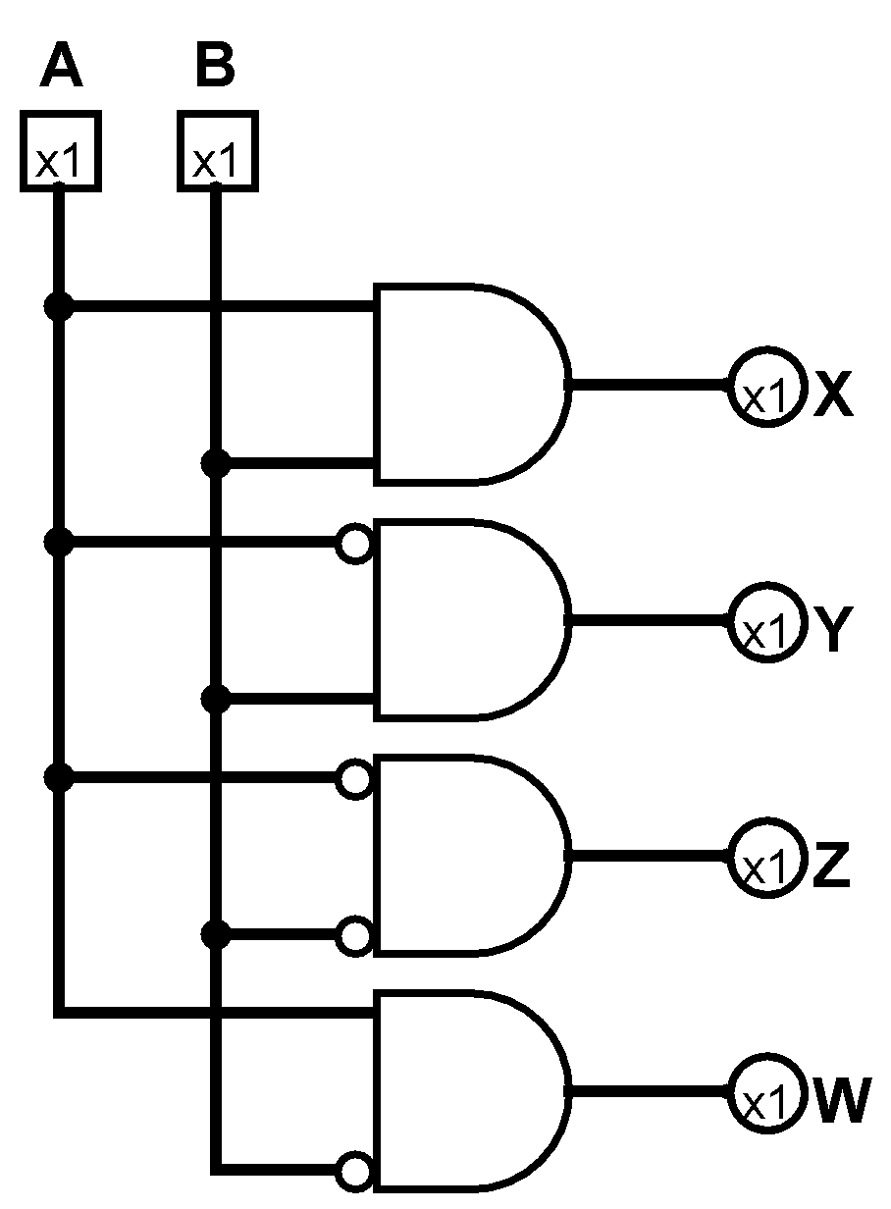
Given this series of inputs 00, 01, 10, 11, with input A being the MSB and B the LSB
What is the series of outputs for the following circuit
Z, X, W, Y
X, Y, W, Z
Z, Y, W, X
X, W, Y, Z
None of the above
Notes:
C

Slide 13
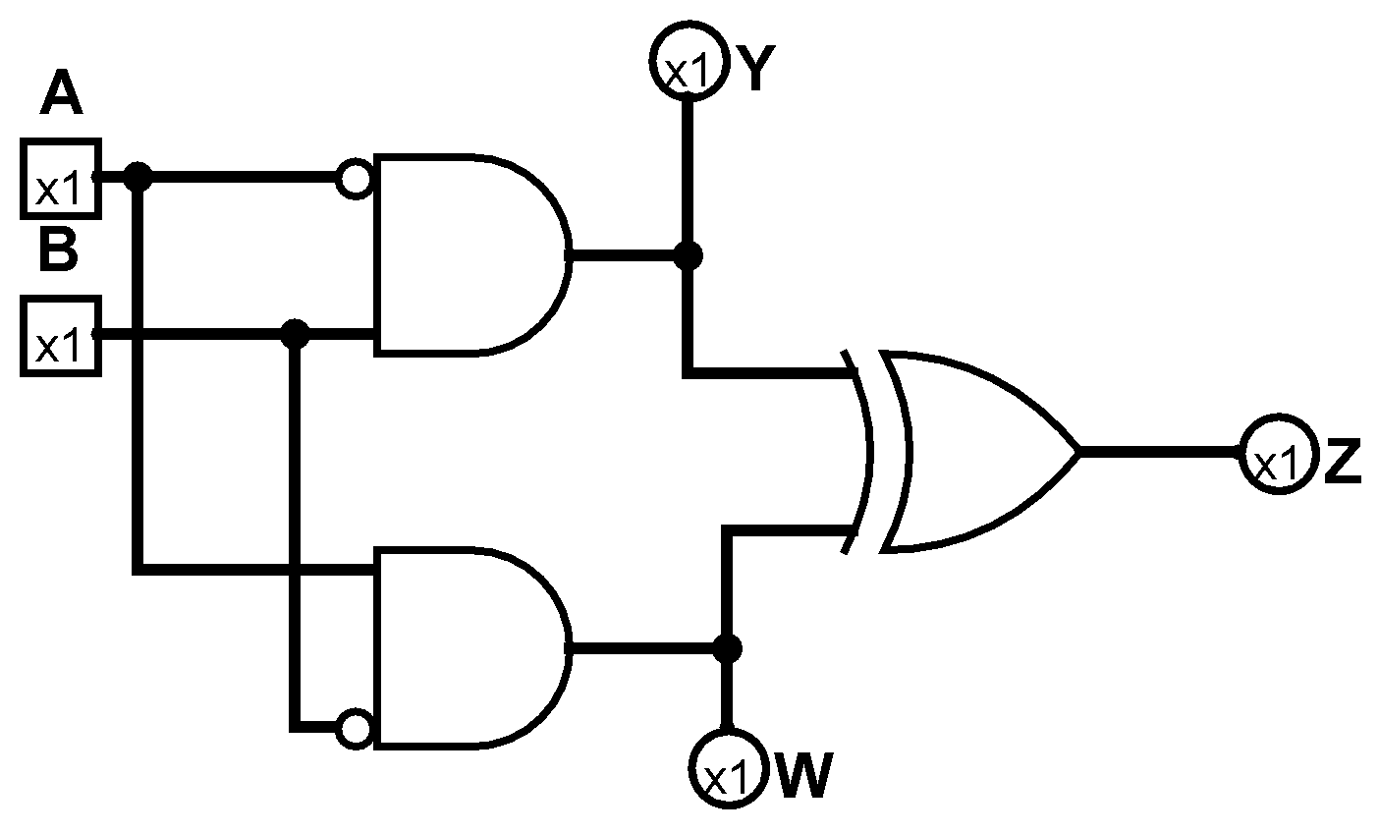
Given the following circuit and the input A=1, B=0, what will be the values for Y, W, and Z
1, 1, 0
0, 1, 1
0, 0, 0
1, 0, 1
None of the above
Notes:
B

Slide 14
The MDR holds addresses that are used by the memory to load and store data
True
False
Notes:
False. Should be MAR

Slide 15
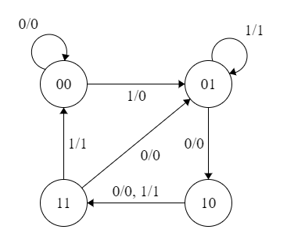
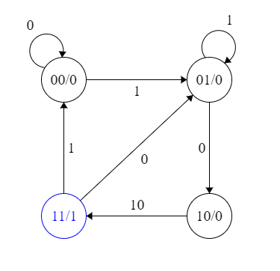
What type of state machine is depicted in figures A and B?
A
B
A:Moore, B:Mealy
A:Mealy, B:Moore
A:Mealy, B:Mealy
A:Moore, B:Moore
None of the above
Notes:
CS160 - Intro
15
Answer is B) Mealy has output associated with a transition, Moore output associated with a state

Slide 16
Mealy machines can sometimes use fewer states to represent the same process than Moore machines, and all Mealy machines can be simulated with a Moore machine
True
False
Notes:
False. Should be all Moore machines can be simulated with a Mealy machine

Slide 17
The purpose of the IR is to hold the address of the next instruction
True
False
Notes:
False. Should be PC

Slide 18
Inputs to the global data bus on the LC3 are moderated by “tri-state devices” i.e GateALU.
Only one device can read the from the bus in a given clock cycle.
True | True
True | False
False | True
False | False
Notes:
False. Should be all devices can read from the bus in a given clock cycle

Slide 19
The BR instruction takes 5 clock cycles on the LC3
True
False
Notes:
False. Should be 4 cycles, 3 for fetch phase, 1 more to finalize the BR

Slide 20
Given a direct mapped cache with 4 byte words, 32 bit address space, byte addressing, and the following address partition:
Tag | Index | Offset
31-14 | 13-10 | 9-0
What is the block size in bytes?
How many blocks are in the cache?
512 bytes, 16 blocks
256 bytes, 64 blocks
1024 bytes, 32 blocks
128 bytes, 32 blocks
None of the above
Notes:
E. Should be 1024 bytes, 16 blocks

Slide 21
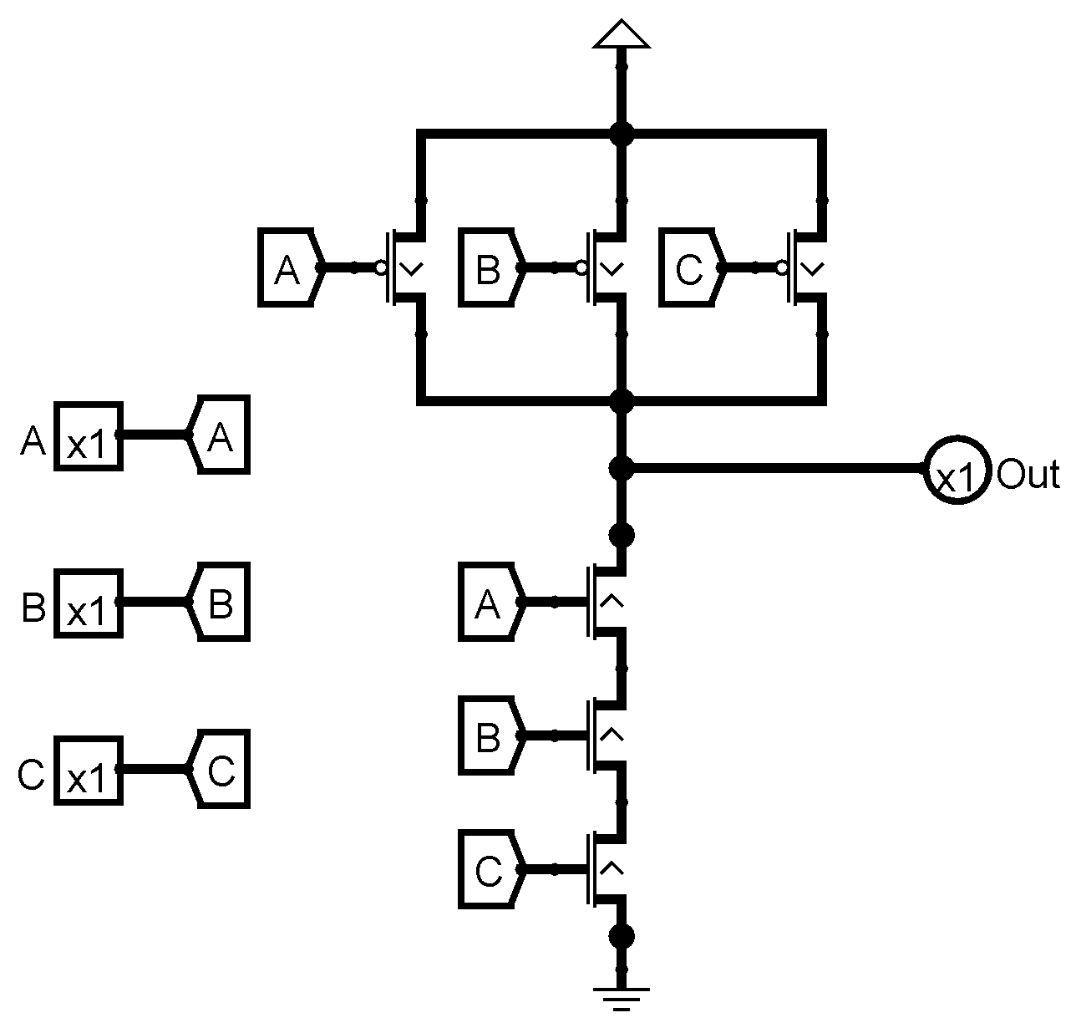
What logical operation does the following circuit implement
OR
NOR
NAND
XOR
None of the above
Notes:
C: NAND

Slide 22
Order of magnitude clock speed increases and similar increases in chip power levels are seen as ways to improve processor performance in the future
True
False
Notes:
False. Should be more cores, accelerators(GPU/TPU), Special IP blocks/ASICs

Slide 23
Add the following Hex numbers together and show the result in Hex.
0xD03 + 0x278
0xF2D
0xE08
0xF8A
0xF7B
None of the above
Notes:
D

Slide 24
All else being equal a cache with higher associativity will have lower _________ misses
Capacity
Conflict
Compulsory
Coherence
Notes:
B

Slide 25
The reason for caches is processor speed improvements have not kept pace with memory improvements over the last ~40 years
True
False
Notes:
False. Should be The reason for caches is memory speed improvements have not kept pace with processor improvements over the last ~40 years

Slide 26
Bandwidth: rate of data transfer
Latency: time between requesting data and receiving the data
True
False
Notes:
True

Slide 27
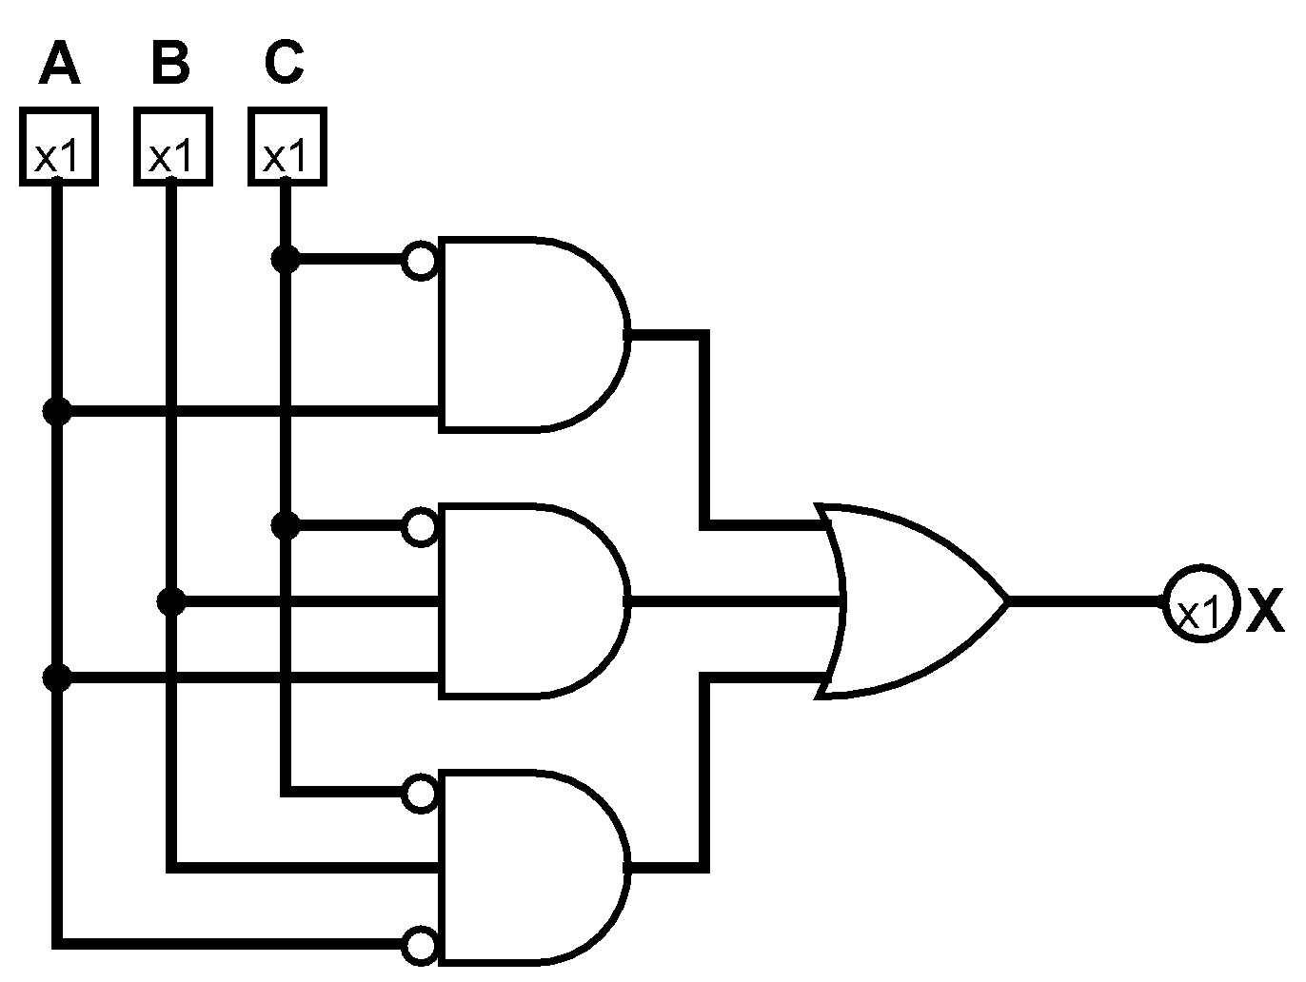
The Boolean expression represented by the following circuit is?
C’A + C’BA + C’BA’
A’C + CBA’ + ABC
BC + ABC’ + CB’
None of the above
Notes:
A

Slide 28
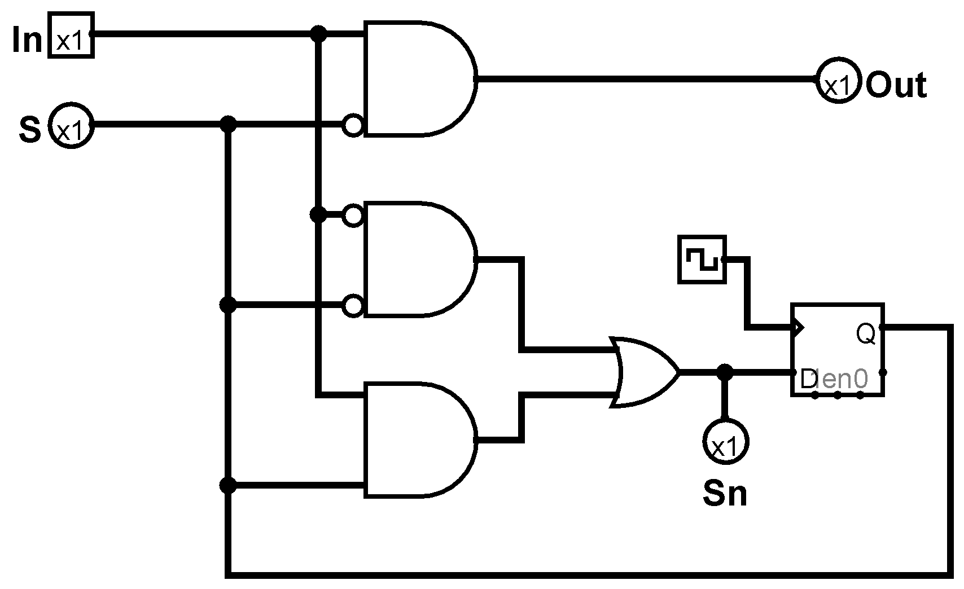
Which truth table matches the following state machine
A
In | S | Sn | Out
0 | 0 | 0 | 0
0 | 1 | 1 | 1
1 | 0 | 1 | 0
1 | 1 | 0 | 0
B
In | S | Sn | Out
0 | 0 | 1 | 0
0 | 1 | 0 | 1
1 | 0 | 0 | 0
1 | 1 | 1 | 0
C
In | S | Sn | Out
0 | 0 | 1 | 0
0 | 1 | 0 | 0
1 | 0 | 0 | 1
1 | 1 | 1 | 0
Notes:
C

Slide 29
Things to take away from this class
Work at the highest level of abstraction that you can.
  Knowing what is happening at lower levels can help you to solve problems related to
    Performance
    Correctness
    Security
Google your error messages
Let your subconscious do some of the work
  Start early

