Slide 1
Peer Instruction #5:
LC-3 Assembly Language
Notes:
CS160 - Intro
1
CS160 - Intro
1
This is the first peer instruction session!

Slide 2
What does the assembly instruction ADD R1,R2,R1 do?
Add R1 to R1, store in R2
Add R2 to R2, store in R2
Add R1 to R2, store in R2
Add R2 to R1, store in R1
None of the above
Notes:
CS160 - Intro
2
Answer is D) opcode, destination register, source 1, source 2

Slide 3
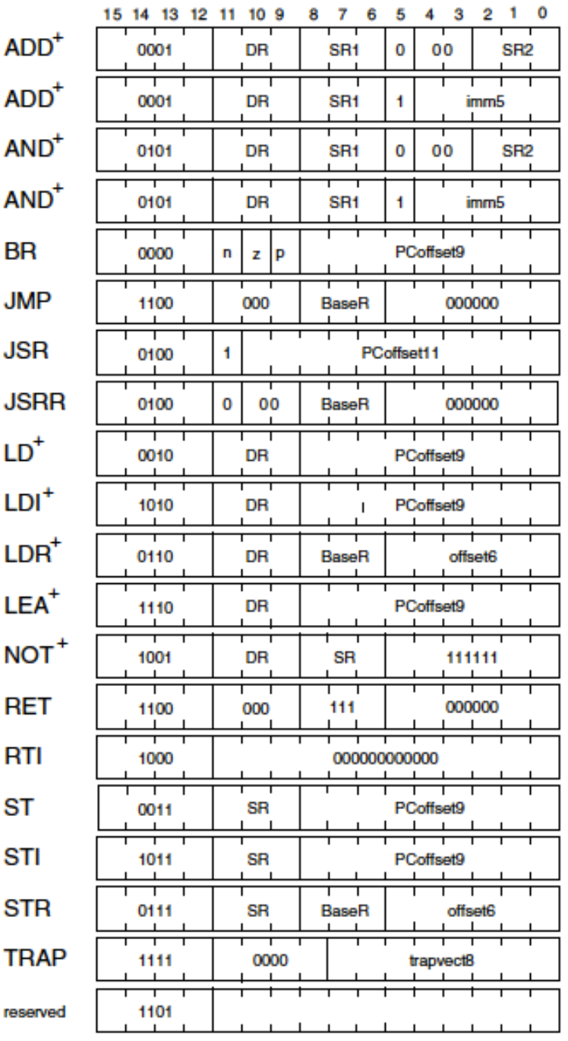
What operation does the assembly instruction 0x3206 specify?
LD – load from memory
RET – return from subroutine
JSR – jump to subroutine
ST – store to memory
None of the above
Notes:
CS160 - Intro
3
Answer is D), the opcode is 0b0011 (ST), the source register is 0b001 (R1), and the PC offset is 0b000000110 (6).

Slide 4
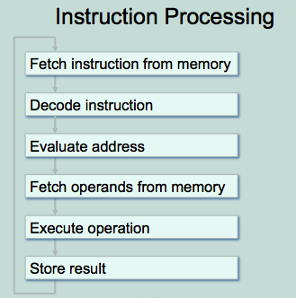
Which instructions require the “Evaluate Address” cycle during instruction processing on the LC-3?
Load (LD)
Store (ST)
Branch (BR)
Jump (JMP)
All of the above
Notes:
CS160 - Intro
4
Answer is E), all of these have an address field that must be evaluated, for different reasons

Slide 5
What is the address space (number of locations), addressability (number of bits), and number of registers on the LC-3.
2¹⁶, 8, 8
2¹⁶, 16, 16
2¹⁶, 32, 16
2³², 32, 8
None of the above
Notes:
CS160 - Intro
5
Answer is E), should be 2¹⁶ address space, 16-bits addressability, 8 registers.

Slide 6
Translate the LC-3 instruction 0x1263 into LC-3 assembly code:
ADD R0,R1,#3
ADD R1,R1,#3
ADD R0,R1, R3
ADD R1,R0, R3
None of the above
Notes:
CS160 - Intro
6
Answer is B), ADD is obvious, 5-bit immediate value is positive, R1 in source and destination.

Slide 7
Translate ADD R3,R2,R1 from assembly code into an LC-3 instruction:
0x1681
0x1682
0x5681
0x5682
None of the above
Notes:
CS160 - Intro
7
Answer is A) first digit and last digit enough to decide which value is correct.

Slide 8
Build an instruction that loads a value from memory, four addresses after the instruction, into R5.
0x2A03
0x2A04
0x2503
0x2504
None of the above
Notes:
CS160 - Intro
8
Answer is A), remember the PC has already been incremented so only need to add 3 not 4.

