Slide 1
Peer Instruction #9:
Memory and State Machines
Notes:
CS160 - Intro
1
CS160 - Intro
1
This is the first peer instruction session!

Slide 2
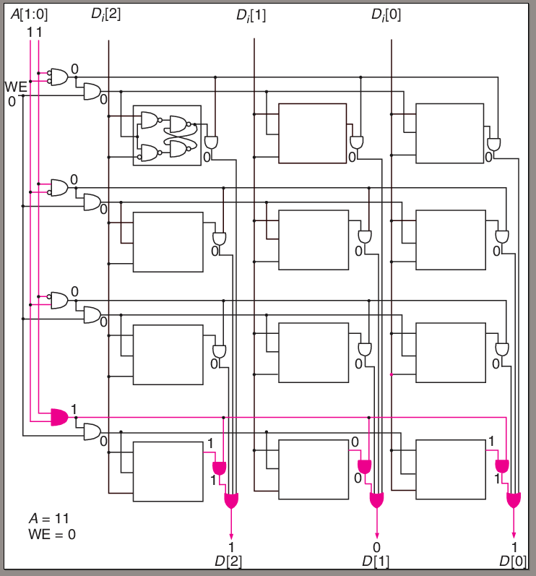
What is the address space and addressability of the memory shown, and what is the circuit doing?
2², 3-bits, writing memory location 00
2³, 4-bits, writing memory location 11
2³, 4-bits, reading memory location 00
2², 3-bits, reading memory location 11
None of the above
Notes:
CS160 - Intro
2
Answer is D), 2 address lines = 4 locations is the address space, each location has 3-bits, reading address 11

Slide 3
What is an advantage of a D latch vs an RS latch
D latches take fewer transistors
RS latches are combinational logic and D latches are sequential logic
D latches ensure the inputs that set the latches output value are never 0 at the same time
D latches can be used as storage element in a state machine since the inputs to the latch do not become outputs until the next clock cycle
All of the above
Notes:
CS160 - Intro
3
Answer is C) D latch adds gates to insure S and R are not 0 at the same time

Slide 4
How many bits of information does a D latch store? When will the input to a D latch become the output, assuming the WE line is asserted?
2 bits, in the current clock cycle
1 bit, in the next clock cycle
1 bit, after some propagation delay
2 bits, in the next clock cycle
None of the above
Notes:
CS160 - Intro
4
Answer is C) D latch stores one bit and if WE is asserted input becomes output after some propagation delay

Slide 5
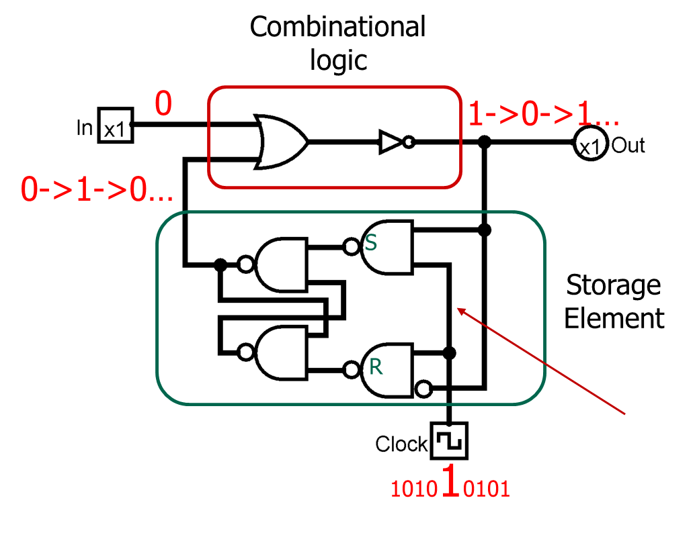
How many bits of information does a D latch store? When will the input to a D latch become the output, assuming the WE line is asserted?
https://www.cs.colostate.edu/~cs270/.Spring20/resources/memory.circ
Notes:
CS160 - Intro
5
Answer is C) D latch stores one bit and if WE is asserted input becomes output after some propagation delay

Slide 6
A D flip-flop is composed of how many D latches. What is the advantage of a D flip-flop over a D latch
.5, input value is available immediately as output
2, input value does not become the output until the next clock cycle
1, no advantage they are just two words that describe the same device
2, input value is available immediately as output
None of the above
Notes:
CS160 - Intro
6
Answer is B)

Slide 7
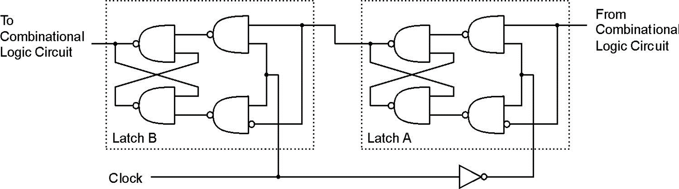
A D flip-flop is composed of how many D latches. What is the advantage of a D flip-flop over a D latch
https://www.cs.colostate.edu/~cs270/.Spring20/resources/memory.circ
Notes:
CS160 - Intro
7

Slide 8
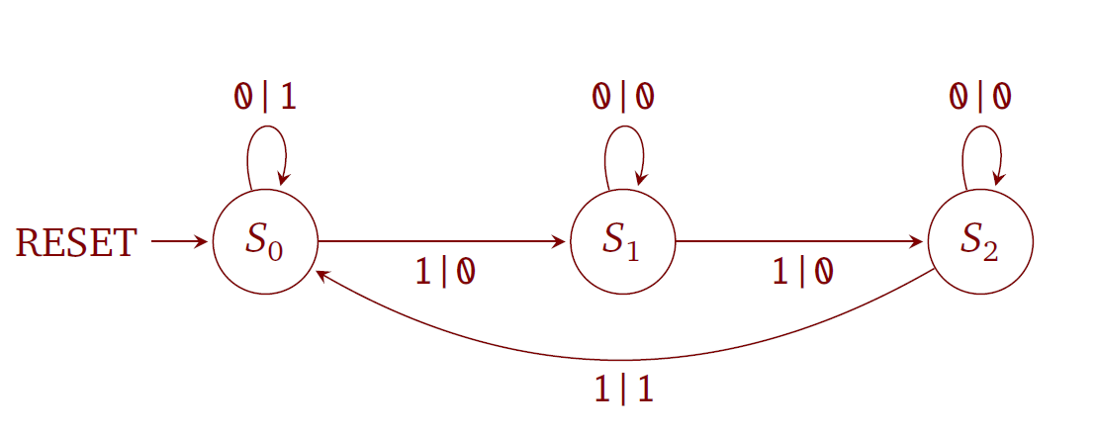
After RESET, which state will the machine shown below end up in if the inputs are 1, 0, 1, 1, 1, 0, 1
S₀
S₁
S₂
None of the above
Notes:
CS160 - Intro
8
Answer is C), RESET to S0, 1 to S1, 0 to S1, 1 to S2, 1 to S0 (Output 1), 1 to S1, 0 to S1, 1 to S2

Slide 9
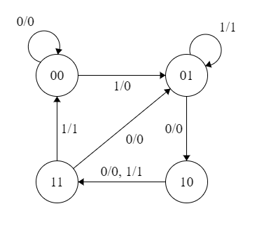
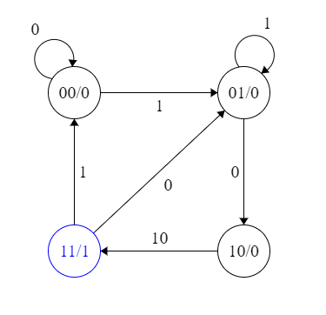
What type of state machine is depicted in figures A and B?
A
B
A:Moore, B:Mealy
A:Mealy, B:Moore
A:Mealy, B:Mealy
A:Moore, B:Moore
None of the above
Notes:
CS160 - Intro
9
Answer is B) Mealy has output associated with a transition, Moore output associated with a state

Slide 10
What rows of the state table have incorrect values for Out, S1’ and S2’
Row | In | S1 | S0 | Out | S1’ | S0’
1 | 0 | 0 | 0 | 1 | 0 | 1
2 | 0 | 0 | 1 | 0 | 1 | 0
3 | 0 | 1 | 0 | 0 | 1 | 1
4 | 0 | 1 | 1 | 0 | 0 | 1
5 | 1 | 0 | 0 | 0 | 1 | 0
6 | 1 | 0 | 1 | 1 | 0 | 1
7 | 1 | 1 | 0 | 1 | 1 | 1
8 | 1 | 1 | 1 | 1 | 1 | 0
1,2,5
2,4,5
3,5,6
1,5,8
None of the above
Notes:
CS160 - Intro
10
Answer is D) by looking at the diagram you can see lines 1, 4, and 7 are incorrect

Slide 11
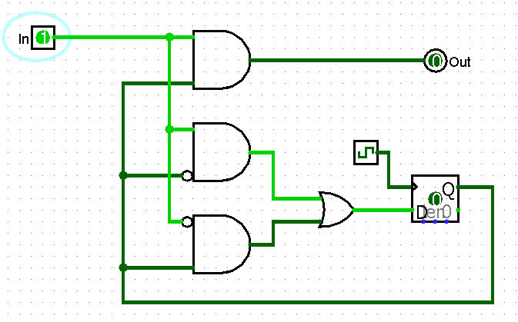
Does the following circuit model a Mealy or Moore state machine
Moore
Mealy
Either
None of the above
Notes:
CS160 - Intro
11
Answer is B) Output is based on state and input

