Slide 1
Peer Instruction #8:
Transistors and Combinational Logic
Notes:
CS160 - Intro
1
CS160 - Intro
1
This is the first peer instruction session!

Slide 2
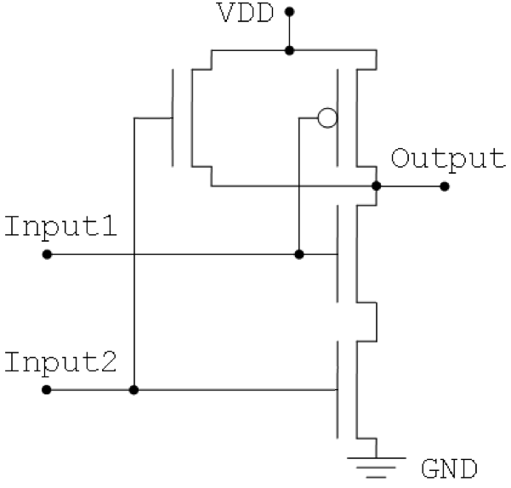
What will happen to the output of the gate shown below when Input1 is 1 and Input 2 is 1?
Connected to ground (0)
Connected to power (1)
Connected to both (!)
Disconnected (x)
None of the above
Notes:
CS160 - Intro
2
Answer is C), not a good thing because the gate would probably burn up or at least draw lots of power.

Slide 3
How many possible Boolean operations are there for 2 input Boolean logic
A | B | AND | OR | …
0 | 0 | 0 | 0
0 | 1 | 0 | 1
1 | 0 | 0 | 1
1 | 1 | 1 | 1

Slide 4
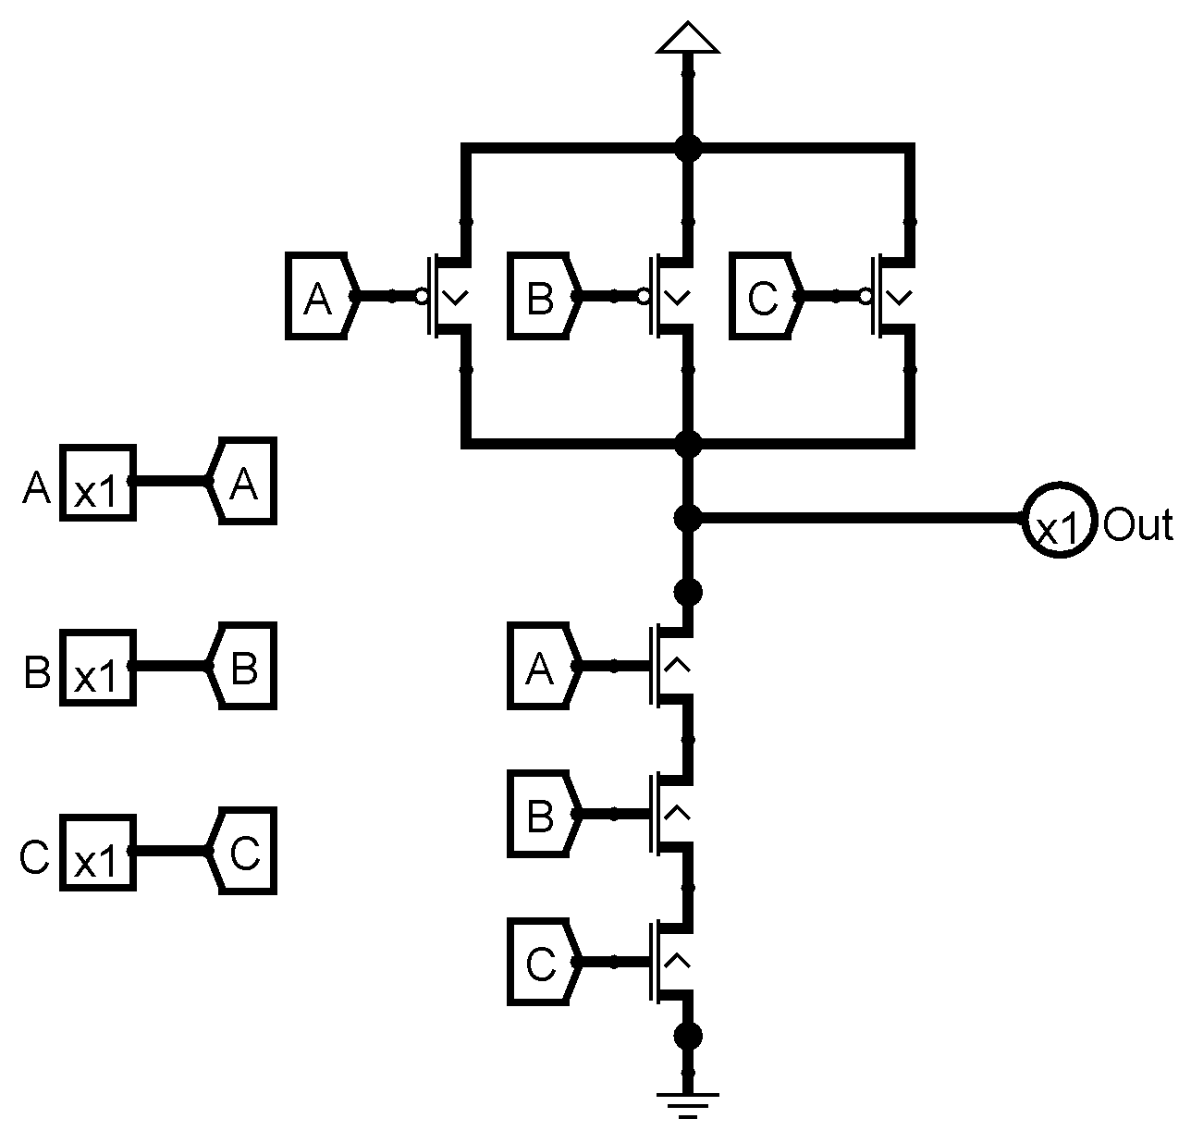
What logical operation does the following circuit implement
OR
NOR
NAND
XOR
None of the above
Notes:
C: NAND

Slide 5
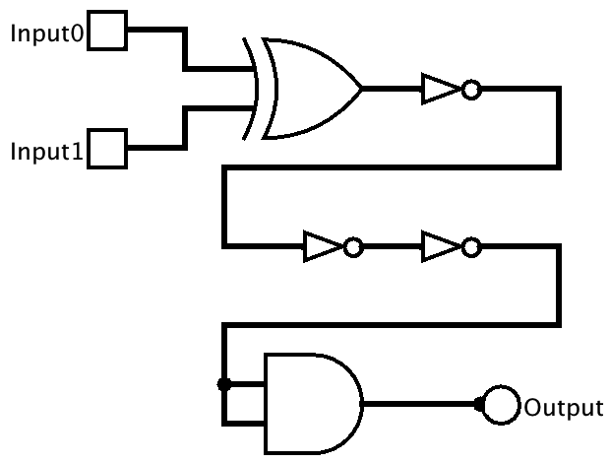
What is the column of the truth table for the Output signal, in binary order for Input1 and Input0 of 00, 01, 10, 11?
0, 1, 1, 0
1, 0, 0, 1
1, 1, 1, 0
0, 0, 0, 1
None of the above
Notes:
CS160 - Intro
5
Answer is B), this is an equals or XNOR gate, note inverter chain, last gate is useless!

Slide 6
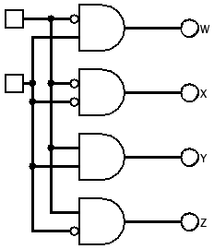
Which output signal is asserted for all possible values for for Input1 (most significant) and Input0 (least significant) in binary order 00, 01, 10, 11?
Input0
W, X, Y, Z
X, W, Z, Y
Y, Z, W, X
X, Z, W, Y
None of the above
Input1
Notes:
CS160 - Intro
6
Answer is D), the big problem with this decoder is that the values are out of order.

Slide 7
What logical operation does the following truth table represent
A | B | C
0 | 0 | 1
0 | 1 | 0
1 | 0 | 0
1 | 1 | 0
OR
NAND
XOR
NOR
None of the above
Notes:
CS160 - Intro
7
Answer is D) NOR

Slide 8
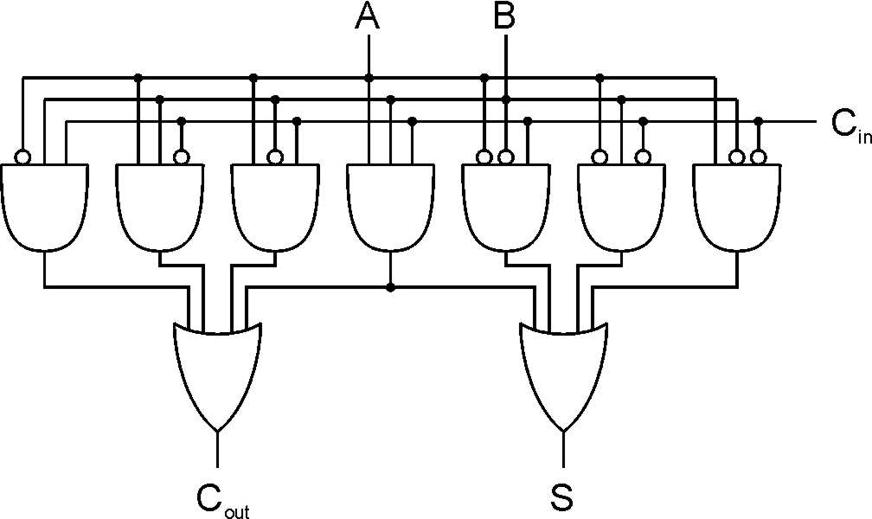
How many gate delays per bit does a full adder have, what is the Big O growth rate of gate delay vs number of bits added
1, O(n)
2, O(n²)
2, O(n)
3, O(n log(n))
None of the above
Notes:
CS160 - Intro
8
Answer is C), Carry lookahead adders have better performance but are more complicated

Slide 9
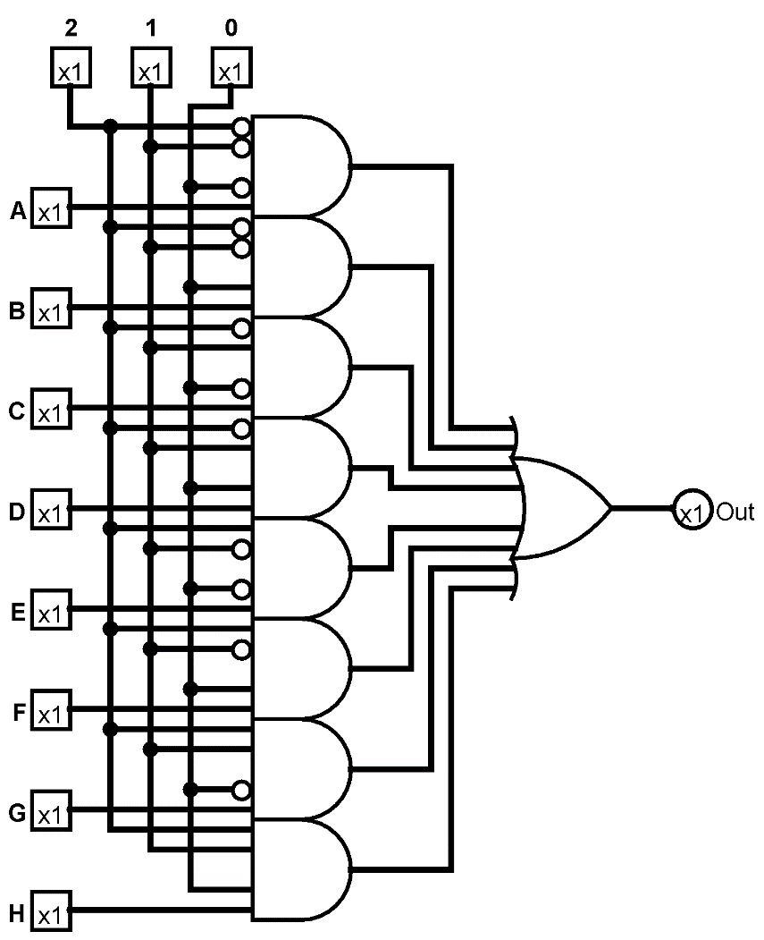
What is the device shown and given the following information what will its output be?
2 | 1 | 0 | A | B | C | D | E | F | G | H
1 | 1 | 0 | 1 | 1 | 1 | 0 | 0 | 1 | 0 | 1
Multiplexer, 0
Multiplexer, 1
Decoder, 1
Decoder, 0
None of the above
Notes:
CS160 - Intro
9
Answer is A) Multiplexer, Given selector value of 110 input G will be selected

Slide 10
What is the Boolean algebra formula that defines the following truth table?
A | B | C | X
0 | 0 | 0 | 0
0 | 0 | 1 | 1
0 | 1 | 0 | 1
0 | 1 | 1 | 0
1 | 0 | 0 | 0
1 | 0 | 1 | 1
1 | 1 | 0 | 1
1 | 1 | 1 | 0
B’C + BC
A’C + C
B’C + BC’
AB + CB’
None of the above
Notes:
CS160 - Intro
10
Answer is C) use a Karnaugh map

Slide 11
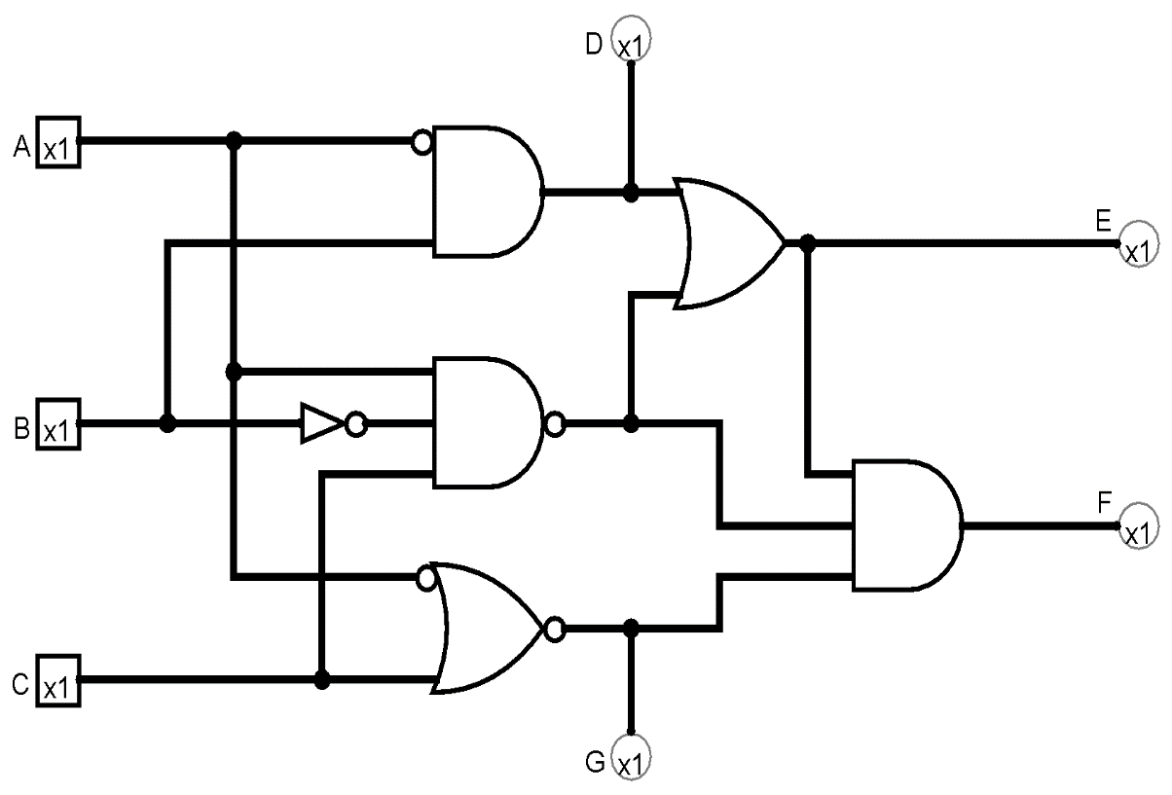
Given the following inputs what will the outputs of this circuit be
A | B | C
1 | 1 | 1
0 | 1 | 0
D | E | F | G
0 | 1 | 1 | 0
1 | 0 | 1 | 1
A
D | E | F | G
0 | 1 | 0 | 0
1 | 1 | 1 | 1
B
D | E | F | G
1 | 1 | 0 | 1
1 | 0 | 1 | 0
C
D None of the above
Notes:
CS160 - Intro
11
Answer is D)

Slide 12
Given a truth table with 4 inputs and 3 outputs what is the maximum number of AND gates needed? OR gates?
12, 4
16, 3
16, 8
8, 1
None of the above
Notes:
CS160 - Intro
12
Answer is B) number of AND gates is 2 raised to the power of the number of inputs, number of OR gates is number of outputs

Slide 13
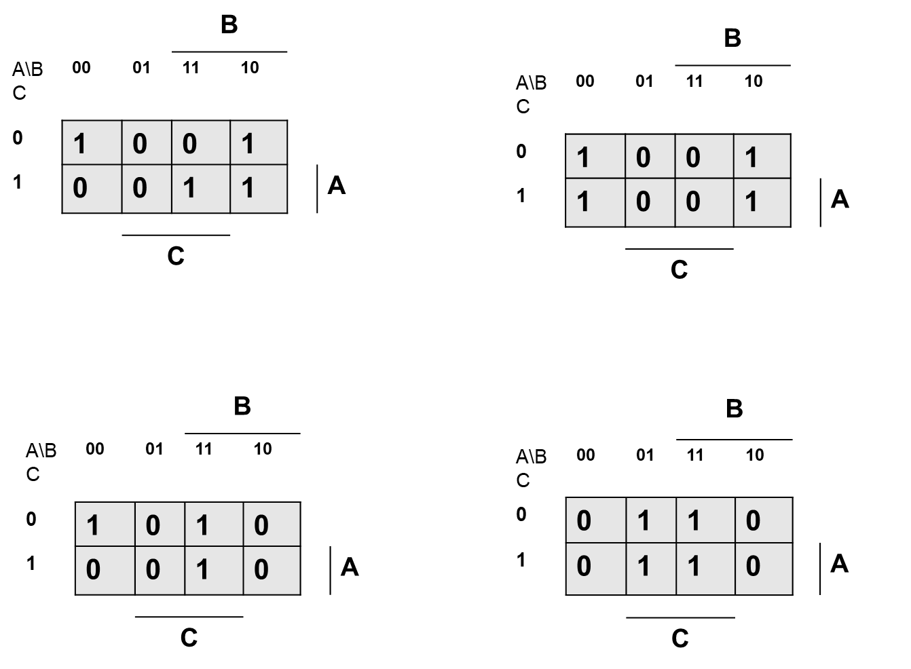
What Karnaugh Map corresponds to the following truth table
A
B
A | B | C | X
0 | 0 | 0 | 1
0 | 0 | 1 | 0
0 | 1 | 0 | 1
0 | 1 | 1 | 0
1 | 0 | 0 | 0
1 | 0 | 1 | 0
1 | 1 | 0 | 1
1 | 1 | 1 | 1
C
D
X
Notes:
CS160 - Intro
13

Slide 14
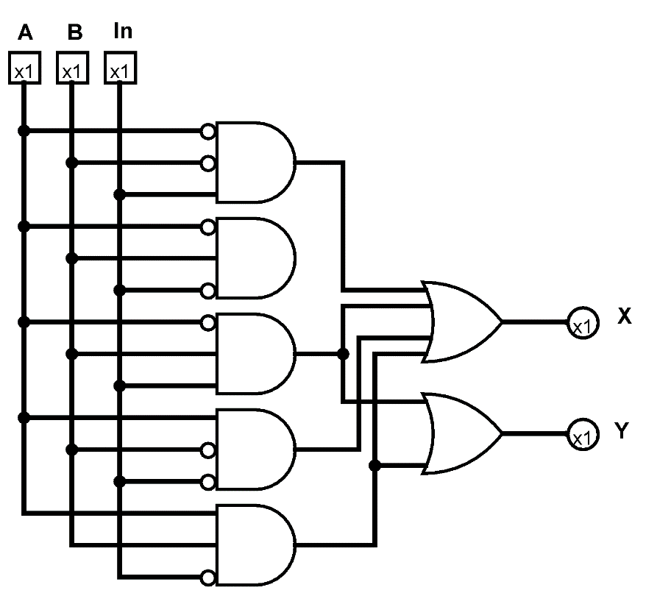
What truth table corresponds to the circuit?
A
B
A | B | In | X | Y
0 | 0 | 0 | 0 | 0
0 | 0 | 1 | 1 | 0
0 | 1 | 0 | 0 | 0
0 | 1 | 1 | 0 | 0
1 | 0 | 0 | 1 | 0
1 | 0 | 1 | 1 | 1
1 | 1 | 0 | 1 | 1
1 | 1 | 1 | 0 | 0
A | B | In | X | Y
0 | 0 | 0 | 0 | 0
0 | 0 | 1 | 1 | 0
0 | 1 | 0 | 0 | 0
0 | 1 | 1 | 1 | 1
1 | 0 | 0 | 1 | 0
1 | 0 | 1 | 0 | 0
1 | 1 | 0 | 1 | 1
1 | 1 | 1 | 0 | 0
C
D
X
A | B | In | X | Y
0 | 0 | 0 | 0 | 0
0 | 0 | 1 | 0 | 0
0 | 1 | 0 | 0 | 0
0 | 1 | 1 | 1 | 1
1 | 0 | 0 | 1 | 1
1 | 0 | 1 | 0 | 0
1 | 1 | 0 | 0 | 1
1 | 1 | 1 | 0 | 0
A | B | In | X | Y
0 | 0 | 0 | 1 | 0
0 | 0 | 1 | 1 | 0
0 | 1 | 0 | 0 | 1
0 | 1 | 1 | 1 | 1
1 | 0 | 0 | 1 | 0
1 | 0 | 1 | 0 | 0
1 | 1 | 0 | 1 | 1
1 | 1 | 1 | 0 | 0
Notes:
CS160 - Intro
14
Answer is B)

Slide 15
A ____adder has inputs A=0, B=1, and carry-in Cin=1. What would be the sum bit S and the carry-out bit Cout?
Half, S=0, Cout=1
Full, S=0, Cout=0
Half, S=1, Cout=1
Full, S=1, Cout=0
None of the above
Notes:
E. Should be Full, S=0, Cout=1

Slide 16
A Decoder with 7 outputs has ____ select lines. A Mux/Multiplexor with 19 inputs has ____ select lines.
2, 5
5, 2
6, 3
3, 5
None of the above
Notes:
D

