Slide 1
Chapter 5
Large and Fast: Exploiting Memory Hierarchy
Modified by Phil Sharp
Additional slides from MIT open courseware
Chris Terman. 6.004 Computation Structures. Spring 2017. Massachusetts Institute of Technology:
MIT OpenCourseWare, https://ocw.mit.edu. License: Creative Commons BY-NC-SA.

Slide 2
Status
P8
Big but not overly hard
Know what helper functions are available
200 points total, graded out of 50
Up to 150 points extra credit
Due next Saturday
Midterm 3
2 parts – see Teams
Not cumulative
Review on Thursday
Peer instruction will cover most topics

Slide 3
Midterm 3 Content
Cache basics
D latch and flip-flop
State machines
Boolean algebra / implementation
Full adder
Mux / decoder
Truth tables for AND, OR, NOT, XOR, NAND, NOR, Full Adder
Basic logic diagrams, outputs given inputs
LC3 registers
Binary / Hex addition / manipulation
N/P type transistors
Sequential vs Combinational logic
Technology trends
Data movement in LC3
Controller implemented with logic vs memory
Basic RTN
DRAM vs SRAM

Slide 4
Memory Technology
Static RAM (SRAM)
0.5ns – 2.5ns, $2000 – $5000 per GB
Dynamic RAM (DRAM)
50ns – 70ns, $20 – $75 per GB
Magnetic disk
5ms – 20ms, $0.20 – $2 per GB
Ideal memory
Access time of SRAM
Capacity and cost/GB of disk

Slide 5
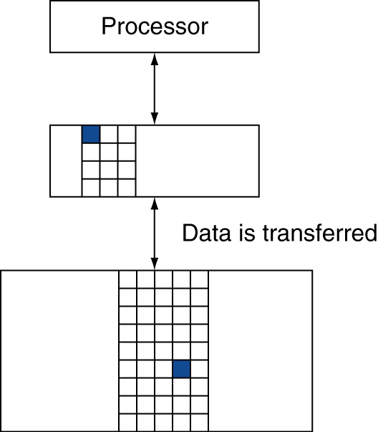
Memory Hierarchy Levels
Block (aka line): unit of copying
May be multiple words
Word “natural” size of data
64 Bytes common
If accessed data is present in upper level
Hit: access satisfied by upper level
Hit ratio: hits/accesses
If accessed data is absent
Miss: block copied from lower level
Time taken: miss penalty
Miss ratio: misses/accesses or
1–hit ratio
Then accessed data supplied from
upper level

Slide 6
Principle of Locality
Programs access a small proportion of their address space at any time
Temporal locality
Items accessed recently are likely to be accessed again soon
e.g., instructions in a loop, induction variables
Spatial locality
Items near those accessed recently are likely to be accessed soon
E.g., sequential instruction access, array data

Slide 7
A
B
C
Chris Terman. 6.004 Computation Structures. Spring 2017. Massachusetts Institute of Technology:
MIT OpenCourseWare, https://ocw.mit.edu. License: Creative Commons BY-NC-SA.

Slide 8
Cache Questions
Where should data from memory be placed in a cache
Anywhere, or a specific location?
How do we find memory data that may be in cache
And is the cache data valid?
Which block is replaced on a cache miss
Optimal strategy?
What happens on a write to memory
How do we keep memory and cache in sync?

Slide 9
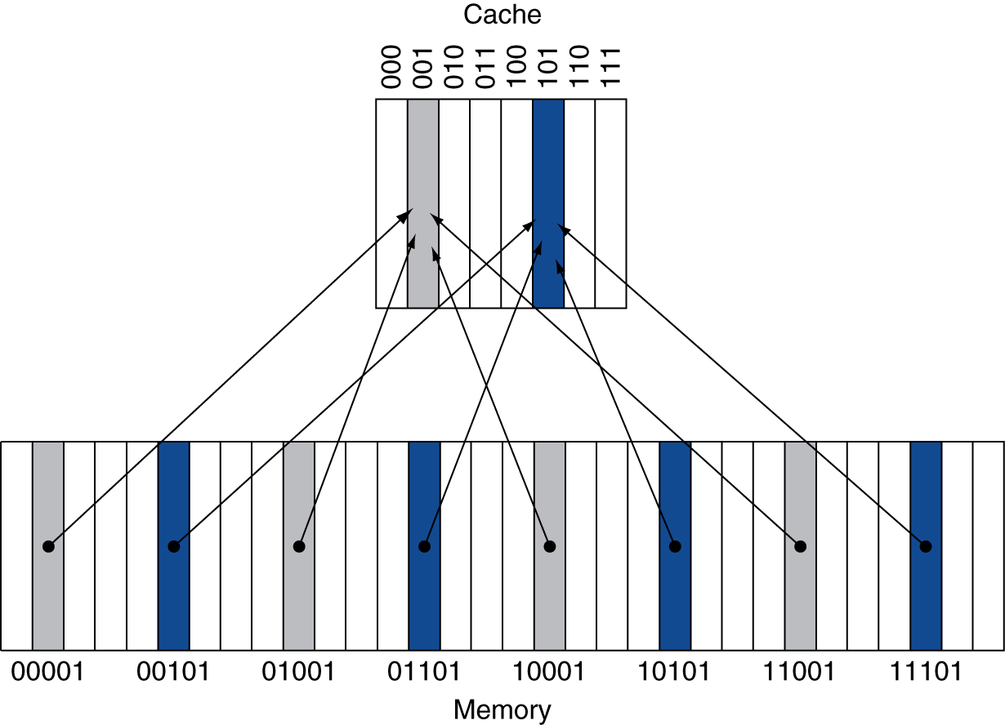
Direct Mapped Cache
Location determined by address
Direct mapped: only one choice
(Block address) modulo (#Blocks in cache)
Number of Blocks is a power of 2
How are memory addresses mapped to the cache?
If cache is size 2^{n}, use lowest n address bits as cache address

Slide 10
Tags and Valid Bits
How do we know which particular block is stored in a cache location?
Store block address as well as the data
Are all address bits needed?
Only higher bits not used for the cache location
Called the tag
What if there is no data in a location?
Valid bit: 1 = present, 0 = not present
Initially 0

Slide 11
Cache Example
Memory |  |  |  |  |  |  | Memory
Address |  |  |  |  | Data |  | Address |  |  |  |  | Data
0 | 0 | 0 | 0 | 0 | A |  | 1 | 0 | 0 | 0 | 0 | Q
0 | 0 | 0 | 0 | 1 | B |  | 1 | 0 | 0 | 0 | 1 | R
0 | 0 | 0 | 1 | 0 | C |  | 1 | 0 | 0 | 1 | 0 | S
0 | 0 | 0 | 1 | 1 | D |  | 1 | 0 | 0 | 1 | 1 | T
0 | 0 | 1 | 0 | 0 | E |  | 1 | 0 | 1 | 0 | 0 | U
0 | 0 | 1 | 0 | 1 | F |  | 1 | 0 | 1 | 0 | 1 | V
0 | 0 | 1 | 1 | 0 | G |  | 1 | 0 | 1 | 1 | 0 | W
0 | 0 | 1 | 1 | 1 | H |  | 1 | 0 | 1 | 1 | 1 | X
0 | 1 | 0 | 0 | 0 | I |  | 1 | 1 | 0 | 0 | 0 | Y
0 | 1 | 0 | 0 | 1 | J |  | 1 | 1 | 0 | 0 | 1 | Z
0 | 1 | 0 | 1 | 0 | K |  | 1 | 1 | 0 | 1 | 0 | AA
0 | 1 | 0 | 1 | 1 | L |  | 1 | 1 | 0 | 1 | 1 | BB
0 | 1 | 1 | 0 | 0 | M |  | 1 | 1 | 1 | 0 | 0 | CC
0 | 1 | 1 | 0 | 1 | N |  | 1 | 1 | 1 | 0 | 1 | DD
0 | 1 | 1 | 1 | 0 | O |  | 1 | 1 | 1 | 1 | 0 | EE
0 | 1 | 1 | 1 | 1 | P |  | 1 | 1 | 1 | 1 | 1 | FF
Memory size 32 words, cache size 8 blocks, 1 word per block, direct mapped
Initial state
Tag size?
Cache
Index |  |  | Valid | Tag | Data
0 | 0 | 0 | N
0 | 0 | 1 | N
0 | 1 | 0 | N
0 | 1 | 1 | N
1 | 0 | 0 | N
1 | 0 | 1 | N
1 | 1 | 0 | N
1 | 1 | 1 | N

Slide 12
Cache Example
Memory |  |  |  |  |  |  | Memory
Address |  |  |  |  | Data |  | Address |  |  |  |  | Data
0 | 0 | 0 | 0 | 0 | A |  | 1 | 0 | 0 | 0 | 0 | Q
0 | 0 | 0 | 0 | 1 | B |  | 1 | 0 | 0 | 0 | 1 | R
0 | 0 | 0 | 1 | 0 | C |  | 1 | 0 | 0 | 1 | 0 | S
0 | 0 | 0 | 1 | 1 | D |  | 1 | 0 | 0 | 1 | 1 | T
0 | 0 | 1 | 0 | 0 | E |  | 1 | 0 | 1 | 0 | 0 | U
0 | 0 | 1 | 0 | 1 | F |  | 1 | 0 | 1 | 0 | 1 | V
0 | 0 | 1 | 1 | 0 | G |  | 1 | 0 | 1 | 1 | 0 | W
0 | 0 | 1 | 1 | 1 | H |  | 1 | 0 | 1 | 1 | 1 | X
0 | 1 | 0 | 0 | 0 | I |  | 1 | 1 | 0 | 0 | 0 | Y
0 | 1 | 0 | 0 | 1 | J |  | 1 | 1 | 0 | 0 | 1 | Z
0 | 1 | 0 | 1 | 0 | K |  | 1 | 1 | 0 | 1 | 0 | AA
0 | 1 | 0 | 1 | 1 | L |  | 1 | 1 | 0 | 1 | 1 | BB
0 | 1 | 1 | 0 | 0 | M |  | 1 | 1 | 1 | 0 | 0 | CC
0 | 1 | 1 | 0 | 1 | N |  | 1 | 1 | 1 | 0 | 1 | DD
0 | 1 | 1 | 1 | 0 | O |  | 1 | 1 | 1 | 1 | 0 | EE
0 | 1 | 1 | 1 | 1 | P |  | 1 | 1 | 1 | 1 | 1 | FF
Memory Accesses
Address |  |  |  |  | Hit/ Miss | Cache Block
0 | 1 | 1 | 1 | 0
1 | 0 | 1 | 1 | 0
1 | 1 | 0 | 0 | 1
1 | 1 | 1 | 1 | 0
0 | 0 | 1 | 1 | 0
0 | 1 | 1 | 0 | 1
0 | 1 | 1 | 0 | 1
Cache
Index |  |  | Valid | Tag | Data
0 | 0 | 0 | N
0 | 0 | 1 | N
0 | 1 | 0 | N
0 | 1 | 1 | N
1 | 0 | 0 | N
1 | 0 | 1 | N
1 | 1 | 0 | N
1 | 1 | 1 | N

Slide 13
Byte offset
If using byte addressing with word size of 4 bytes and one word per cache line (block size of one word) lowest 2 bits of address will not be used for the cache index
Because address changes in those bits will not effect the index location
x86 uses byte addressing
LC3?
For block sizes of multiple words more of the lowest address bits will be unused
4 word / 16 byte cache blocks = 4 unused bits
8 word / 32 byte cache blocks = 5 unused bits
Etc.

Slide 14
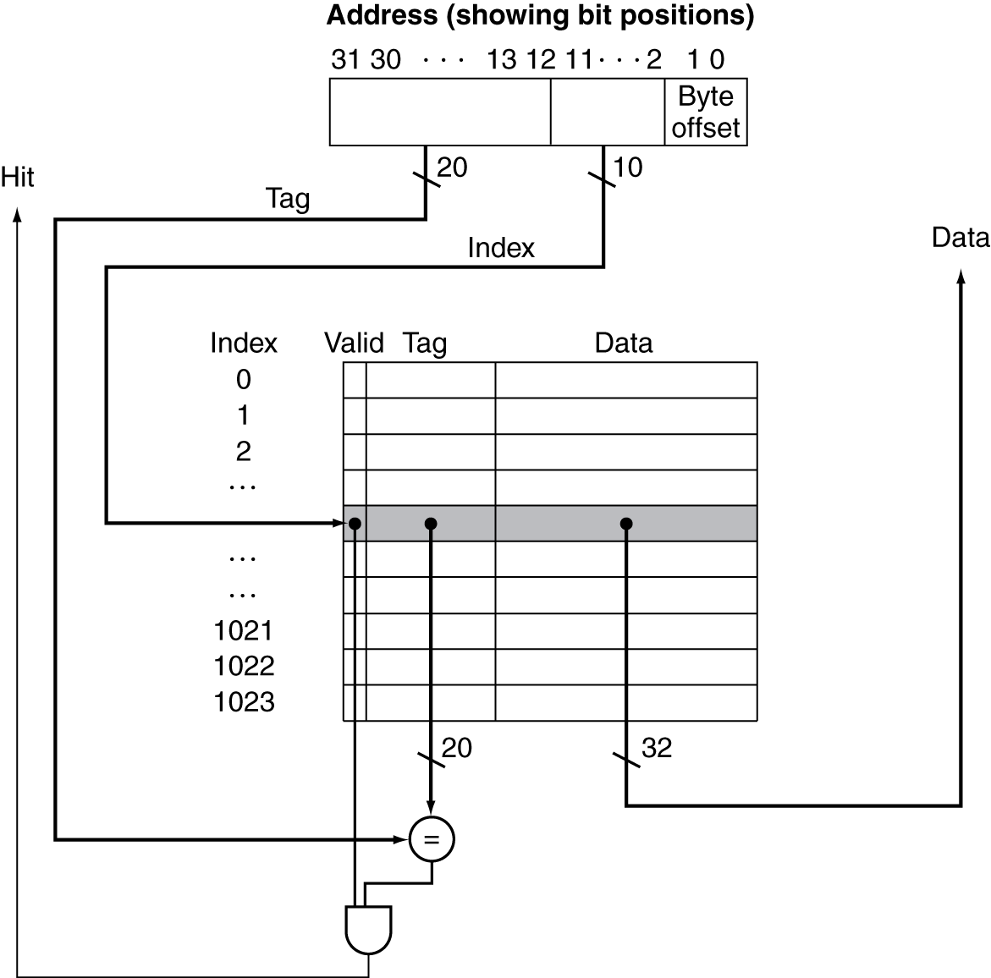
Address Subdivision
Why does the Tag need to be 20 bits
How many bytes fit in a cache line based on this offset

Slide 15
Example: Larger Block Size
64 blocks, 16 bytes/block, 32 bit addresses
To what block number does address 1200 map?
Block address = ⎣1200/16⎦ = 75
Block number = 75 modulo 64 = 11
Tag, Index, and Offset size?
31
10
9
4
3
0
Tag
Index
Offset
22 bits
6 bits
4 bits
Address = 1200 = 0b0000’0000’0000’0000’0000’0100’1011’0000

Slide 16
Explanation
Address = 1200 = 0b0000’0000’0000’0000’0000’0100’1011’0000
Byte addressing so each block covers 16 addresses
16 addresses represented by 4 bits
Remove lower 4 bits from 0b…10010110000
0b…1001011 = 75 = block address
Next 6 bytes are the index
0b001011 = 11 = cache block number
Remaining bits are the tag
0b00000000000000000000001 = tag

Slide 17
Chris Terman. 6.004 Computation Structures. Spring 2017. Massachusetts Institute of Technology:
MIT OpenCourseWare, https://ocw.mit.edu. License: Creative Commons BY-NC-SA.

Slide 18
Chris Terman. 6.004 Computation Structures. Spring 2017. Massachusetts Institute of Technology:
MIT OpenCourseWare, https://ocw.mit.edu. License: Creative Commons BY-NC-SA.

Slide 19
Chris Terman. 6.004 Computation Structures. Spring 2017. Massachusetts Institute of Technology:
MIT OpenCourseWare, https://ocw.mit.edu. License: Creative Commons BY-NC-SA.

Slide 20
Associative Caches
Fully associative
Allow a given block to go in any cache entry
Requires all entries to be searched at once
Comparator per entry (expensive)
n-way set associative
Each set contains n entries
Block number determines which set
(Block number) modulo (#Sets in cache)
Search all entries in a given set at once
n comparators (less expensive)

Slide 21
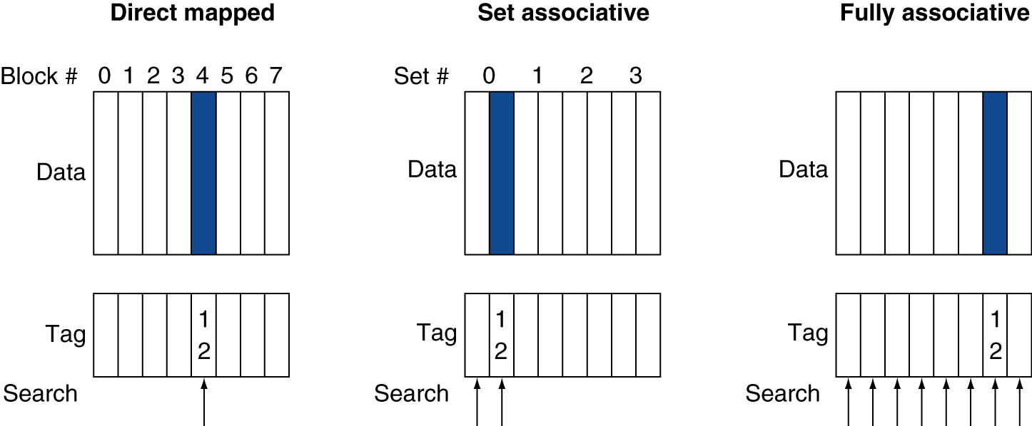
Associative Cache Example

Slide 22
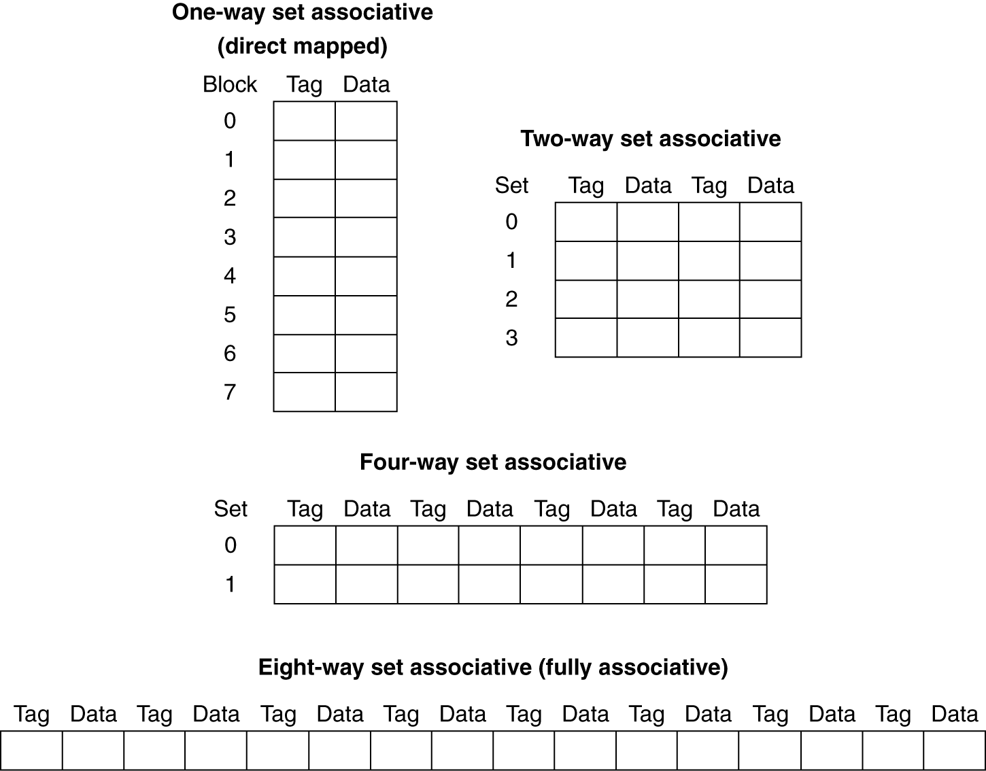
Spectrum of Associativity
For a cache with 8 entries

Slide 23
Associativity Example
Compare 4-block caches
Direct mapped, 2-way set associative, fully associative
Block access sequence: 0, 8, 0, 6, 8
Direct mapped
Cache index = lower 2 bits of address / mod by 4
Block address | Cache index | Hit/miss | Cache content after access
 |  |  | 0 | 1 | 2 | 3
0 | 0 | miss | Mem[0]
8 | 0 | miss | Mem[8]
0 | 0 | miss | Mem[0]
6 | 2 | miss | Mem[0] |  | Mem[6]
8 | 0 | miss | Mem[8] |  | Mem[6]

Slide 24
Associativity Example
2-way set associative, index = lower 1 bit / mod by 2
Block address | Cache index | Hit/miss | Cache content after access
 |  |  | Set 0 |  | Set 1
0 | 0 | miss | Mem[0]
8 | 0 | miss | Mem[0] | Mem[8]
0 | 0 | hit | Mem[0] | Mem[8]
6 | 0 | miss | Mem[0] | Mem[6]
8 | 0 | miss | Mem[8] | Mem[6]
Fully associative, no index block can be anywhere
Block address |  | Hit/miss | Cache content after access
0 |  | miss | Mem[0]
8 |  | miss | Mem[0] | Mem[8]
0 |  | hit | Mem[0] | Mem[8]
6 |  | miss | Mem[0] | Mem[8] | Mem[6]
8 |  | hit | Mem[0] | Mem[8] | Mem[6]

Slide 25
How Much Associativity
Increased associativity decreases miss rate
But with diminishing returns
Increased associativity increases complexity / hit time
Simulation of a system with 64KB D-cache, 16-word blocks, SPEC2000
1-way: 10.3%
2-way: 8.6%
4-way: 8.3%
8-way: 8.1%

Slide 26
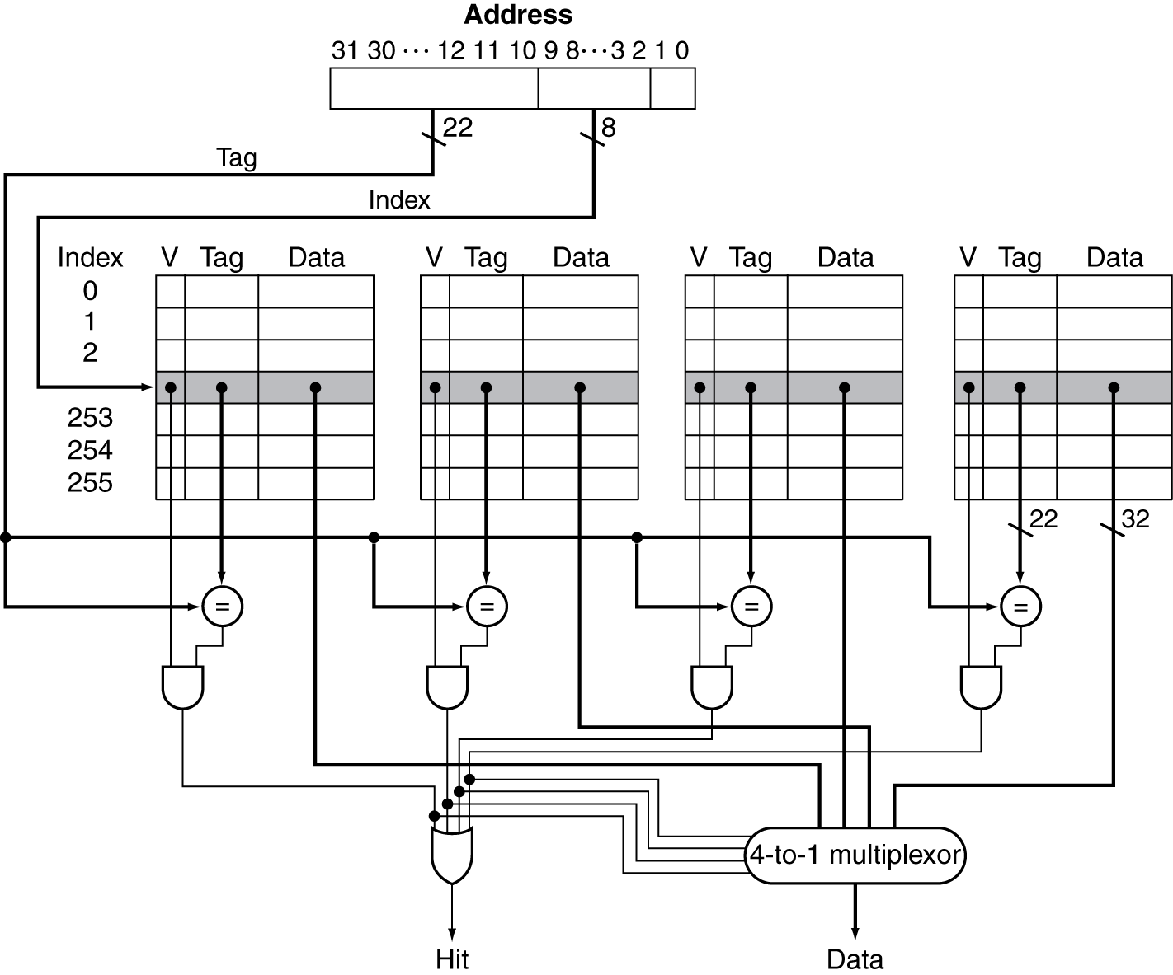
Set Associative Cache Organization
More Tag bits and less Index bits than Direct Mapped, Why?
More Complexity than Direct Mapped

Slide 27
Block Placement
Determined by associativity
Direct mapped (1-way associative)
One choice for placement
n-way set associative
n choices within a set
Fully associative
Any location
Higher associativity reduces miss rate
Increases complexity, cost, and access time

Slide 28
Finding a Block
Associativity | Location method | Tag comparisons
Direct mapped | Index | 1
n-way set associative | Set index, then search entries within the set | n
Fully associative | Search all entries | #entries
 | Full lookup table | 0
Hardware caches
Reduce comparisons to reduce cost

Slide 29
Replacement Policy
Direct mapped: no choice
Set associative
Prefer non-valid entry, if there is one
Otherwise, choose among entries in the set
Least-recently used (LRU)
Choose the one unused for the longest time
Simple for 2-way, manageable for 4-way, too hard beyond that
Random
Gives approximately the same performance as LRU for high associativity

Slide 30
Handling Writes

Slide 31
Write-Through
On data-write hit, could just update the block in cache
But then cache and memory would be inconsistent
Write through: also update memory
But makes writes take longer
e.g., if base CPI = 1, 10% of instructions are stores, write to memory takes 100 cycles
Effective CPI = 1 + 0.1×100 = 11
Solution: write buffer
Holds data waiting to be written to memory
CPU continues immediately
Only stalls on write if write buffer is already full

Slide 32
Write-Back
Alternative: On data-write hit, just update the block in cache
Keep track of whether each block is dirty
dirty: cache block holds correct data, memory has old data
When a dirty block is replaced
Write it back to memory
Can use a write buffer to allow replacing block to be read first

Slide 33
Write Allocation
What should happen on a write miss?
Alternatives for write-through
Allocate on miss: fetch the block, then update cache and memory
Write around: don’t fetch the block, just update memory
Since programs often write a whole block before reading it (e.g., initialization)
For write-back
Usually fetch the block, then update block in cache

Slide 34
Multilevel Caches
Primary cache attached to CPU
Small, but fast
Level-2 cache services misses from primary cache
Larger, slower, but still faster than main memory
Main memory services L-2 cache misses
Some high-end systems include L-3 cache

Slide 35
Multilevel Cache Example
Given
CPU base CPI = 1, clock rate = 4GHz
Miss rate/instruction = 2%
Main memory access time = 100ns
With just primary cache
Miss penalty = 100ns/0.25ns = 400 cycles
Effective CPI = 1 + 0.02 × 400 = 9

Slide 36
Example (cont.)
Now add L-2 cache
Access time = 5ns
Global miss rate to main memory = 0.5%
Primary miss with L-2 hit
Penalty = 5ns/0.25ns = 20 cycles
Primary miss with L-2 miss
Extra penalty = 500 cycles
CPI = 1 + 0.02 × 20 + 0.005 × 400 = 3.4
Performance ratio = 9/3.4 = 2.6

Slide 37
Multilevel Cache Considerations
Primary cache
Focus on minimal hit time
L-2 cache
Focus on low miss rate to avoid main memory access
Hit time has less overall impact
Results
L-1 cache usually smaller than a single cache
L-1 block size smaller than L-2 block size

Slide 38
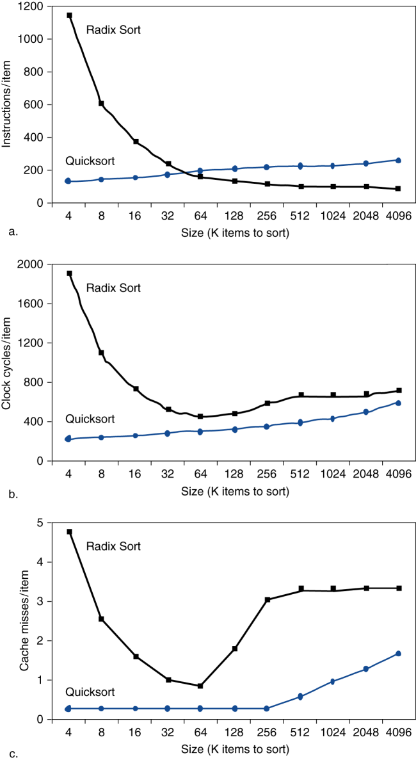
Interactions with Software
Misses depend on memory access patterns
Algorithm behavior
Compiler optimization for memory access

Slide 39
Sources of Misses
Compulsory misses (aka cold start misses)
First access to a block
Capacity misses
Due to finite cache size
A replaced block is later accessed again
Conflict misses (aka collision misses)
In a non-fully associative cache
Due to competition for entries in a set
Would not occur in a fully associative cache of the same total size

Slide 40
Cache Design Trade-offs
Design change | Effect on miss rate | Negative performance effect
Increase cache size | Decrease capacity misses | May increase access time
Increase associativity | Decrease conflict misses | May increase access time
Increase block size | Decrease compulsory misses | Increases miss penalty. For very large block size, may increase miss rate due to pollution.

Slide 41
Concluding Remarks
Fast memories are small, large memories are slow
We really want fast, large memories ☹
Caching gives this illusion ☺
Principle of locality
Programs use a small part of their memory space frequently
Memory hierarchy
L1 cache ↔ L2 cache ↔ … ↔ DRAM memory ↔ disk
Memory system design is critical for multiprocessors
§5.16 Concluding Remarks

