Slide 1
Chapter 9 TRAP Routines and Subroutines

Slide 2
System Calls
Certain operations require specialized knowledge and protection:
Specific knowledge of I/O device registers and the sequence of operations needed to use them
I/O resources shared among multiple users/programs; a mistake could affect lots of other users!
Not every programmer knows (or wants to know) this level of detail
Provide service routines or system calls (part of operating system) to safely and conveniently perform low-level, privileged operations
Linux examples: open(), rmdir(), socket(), mmap()
http://man7.org/linux/man-pages/man2/syscalls.2.html
Notes:
You will learn more about this in 370, but in modern hardware and operating systems the OS kernel has high privilges than user programs and so certain activities must be performed by calling kernel functions

Slide 3
System Call
1. User program invokes system call.
2. Operating system code performs operation.
3. Returns control to user program.
In LC-3, this is done through the TRAP mechanism.

Slide 4
LC-3 TRAP Mechanism
1. A set of service routines.
part of operating system -- routines start at arbitrary addresses (convention is that system code is below x3000)
up to 256 routines
2. Table of starting addresses.
stored at x0000 through x00FF in memory
called System Control Block in some architectures
3. TRAP instruction.
used by program to transfer control to operating system
8-bit trap vector names one of the 256 service routines
4. A linkage back to the user program.
execution should resume immediately after the TRAP instruction
Notes:
The 8 bit trap vector is a location in memory x00 – xFF the value at this location is the address of the system call being called by the TRAP

Slide 5
TRAP Instruction
Trap vector
identifies which system call to invoke
8-bit index into table of service routine addresses
in LC-3, this table is stored in memory at 0x0000 – 0x00FF
8-bit trap vector is zero-extended into 16-bit memory address
Where to go
lookup starting address from table; place in PC
How to get back
save address of next instruction (current PC) in R7
Notes:
Store the current PC then generate an address to load into the PC. First generate a memory address by zero extending the TRAP vector, then get the value at that location in memory and load it into the PC

Slide 6
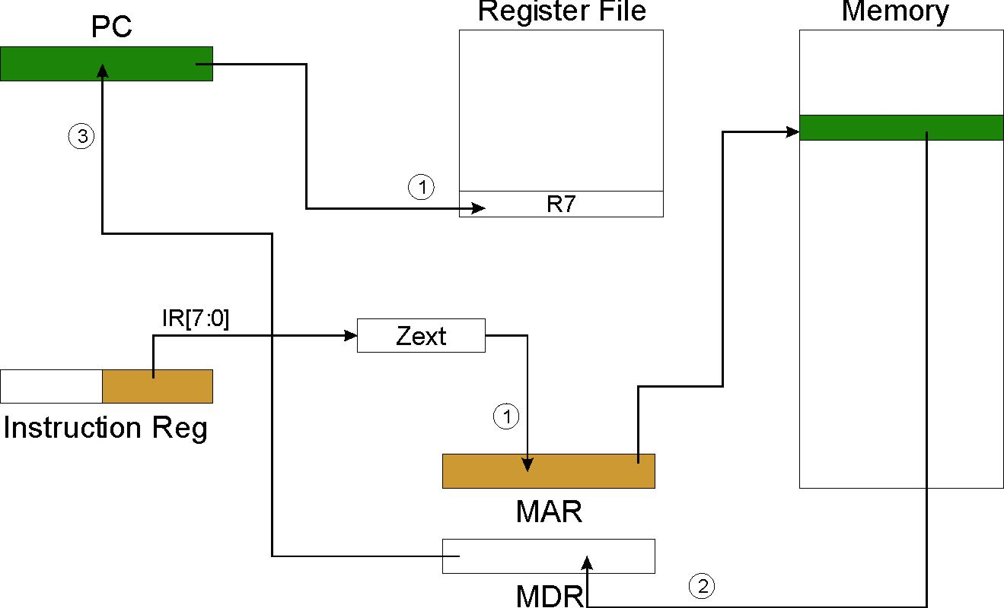
TRAP
NOTE: PC has already been incremented during instruction fetch stage.

Slide 7
RET (JMP R7)
How do we transfer control back to instruction following the TRAP?
We saved old PC in R7.
JMP R7 gets us back to the user program at the right spot.
LC-3 assembly language lets us use RET (return) in place of “JMP R7”.
Must make sure that service routine does not change R7, or we won’t know where to return.
15 14 13 12 11 10 9 8 7 6 5 4 3 2 1 0
RET 1 1 0 0 0 0 0 1 1 1 0 0 0 0 0 0
R7

Slide 8
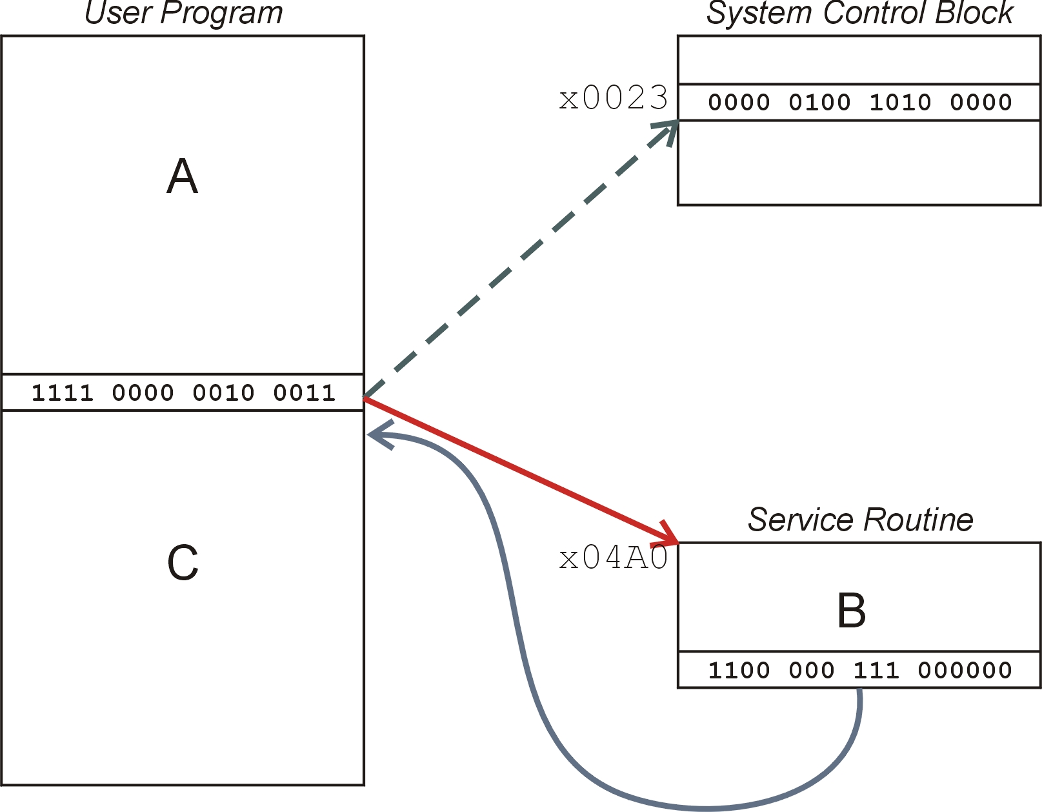
TRAP Mechanism Operation
Lookup starting address.
Transfer to service routine.
Return (JMP R7).

Slide 9
Example: Using the TRAP Instruction
.ORIG x3000
LD R2, TERM ; Load negative ASCII ‘7’ LD R3, ASCII ; Load ASCII difference AGAIN TRAP x23 ; input character ADD R1, R2, R0 ; Test for terminate BRz EXIT ; Exit if done ADD R0, R0, R3 ; Change to lowercase TRAP x21 ; Output to monitor... BRnzp AGAIN ; ... again and again... TERM .FILL xFFC9 ; -‘7’ ASCII .FILL x0020 ; lowercase bit EXIT TRAP x25 ; halt .END

Slide 10
Example: Output Service Routine
.ORIG x0430 ; syscall address ST R7, SaveR7 ; save R7 & R1 ST R1, SaveR1 ; ----- Write character TryWrite LDI R1, CRTSR ; get status BRzp TryWrite ; look for bit 15 on WriteIt STI R0, CRTDR ; write char ; ----- Return from TRAP Return LD R1, SaveR1 ; restore R1 & R7 LD R7, SaveR7 RET ; back to user CRTSR .FILL xF3FC CRTDR .FILL xF3FF SaveR1 .FILL 0 SaveR7 .FILL 0 .END
stored in table, location x21

Slide 11
TRAP Routines and their Assembler Names
vector | symbol | routine
x20 | GETC | read a single character (no echo)
x21 | OUT | output a character to the monitor
x22 | PUTS | write a string to the console
x23 | IN | print prompt to console, read and echo character from keyboard
x25 | HALT | halt the program

Slide 12
Saving and Restoring Registers
Must save the value of a register if:
Its value will be destroyed by service routine, and
We will need to use the value after that action.
Who saves?
caller of service routine?
knows what it needs later, but may not know what gets altered by called routine
called service routine?
knows what it alters, but does not know what will be needed later by calling routine

Slide 13
Example
LEA R3, Binary LD R6, ASCII ; char->digit template LD R7, COUNT ; initialize to 10 AGAIN TRAP x23 ; Get char ADD R0, R0, R6 ; convert to number STR R0, R3, #0 ; store number ADD R3, R3, #1 ; incr pointer ADD R7, R7, -1 ; decr counter BRp AGAIN ; more? BRnzp NEXT ASCII .FILL xFFD0 COUNT .FILL #10 Binary .BLKW #10
What’s wrong with this routine? What happens to R7?

Slide 14
Saving and Restoring Registers
Called routine -- “callee-save”
Before start, save any registers that will be altered (unless altered value is desired by calling program!)
Before return, restore those same registers
Calling routine -- “caller-save”
Save registers destroyed by own instructions or by called routines (if known), if values needed later
save R7 before TRAP
save R0 before TRAP x23 (input character)
Or avoid using those registers altogether
Values are saved by storing them in memory.

Slide 15
Question
Can a service routine call another service routine?
Yes
If so, is there anything special the calling service routine must do?
Save R7 before call and restore R7 after called service routine returns so calling routine can return to the correct address

Slide 16
What about User Code?
Service routines provide three main functions:
1. Shield programmers from system-specific details.
2. Write frequently-used code just once.
3. Protect system resources from malicious/clumsy programmers.
Are there any reasons to provide the same functions for non-system (user) code?
Yes
Reuse code
Split up work between programmers
Raise the level of abstraction
Increase readability

Slide 17
Subroutines
A subroutine is a program fragment that:
lives in user space
performs a well-defined task
is invoked (called) by another user program
returns control to the calling program when finished
Like a service routine, but not part of the OS
not concerned with protecting hardware resources
no special privilege required
Reasons for subroutines:
reuse useful (and debugged!) code without having to keep typing it in
divide task among multiple programmers
use vendor-supplied library of useful routines

Slide 18
JSR Instruction
Jumps to a location (like a branch but unconditional), and saves current PC (addr of next instruction) in R7.
saving the return address is called “linking”
target address is PC-relative (PC + Sext(IR[10:0]))
bit 11 specifies addressing mode
if =1, PC-relative: target address = PC + Sext(IR[10:0])
if =0, register: target address = contents of register IR[8:6]

Slide 19
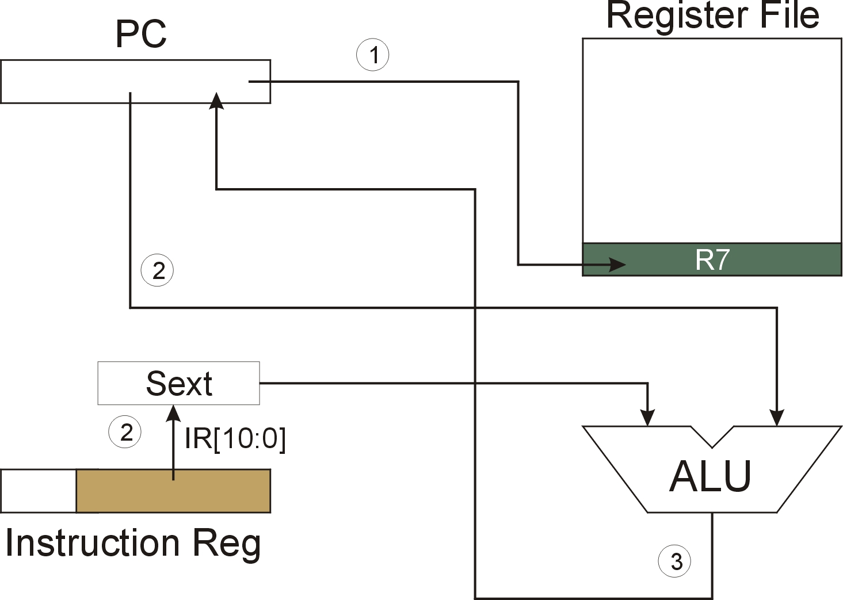
JSR
NOTE: PC has already been incremented during instruction fetch stage.

Slide 20
JSRR Instruction
Just like JSR, except Register addressing mode.
target address is Base Register
bit 11 specifies addressing mode
What important feature does JSRR provide that JSR does not?

Slide 21
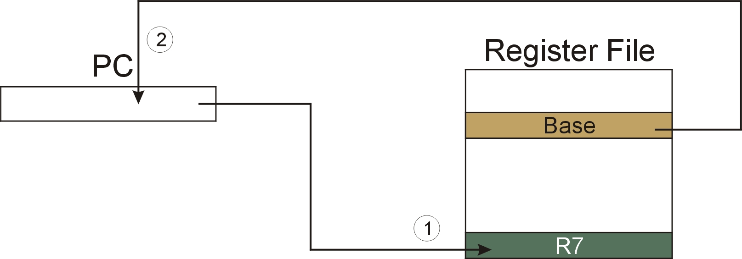
JSRR
NOTE: PC has already been incremented during instruction fetch stage.

Slide 22
Returning from a Subroutine
15 14 13 12 11 10 9 8 7 6 5 4 3 2 1 0
RET 1 1 0 0 0 0 0 1 1 1 0 0 0 0 0 0
R7
RET (JMP R7) gets us back to the calling routine.
just like TRAP

Slide 23
Example: Negate the value in R0
2sComp NOT R0, R0 ; flip bits ADD R0, R0, #1 ; add one RET ; return to caller
To call from a program (within 1024 instructions):
; need to compute R4 = R1 - R3 ADD R0, R3, #0 ; copy R3 to R0 JSR 2sComp ; negate ADD R4, R1, R0 ; add to R1 ...
Note: Caller should save R0 if we’ll need it later!

Slide 24
Passing Information to/from Subroutines
Arguments
A value passed in to a subroutine is called an argument.
This is a value needed by the subroutine to do its job.
Examples:
In 2sComp routine, R0 is the number to be negated
In OUT service routine, R0 is the character to be printed.
In PUTS routine, R0 is address of string to be printed.
Return Values
A value passed out of a subroutine is called a return value.
This is the value that you called the subroutine to compute.
Examples:
In 2sComp routine, negated value is returned in R0.
In GETC service routine, character read from the keyboard is returned in R0.

Slide 25
Using Subroutines
In order to use a subroutine, a programmer must know:
its address (or at least a label that will be bound to its address)
its function (what does it do?)
NOTE: The programmer does not need to know how the subroutine works, but what changes are visible in the machine’s state after the routine has run.
its arguments (where to pass data in, if any)
its return values (where to get computed data, if any)

Slide 26
Saving and Restore Registers
Generally use “callee-save” strategy, except for return values.
Save all registers that the subroutine will alter internally that shouldn’t be visible when the subroutine returns.
i.e. if R0 is used to return data it’s initial value does not need to be saved by callee.
Caller needs to save R0 value in this case, callee will save the rest of the registers.
If caller needs to return to function that called it, it must also save R7.
Remember: You MUST save R7 if you call any other subroutine or service routine (TRAP).
Otherwise, you won’t be able to return to caller.

Slide 27
Example
Write a subroutine FirstChar to:
find the first occurrence of a particular character (in R0) in a string (pointed to by R1); return pointer to the character or to end of string (NULL) in R2.
(2) Use FirstChar to write CountChar, which:
counts the number of occurrences of a particular character (in R0) in a string (pointed to by R1); return count in R2.
Can write the second subroutine first, without knowing the implementation of FirstChar!

Slide 28
CountChar Algorithm (using FirstChar)
save regs
R1 <- R2 + 1
call FirstChar
save R7, since we’re using JSR
R3 <- M(R2)
restore
regs
R3=0
no
return
yes

Slide 29
CountChar Implementation
; CountChar: subroutine to count occurrences of a char CountChar ST R3, CCR3 ; save registers ST R4, CCR4 ST R7, CCR7 ; JSR alters R7 ST R1, CCR1 ; save original string ptr AND R4, R4, #0 ; initialize count to zero
; CC1 JSR FirstChar ; find next occurrence (ptr in R2) LDR R3, R2, #0 ; see if char or null BRz CC2 ; if null, no more chars ADD R4, R4, #1 ; increment count ADD R1, R2, #1 ; point to next char in string
BRnzp CC1
; CC2 ADD R2, R4, #0 ; move return val (count) to R2 LD R3, CCR3 ; restore regs LD R4, CCR4 LD R1, CCR1 LD R7, CCR7 RET ; and return

Slide 30
FirstChar Algorithm
R3=R0
save regs
yes
R2 <- R1
no
R2 <- R2 + 1
R3 <- M(R2)
restore
regs
R3=0
no
return
yes

Slide 31
FirstChar Implementation
; FirstChar: subroutine to find first occurrence of a char FirstChar ST R3, FCR3 ; save registers ST R4, FCR4 ; save original char NOT R4, R0 ; negate R0 for comparisons ADD R4, R4, #1 ADD R2, R1, #0 ; initialize ptr to beginning of string
; FC1 LDR R3, R2, #0 ; read character BRz FC2 ; if null, we’re done ADD R3, R3, R4 ; see if matches input char BRz FC2 ; if yes, we’re done ADD R2, R2, #1 ; increment pointer BRnzp FC1
; FC2 LD R3, FCR3 ; restore registers LD R4, FCR4 ; RET ; and return

Slide 32
Library Routines
Vendor may provide object files containing useful subroutines
don’t want to provide source code -- intellectual property
assembler/linker must support EXTERNAL symbols (or starting address of routine must be supplied to user)
... .EXTERNAL SQRT
... LD R2, SQAddr ; load SQRT addr JSRR R2 ... SQAddr .FILL SQRT
Using JSRR, because we don’t know whether SQRT is within 1024 instructions.
Notes:
SQRT replaced by the linker with the address of the square root function in the separate library

