Slide 1
Peer Instruction #6:
LC-3 Assembly Language
(continued)
Notes:
CS160 - Intro
1
CS160 - Intro
1
This is the first peer instruction session!

Slide 2
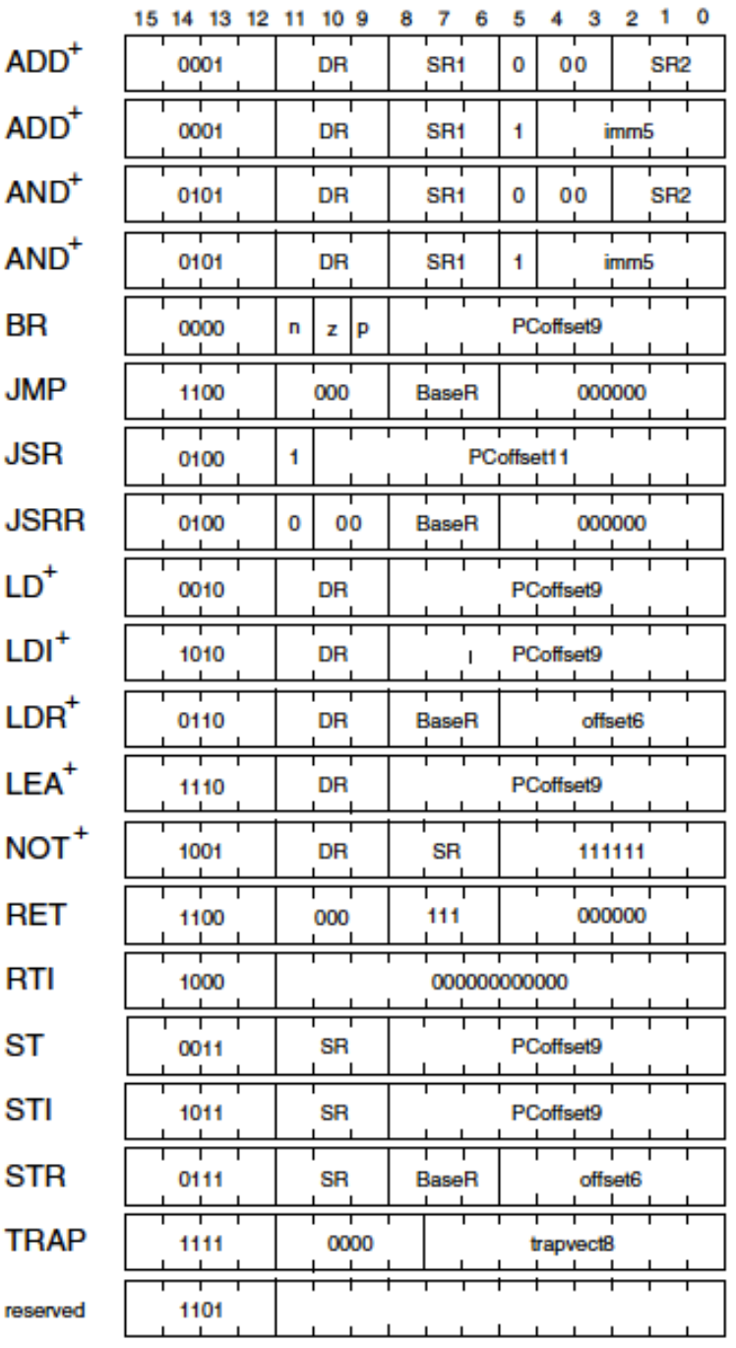
Translate the LC-3 instruction 0x4840 into LC-3 assembly code:
JSR Label (Label at PC + 0x3F)
JSR Label (Label at PC + 0x40)
JSRR R3
JSRR R1
None of the above
Notes:
CS160 - Intro
2
Answer is B), but remember the PC has already been incremented. JSRR R1 would be 0x4040.

Slide 3
Translate the LC-3 instruction 0xC1C0 into LC-3 assembly code:
JMP R7
RET
Both of the above
None of the above
Notes:
CS160 - Intro
3
Answer is C), RET and JMP R7 are exactly the same.

Slide 4
Translate ADD R0,R1,x10 from assembly code into an LC-3 instruction in hexadecimal:
0x1040
0x106F
0x1070
0x107F
Cannot be done!
Notes:
CS160 - Intro
4
Answer is E) x10 = 16 decimal, cannot fit into 5-bits in 2’s complement format, only stores -16 to 15.

Slide 5
DATA .FILL 0x1234
LD R5,DATA
AND R5,R5,#15
NOT R5,R5
What value is in R5 after the above code?
0x123F
0xEDCB
0xFFFB
0xFFFC
None of the above
Notes:
CS160 - Intro
5
Answer is C), ~(0x1234 & 0x000F) = 0xFFFB

Slide 6
.ORIG x3000
AND,R1,R1,#0
ADD R1,R0,#1
BRp MAIN
Is the branch taken in the above code?
Yes
No
Depends on initial value of R0
Depends on initial value of R1
None of the above
Notes:
CS160 - Intro
6
Answer is C), branch depends on R1, don’t know if R1 positive unless R0 is known, since R1 = R0 + 1

Slide 7
Which instruction branches to Main if R0 is less than or equal to 12?
Twelve .FILL x000C
Main LD R1,Twelve
NOT R1,R1
ADD R1,R1,1
ADD R0,R0,R1
??? Main
BRn
BRz
BRp
BRnz
BRzp
Notes:
CS160 - Intro
7
Answer is D), Condition codes set by R0 – 12, so negative if R0 < 12 and zero if R0 == 12.

Slide 8
What is the value in R0, and the instruction associated with the LOOP label when the program reaches the HALT command?
AND R0, R0, #0
ADD R1, R0, #2
LOOP ADD R0, R0, #3
LD R2, LOOP
ADD R2, R2, #2
ST R2, LOOP
ADD R1, R1, #-1
BRp LOOP
HALT
5, ADD R0, R0, #3
8, ADD R0, R0, #7
3, ADD R0, R0, #5
7, AND R0, R0, #7
None of the above
Notes:
CS160 - Intro
8
Answer is B) ADD R0, R0, #3 is treated as both an instruction and data by the code, so ADD R2, R2, #2 instruction increments the offset to 7. R0 goes from 0 to 3 to 8

Slide 9
What are the values in R0,R1,R2 after the code below executes? Assume the Main label is at address x3000.
Main LD R0,Data
LEA R1,Data
LDR R2,R1,0
HALT
Data .FILL 0x4321
x4321, x3003, x7324
x4321, x3004, x7324
x4321, x3003, x4321
x4321, x3004, x4321
None of the above
Notes:
CS160 - Intro
9
Answer is D) LD just loads data value (x4321), LEA gets data address (x3003), LDR gets data pointed at by R1, which is data again (x4321)

Slide 10
What is the value in R0 and R1 after the code executes from Main label?
Array .FILL x1133
.FILL x2244
.FILL x3355
Main NOT R1,R1
LEA R2,Array
LDR R0,R2,2
LDR R1,R2,3
HALT
x1133, x2244
x2244, x3355
x3355, x903F
x3355, x927F
None of the above
Notes:
CS160 - Intro
10
Answer is D), offset of 2 from R2 gives Array[2], offset of 3 gives NOT R1,R1, which is x927F.

Slide 11
What is the PC offset field in the ST instruction shown below?
Data0 .FILL x1234
Data1 .FILL x2345
Data2 .BLKW 1
Main LD R1,Data0
LD R2, Data1
ADD R3,R2,R1
ST R3,Data2
0b111111011
0b111111100
0b111111101
0b100000100
0b100000101
Notes:
CS160 - Intro
11

Slide 12
Match the LD R0, Var assembly instruction to the corresponding C statement
LC3 Assembly Code:
.ORIG x3000
var .FILL x0004
ptr .FILL x3000
LD R0, var
R0 = var;
R0 = &var;
R0 = *ptr;
None of the above
All of the above
C Code:
int var = 4;
int *ptr = &var;
int R0;
// what goes here?
Notes:
CS160 - Intro
12

Slide 13
Match the LEA R0, Var assembly instruction to the corresponding C statement
LC3 Assembly Code:
.ORIG x3000
var .FILL x0004
ptr .FILL x3000
LEA R0, var
R0 = var;
R0 = &var;
R0 = *ptr;
None of the above
All of the above
C Code:
int var = 4;
int *ptr = &var;
int R0;
// what goes here?
Notes:
CS160 - Intro
13

Slide 14
Match the LDI R0, Ptr assembly instruction to the corresponding C statement
LC3 Assembly Code:
.ORIG x3000
var .FILL x0004
ptr .FILL x3000
LDI R0, ptr
R0 = var;
R0 = &var;
R0 = *ptr;
None of the above
All of the above
C Code:
int var = 4;
int *ptr = &var;
int R0;
// what goes here?
Notes:
CS160 - Intro
14

Slide 15
Match the LD R1, PTR and LDR R0, R1, #0 assembly instructions to the corresponding C statement
LC3 Assembly Code:
.ORIG x3000
var .FILL x0004
ptr .FILL x3000
LD R1, ptr
LDR R0, R1, #0
R0 = var;
R0 = &var;
R0 = *ptr;
None of the above
All of the above
C Code:
int var = 4;
int *ptr = &var;
int R0, R1;
// what goes here?
Notes:
CS160 - Intro
15

