Slide 1
Peer Instruction #9:
Memory and State Machines
Notes:
CS160 - Intro
1
CS160 - Intro
1
This is the first peer instruction session!

Slide 2
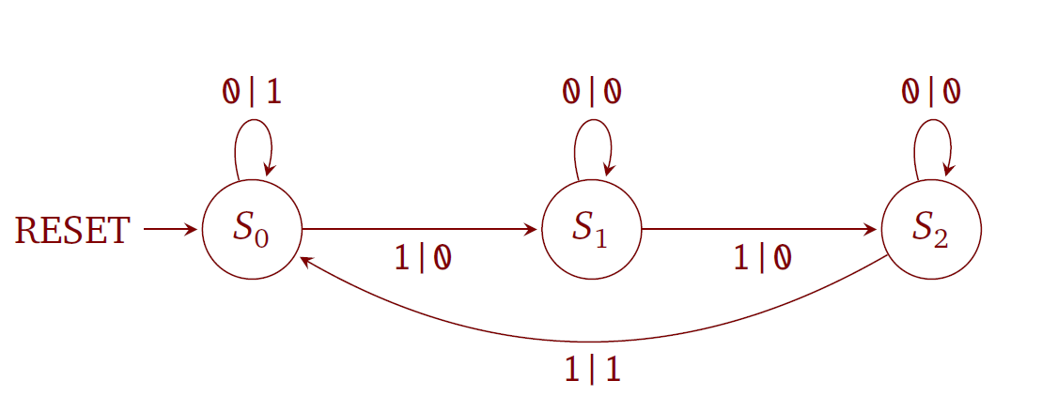
After RESET, which state will the machine shown below end up in if the inputs are 1, 0, 1, 1, 1, 0, 1
S₀
S₁
S₂
None of the above
Notes:
CS160 - Intro
2
Answer is C), RESET to S0, 1 to S1, 0 to S1, 1 to S2, 1 to S0 (Output 1), 1 to S1, 0 to S1, 1 to S2

Slide 3
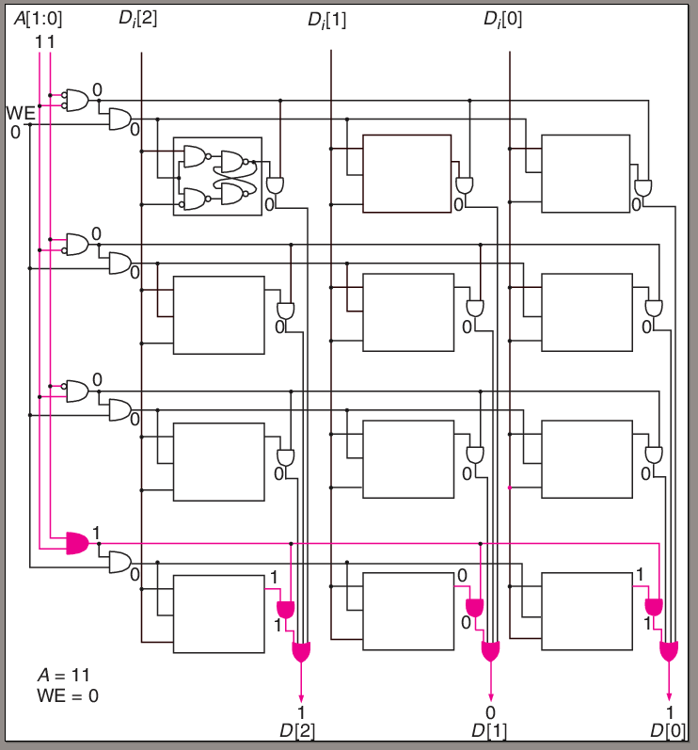
What is the address space and addressability of the memory shown, and what is the circuit doing?
2², 3-bits, writing memory location 00
2³, 4-bits, writing memory location 11
2³, 4-bits, reading memory location 00
2², 3-bits, reading memory location 11
None of the above
Notes:
CS160 - Intro
3
Answer is D), 2 address lines = 4 locations is the address space, each location has 3-bits, reading address 11

Slide 4
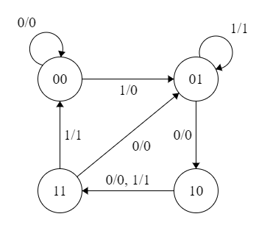
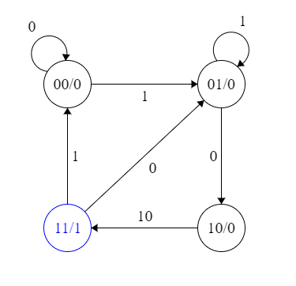
What type of state machine is depicted in figures A and B?
A
B
A:Moore, B:Mealy
A:Mealy, B:Moore
A:Mealy, B:Mealy
A:Moore, B:Moore
None of the above
Notes:
CS160 - Intro
4
Answer is B) Mealy has output associated with a transition, Moore output associated with a state

Slide 5
What rows of the state table have incorrect values for Out, S1’ and S2’
Row | In | S1 | S0 | Out | S1’ | S0’
1 | 0 | 0 | 0 | 1 | 0 | 1
2 | 0 | 0 | 1 | 0 | 1 | 0
3 | 0 | 1 | 0 | 0 | 1 | 1
4 | 0 | 1 | 1 | 0 | 0 | 1
5 | 1 | 0 | 0 | 0 | 1 | 0
6 | 1 | 0 | 1 | 1 | 0 | 1
7 | 1 | 1 | 0 | 1 | 1 | 1
8 | 1 | 1 | 1 | 1 | 1 | 0
1,2,5
2,4,5
3,5,6
1,5,8
None of the above
Notes:
CS160 - Intro
5
Answer is D) by looking at the diagram you can see lines 1, 4, and 7 are incorrect

Slide 6
What is an advantage of a D latch vs an RS latch
D latches take fewer transistors
RS latches are combinational logic and D latches are sequential logic
D latches ensure the inputs that set the latches output value are never 0 at the same time
D latches can be used as storage element in a state machine since the inputs to the latch do not become outputs until the next clock cycle
All of the above
Notes:
CS160 - Intro
6
Answer is C) D latch adds gates to insure S and R are not 0 at the same time

Slide 7
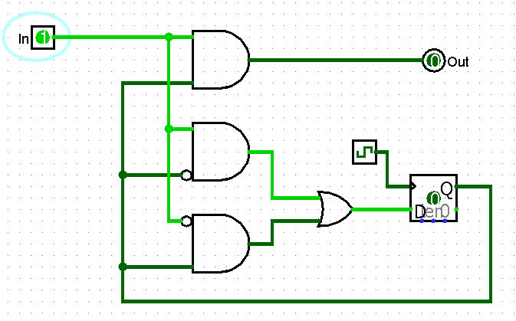
Does the following circuit model a Mealy or Moore state machine
Moore
Mealy
Either
None of the above
Notes:
CS160 - Intro
7
Answer is B) Output is based on state and input

