Slide 1
Midterm 1 Review Peer Instruction
Notes:
CS160 - Intro
1
CS160 - Intro
1

Slide 2
Convert A21 from base 11 to base 10
324
1100
1233
567
None of the above
Notes:
CS160 - Intro
2
Answer is C

Slide 3
Convert 67 from base 10 to base 6
75
100
151
567
None of the above
Notes:
CS160 - Intro
3
Answer is C

Slide 4
What does the C code shown below print to the console?
int i = 12;
int *p = &i;
printf(“%x\n”, *p);
value of i
address of i
value of p
address of p
Will not compile
Notes:
CS160 - Intro
4
Answer is A), just a pointer dereference, explain all the syntax.

Slide 5
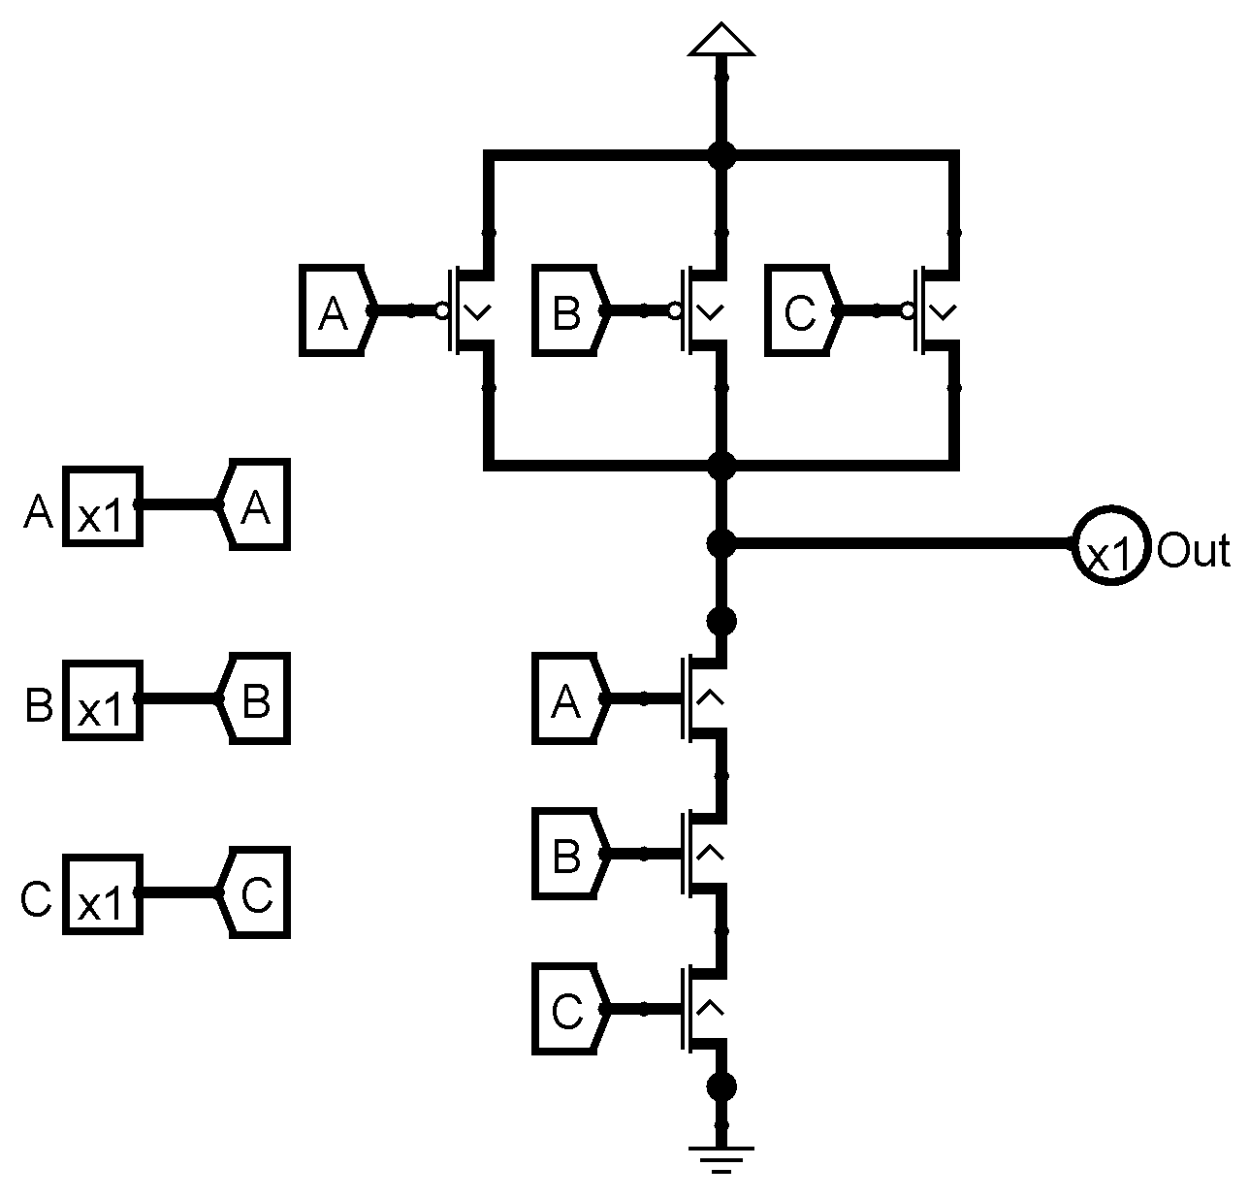
What logical operation does the following circuit implement
OR
NOR
NAND
XOR
None of the above
Notes:
C: NAND

Slide 6
What is the minimum number of bits needed to represent 312 distinct values? How many bit patterns are leftover?
10-bits, 712 patterns unused
9-bits, 200 patterns unused
8-bits, 8 patterns unused
7-bits, no patterns unused
None of the above
6
Notes:
CS160 - Intro
6
CS160 - Intro
Correct answer is B), 2 to the 9 is 512 – 312 = 200.

Slide 7
What are the binary and hexadecimal equivalents of the decimal number 98, assuming 8-bit precision?
01010010, 0x52
01100010, 0x52
01010010, 0x62
01100010, 0x62
None of the above
7
Notes:
CS160 - Intro
7
CS160 - Intro
Correct answer is D), 64 + 32 + 2 = 98, 0b0110 = 0x6, and 0b0010 = 0x2.

Slide 8
What is 0xABCD in binary, and 1101 0010 0110 1110 in
hexadecimal, assuming 16-bit precision?
1011 1100 1101 1110, 0xB26D
1010 1011 1100 1101, 0xC26F
1001 1010 1011 1100, 0xD26E
1010 1011 1100 1101, 0xD26F
None of the above
8
Notes:
CS160 - Intro
8
CS160 - Intro
Correct answer is E).

Slide 9
What is the number minus 7 in binary, using 2’s complement format, assuming 5-bit precision?
11001
11010
11011
10111
All of the above
9
Notes:
CS160 - Intro
9
CS160 - Intro
Correct answer is A), just invert bits, and add 1 for 2’s complement.

Slide 10
int x = 8;
int y = x-- + 1;
What is the value of x and y after these instructions?
x: 7, y: 9
x: 8, y: 9
x: 9, y: 7
Causes a segmentation fault
None of the above
https://en.cppreference.com/w/c/language/operator_precedence
Notes:
CS160 - Intro
10
A

Slide 11
(0xF7D ^ 0x23B) | 0x48C = ?
0x568
0xF3A
0xDCE
0xC3F
None of the above
Notes:
CS160 - Intro
11
C

Slide 12
Adding 0x456 and 0xB3F in 12 bit 2’s comp results in the integer value?
68
-107
-65
51
None of the above
Notes:
CS160 - Intro
12
B

Slide 13
Adding 0xC4A and 0x391 results in what 12 bit Hex value?
0xD41
0xDFB
0xFDB
0x7CF
None of the above
Notes:
CS160 - Intro
13
C

Slide 14
The output value of a D flipflop reflects the input value to the flipflop after some propagation delay
True
False
Notes:
False. Should be after the next clock cycle

Slide 15
A single D Latch can be used to store one bit of state in a sequential circuit based state machine, that uses a clock to trigger the transition between states
True
False
Notes:
False. Should be D flip flop. This is needed to prevent the output of a circuit becoming the input within the same clock cycle

Slide 16
With 5 flip flops how many states can a sequential circuit implement
5
Log₂ 5
16
32
64
Notes:
D: 32

Slide 17
For the combinational circuit described by this function X = AB’C + A’C’ + A’B’ + A’BC How many AND and OR gates will be needed to implement the function without any optimization
4 AND gates, 1 OR gate
1 AND gate, 4 OR gates
4 AND gates, 3 OR gates
3 AND gates, 4 OR gates
None of the above
Notes:
A

Slide 18
A Multiplexor uses the values of its select lines/bits to set the value of a single output line to 1. A Decoder selects a single input line’s value to be passed on as the value on its output line
True
False
Notes:
False. Terms are switched

Slide 19
The following truth table represents what logical operation
A | B | X
0 | 0 | 0
0 | 1 | 1
1 | 0 | 1
1 | 1 | 0
OR
NOR
NAND
XOR
None of the above
Notes:
D: XOR

Slide 20
A ____adder has inputs A=0, B=1, and carry-in Cin=1. What would be the sum bit S and the carry-out bit Cout?
Half, S=0, Cout=1
Full, S=0, Cout=0
Half, S=1, Cout=1
Full, S=1, Cout=0
None of the above
Notes:
E. Should be Full, S=0, Cout=1

Slide 21
A Decoder with 7 outputs has ____ select lines. A Mux/Multiplexor with 19 inputs has ____ select lines.
2, 5
5, 2
6, 3
3, 5
None of the above
Notes:
D

Slide 22
What is the range of unsigned numbers you can represent with 6 bits? What about the range of 2’s comp numbers?
0 to 63, -64 to +63
0 to 128, -32 to +32
0 to 32, -128 to +127
0 to 63, -32 to 31
Notes:
D

Slide 23
The MDR holds addresses that are used by the memory to load and store data
True
False
Notes:
False. Should be MAR

Slide 24
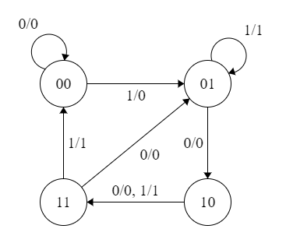
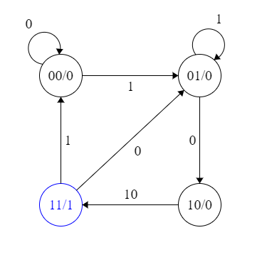
What type of state machine is depicted in figures A and B?
A
B
A:Moore, B:Mealy
A:Mealy, B:Moore
A:Mealy, B:Mealy
A:Moore, B:Moore
None of the above
Notes:
CS160 - Intro
24
Answer is B) Mealy has output associated with a transition, Moore output associated with a state

Slide 25
Mealy machines can sometimes use fewer states to represent the same process than Moore machines, and all Mealy machines can be simulated with a Moore machine
True
False
Notes:
False. Should be all Moore machines can be simulated with a Mealy machine

Slide 26
A sequential circuit is described by the state table. If the initial state is 0,0, what will be the output values if successive inputs values are 0,1,1
1,1,1
0,1,0
1,0,0
0,0,1
Present St |  | Input | Next St |  | Output
A | B | X | A | B | X
0 | 0 | 0 | 0 | 0 | 0
0 | 0 | 1 | 0 | 1 | 1
0 | 1 | 0 | 0 | 0 | 1
0 | 1 | 1 | 1 | 1 | 0
1 | 0 | 0 | 0 | 0 | 1
1 | 0 | 1 | 1 | 0 | 0
1 | 1 | 0 | 0 | 0 | 1
1 | 1 | 1 | 1 | 0 | 0
Notes:
B

Slide 27
NOT is an example of a/an ________ instruction
Operate
Data Movement
Control
None of the above

Slide 28
How many transistors does is take to implement a 2 input NOR gate
2
4
6
8
Notes:
B

Slide 29
To be able to use the function, qsort, defined in the header file, stdlib.h, the preprocessor directive ___________ should appear in your program before it is used.
import stdlib
#include <stdlib.h>
#define “stdlib.h>
#include “stdlib.h”
Notes:
B

Slide 30
Of all the possible inputs to a Full Adder (rows in its truth table) how many cause the output S/Sum to be a 1?
2
3
4
5
6

Slide 31
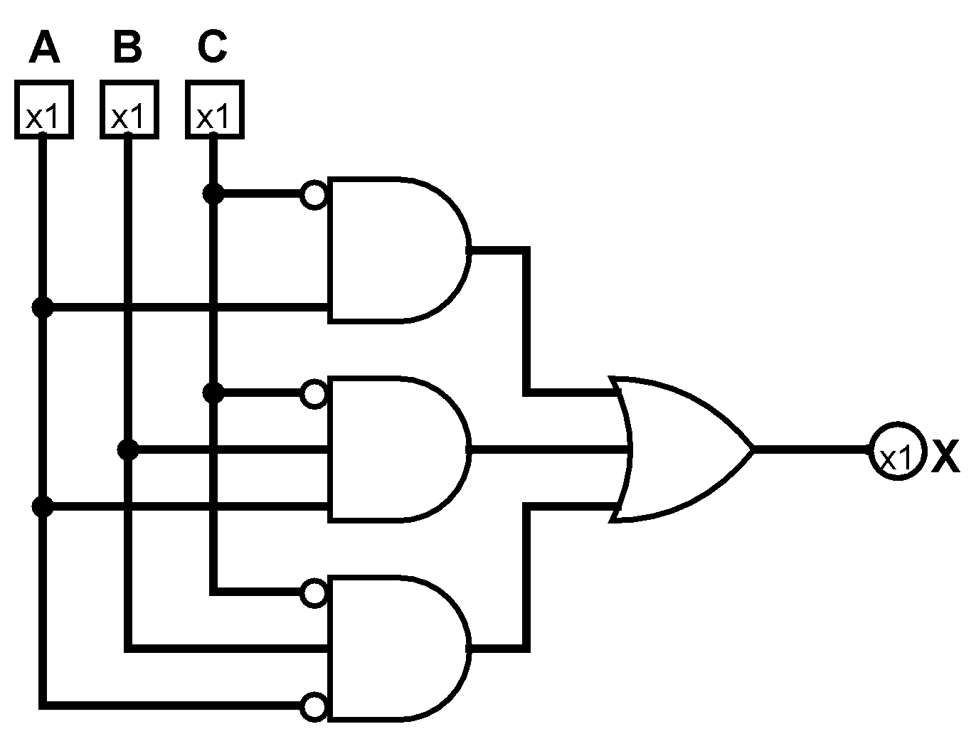
The Boolean expression represented by the following circuit is?
X = C’A + C’BA + C’BA’
X = A’C + CBA’ + ABC
X = BC + ABC’ + CB’
None of the above
Notes:
A

Slide 32
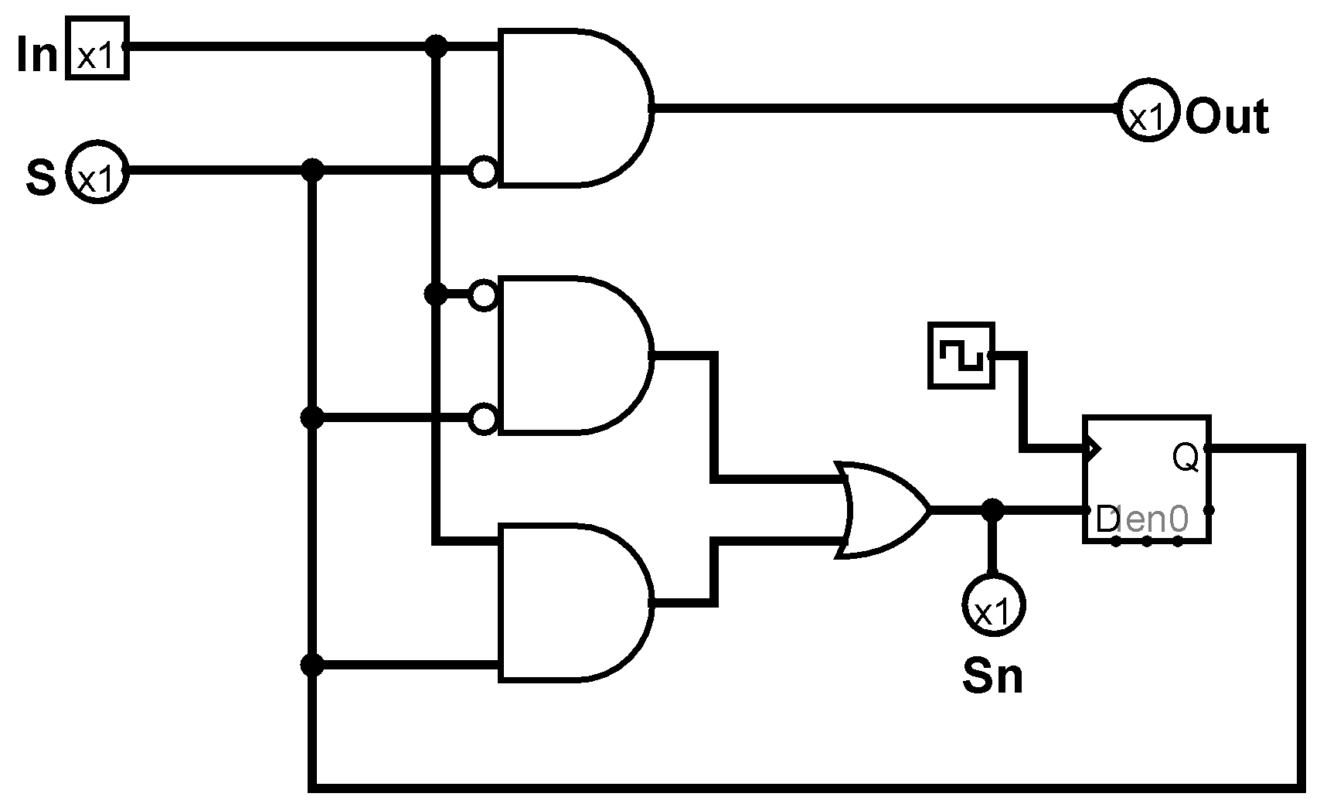
Which truth table matches the following state machine
A
In | S | Sn | Out
0 | 0 | 0 | 0
0 | 1 | 1 | 1
1 | 0 | 1 | 0
1 | 1 | 0 | 0
B
In | S | Sn | Out
0 | 0 | 1 | 0
0 | 1 | 0 | 1
1 | 0 | 0 | 0
1 | 1 | 1 | 0
C
In | S | Sn | Out
0 | 0 | 1 | 0
0 | 1 | 0 | 0
1 | 0 | 0 | 1
1 | 1 | 1 | 0
Notes:
C

