Slide 1
CS270
Peer Instruction #1:
Numerical Representation
CS 270, Fall Semester 2016
1
Notes:
CS160 - Intro
1
CS160 - Intro
CS160 - Intro
This is the first peer instruction session!

Slide 2
Peer Instruction: The process
A (somewhat) difficult question will be projected.
Individually choose an answer and submit.
Instructor will close poll, without showing results.
Discuss your answer with your peers.
In your group, choose an answer and submit.
Instructor will lead discussion, and show results.
2
Notes:
Need to address the chaos that results from group discussion, and the need to settle down afterwards!
CS160 - Intro
2

Slide 3
What is the minimum number of bits needed to represent 312 distinct values? How many bit patterns are leftover?
10-bits, 712 patterns unused
9-bits, 200 patterns unused
8-bits, 8 patterns unused
7-bits, no patterns unused
None of the above
Notes:
CS160 - Intro
3
CS160 - Intro
Correct answer is B), 2 to the 9 is 512 – 312 = 200.

Slide 4
What is 2⁵, 2^{7,} 2⁹, 2¹⁰
16, 64, 128, 512
32, 128, 512, 1024
24, 96, 456, 914
None of the above
Notes:
CS160 - Intro
4
CS160 - Intro
Correct answer is B)

Slide 5
What do the following bits represent? 11011
27
-11
-4
-5
Not enough information
Notes:
CS160 - Intro
5
CS160 - Intro
.All could be right, but E is the best, without specifying the format the bits are in they are meaningless

Slide 6
What is the weight of the position marked with an X in base 10, 2 and 7? _ _ X _ _
100, 27, 3
100, 4, 49
4, 49, 10
10^2, 2^2, 7^2
B and C
Notes:
CS160 - Intro
6
CS160 - Intro
Correct answer is E)

Slide 7
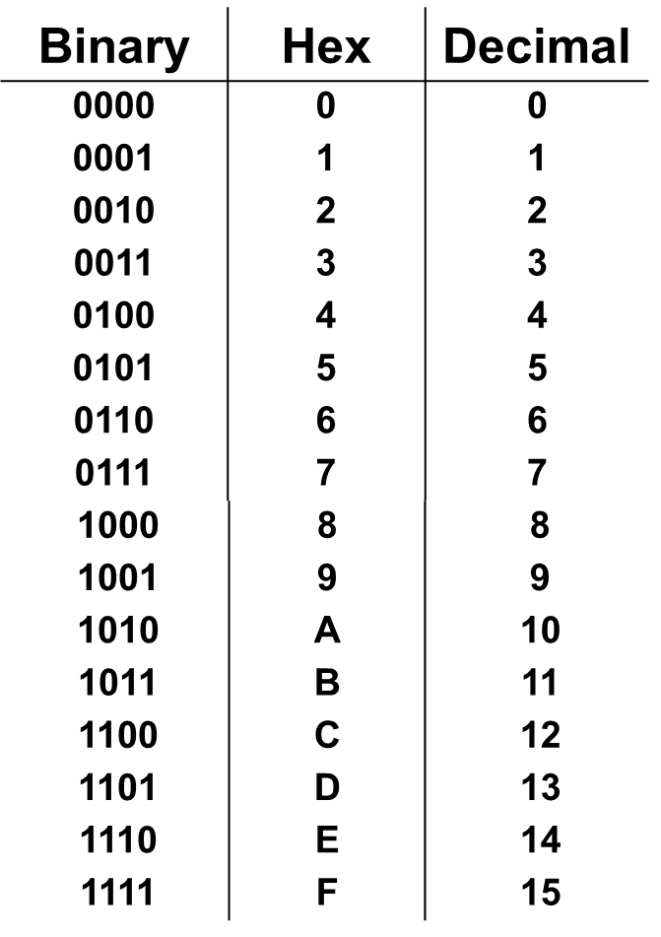
What are the binary and hexadecimal equivalents of the decimal number 98, assuming 8-bit precision?
01010010, 0x52
01100010, 0x52
01010010, 0x62
01100010, 0x62
None of the above
Notes:
CS160 - Intro
7
CS160 - Intro
Correct answer is D), 64 + 32 + 2 = 98, 0b0110 = 0x6, and 0b0010 = 0x2.

Slide 8
What is the range of a 5 bit 2’s complement value?
hint -2^{n-1} through 2^{n-1}-1
-16 to 16
-32 to 31
-16 to 8
-16 to 15
None of the above
Notes:
CS160 - Intro
8
CS160 - Intro
Correct answer is D)

Slide 9
What is the number minus 7 in binary, using the 1’s and 2’s complement format, assuming 5-bit precision?
11000, 11001
11001, 11010
11010, 11011
10111, 11000
All of the above
Notes:
CS160 - Intro
9
CS160 - Intro
Correct answer is A), just invert bits for 1’s complement, and add 1 for 2’s complement.

Slide 10
Which binary equation matches 12 – 2 = 10
(12 + -2 = 10) assuming 5-bits and 2’s complement?
01100 + 11110 = 01010
01100 – 00010 = 01010
A and B
None of the above
Notes:
CS160 - Intro
10
CS160 - Intro
Correct answer is C)

Slide 11
What is 273 in base 10 when converted to base 11?
229
182
270
156
None of the above
Notes:
CS160 - Intro
11
CS160 - Intro
Correct answer is A)

Slide 12
What does the unsigned integer 0b1011 look like when extended to 6bits? What about the 2’s Comp signed integer 0b0110 extended to 6bits
0b111011, 0b110110
0b001011, 0b000110
0b001011, 0b110110
None of the above
Notes:
CS160 - Intro
12
CS160 - Intro
Correct answer is B)

Slide 13
What is 0xABCD in binary, and 1101 0010 0110 1110 in hexadecimal, assuming 16-bit precision?
1011 1100 1101 1110, 0xB26D
1010 1011 1100 1101, 0xC26F
1001 1010 1011 1100, 0xD26E
1010 1011 1100 1101, 0xD26F
None of the above
Notes:
CS160 - Intro
13
CS160 - Intro
Correct answer is E).

Slide 14
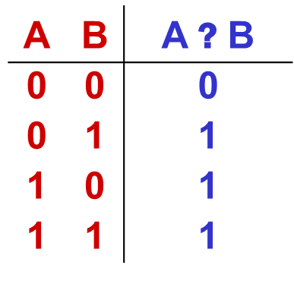
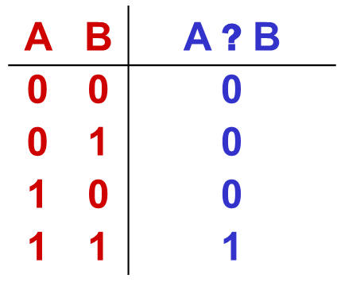
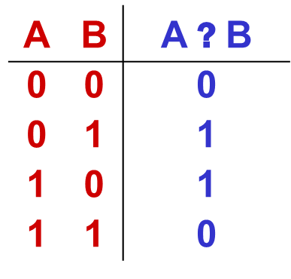
What Logical (Bitwise) Operations are represented by A, B, and C
A B C
A: AND B: OR C:XOR
A: OR B: ANR C:XOR
A: XOR B: OR C:AND
A: AND B: XOR C:OR
Notes:
CS160 - Intro
14
CS160 - Intro
Correct answer is B).

Slide 15
What is the result of ANDing 0b1011 and 0b1100 together? What about ORing?
0b1000, 0b1101
0b1011, 0b1111
0b1000, 0b1111
0b1111, 0b1011
Notes:
CS160 - Intro
15
CS160 - Intro
Correct answer is C).

Slide 16
What is the correct translation of the string “cs 270” into ASCII codes, using decimal values (without the null terminator)?
99 114 32 50 55 48
99 115 50 55 48
99 115 32 50 55 48
63 73 20 32 37 30
None of the above
Notes:
CS160 - Intro
16
CS160 - Intro
Correct answer is C), need ASCII chart.

Slide 17
What is the decimal value of the binary number shown below, in 16 bit IEEE floating point format?
0 10000 1010000000
2.25
-3.25
-4.25
3.75
None of the above
Floating Point Format
Notes:
CS160 - Intro
17
CS160 - Intro
Correct answer is E), sign bit is 0 (+), exponent is 16-15 = 1, mantissa = 1.101b = 1.625 * 2 = 3.25.

