Slide 1
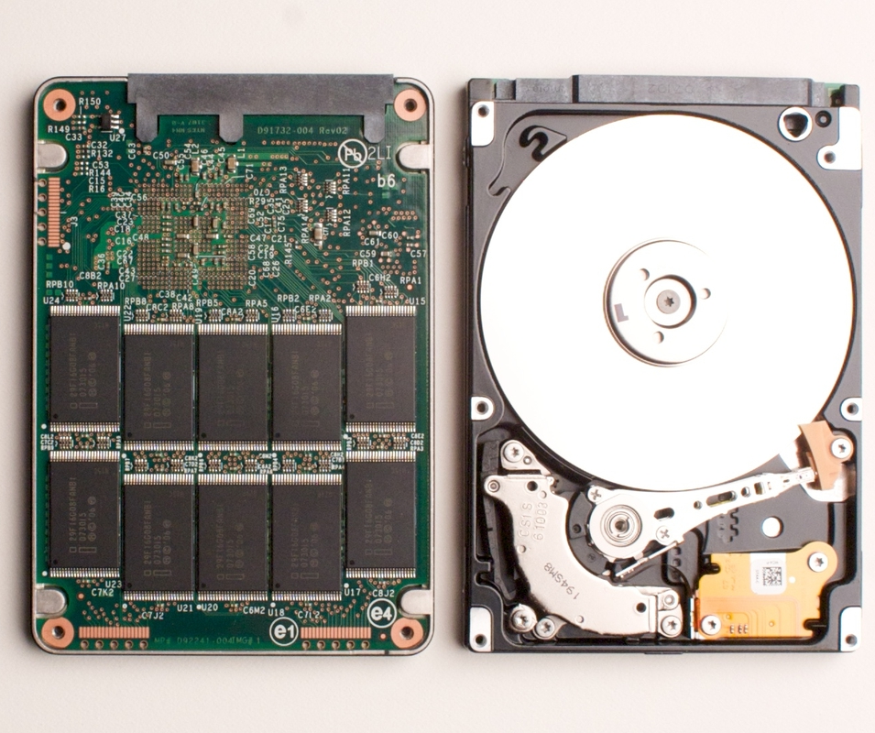
Storage: Where it’s come from and is going

Slide 2
The First Drives:
Storage Capacity: 3.75 MB
Physical Size: 87.9 ft³
Price for storage: 15,000$/MB
Seek Time: 600 ms
Rotational Speed: 1200 RPM

Slide 3
Platter Specifications
Storage Capacity: 80GB – 3 TB
Physical Size: .002 ft³
Price for storage: 10¢/ GB
Seek Time: 9ms
Rotational Speed: 7200-10000 RPM

Slide 4
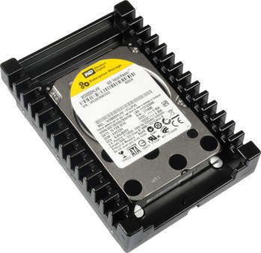

Slide 5
The Fastest Platter Drive
WD VelociRaptor:
Storage Capacity: 600GB
Price: 289.99$
Price for storage: 48¢/ GB
Seek Time: 7ms
Rotational Speed: 10000 RPM
Sequential Read/Write: 157 MB/s
Random Read: 1 MB/s
Random Write: 1 MB/s
IOPS: 905

Slide 6
OCZ Vertex 2
Storage Capacity: 60GB-240GB
Price: $209.99(120 GB)
Price for storage: 1.74$/GB
Sequential Read: 265.5 MB/s
Sequential Write: 251.9 MB/s
Random Read: 62 MB/s
Random Write: 164.9 MB/s
IOps: 50,000

Slide 7
Single Most Noticeable Upgrade?
Why is there so much hype about SSDs?
Speed?
Reliability?
Ability to tell future?
Making Vista usable?
+5 armor immunity to random access latency?

Slide 8
History
First SSD not in 2007, more like 1976…
Only had capacity of 2 MB
Fast-forward to 2007:
NAND Flash (Invented in 1980)
Non-Volatile Storage System
Used in USB Flash Drives, MP3 Players & SSDs
Multiple types: Single Level Cell(SLC) & Multi Level Cell(MLC)
Guess and Check reading and writing

Slide 9
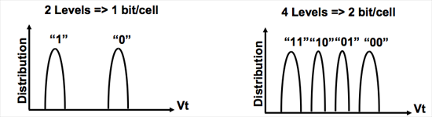
Reading & Writing
SLC Flash MLC Flash
Apply Voltage
Wait for Reaction
Return Result or
Apply More Voltage, Repeat

Slide 10
Performance of SLC vs. MLC
Difference?
Since there are only 2 possible values of SLC it only takes 1 voltage to return a 0 or 1
MLC requires a maximum of 3 different voltages to assure that the value will be found.
Random Read Speeds:
SLC: 25 µs MLC: 50 µs
Random Write Speeds:
SLC: 250 µs MLC: 900 µs

Slide 11
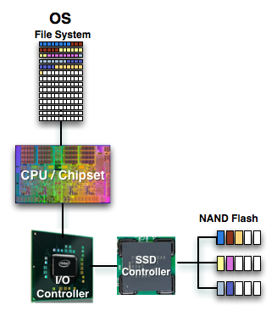
Process Control Flow

Slide 12
What makes an SSD special?
We’ve all used SSDs before, the same technology is used in USB Flash Drives and they only function around 5-40MB/s.
What if we use 10 USB Flash Drives in raid as a HDD?
Anywhere between 40GB – 320GB
Possible access speed of 50-400MB/s

Slide 13
Structure on the Board
Each SSD board contains any number of NAND ICs, chip used to store data, all depending on how expensive the board is.
Each SDD board also contains any number of support channels, normally one per NAND IC, which allows the controller to communicate to each NAND IC.

Slide 14
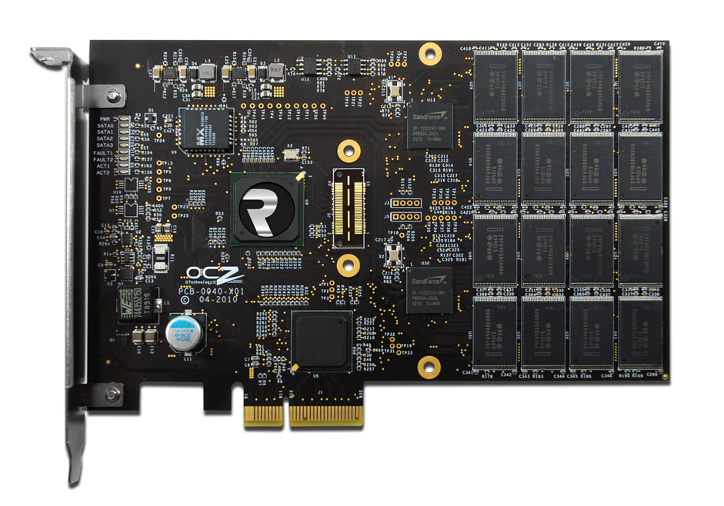
OCZ Revodrive

Slide 15
Can you say Parallelism?
The sheer speed of a SSD comes from the fact that it can access each of its NAND IC at exactly the same time.
While Platter HDDs like to have reads/writes to be in the same location for future access SSDs would rather have the data spread evenly across all of its NAND ICs for maximum accessibility.

Slide 16
What could be better?
You have it all in an SSD:
Almost instantaneous read and write times
The ability to read or write in multiple locations at once
The speed of the drive scales extremely well with the number of NAND ICs on board
But…

Slide 17
What about Erasing?
To erase the value in flash memory the original voltage must be reset to neutral before a new voltage can be applied, known as write amplification.
Random Erase Speed:
SLC 2ms per block MLC 2ms per block
What is this block stuff?

Slide 18
Memory Structure
1 or 2 bits does us no good
Pages!!!
1 Page = 4KB coincidence?
Block = 128 Pages = 512 KB
Plane = 1024 Blocks = 512 MB
Depending on the board the combining keeps going up until you get a single chip, NAND IC, on the board

Slide 19
The Achilles' Heel of SSDs
Wait a sec, we can write and read a single page of data from a SSD but we have to delete an entire block to release it?
I guess its ok since we are able to write to individual pages on the SSD, oh there’s one more thing the page has to be empty before we can write to it…crap.
To make matters worse, a standard MLC can only be erased 10,000 times before it goes bad.
Solution: Lets not actually delete files when they are deleted on the OS, much like a platter drive.

Slide 20
The Original Solution
Rather then deleting the block and writing the modified block with the new page back in the original location just write the modified block to another location in memory.
Believe it or not drives were actually shipped with this solution, never thinking about what happened when the drive filled up.
After the drive filled up the amount of time to write a block of data went from 250 µs to 250 µs + 2ms since it also had to delete a block. This actually made the SSDs slower then a regular platter drive when writing.

Slide 21
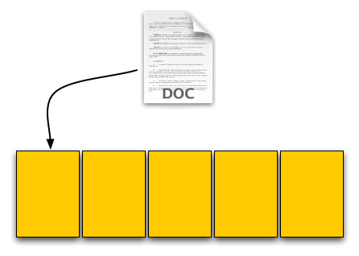
Example:
Hypothetical SSD:
Page Size: 4KB
Block Size: 5 Pages
Drive Size: 1 Block
Read Speed: 2 KB/s
Write Speed: 1 KB/s

Slide 22
Example Cont.
Lets write a 4kb text file to the brand new SSD.

Slide 23
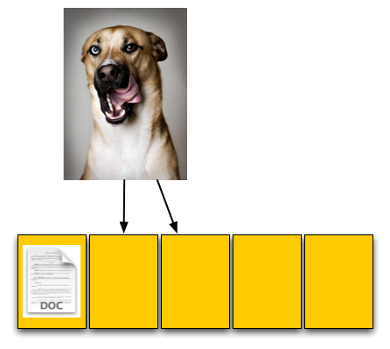
Example Cont.
Now lets write an 8kb pic file to the almost brand new SSD, thankfully there's space.

Slide 24
Example Cont.
Now lets delete the txt file in the first page.

Slide 25
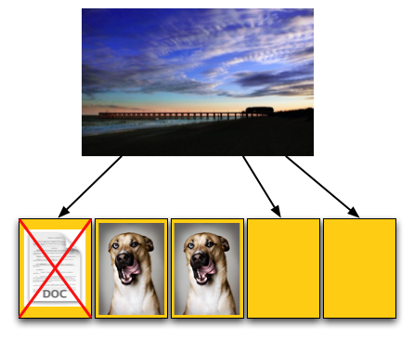
Example Cont.
Finally lets write a 12kb pic to the SSD. How long should it take? 1 kb/s write speed

Slide 26
Example Cont.
What’s wrong here?
The OS is told there are 3 open pages on the SSD when there are only 2 available.
Time for the SSD to do some fancy footwork to open up the space.
Banking on the quality of the SSD hopefully it has an onboard cache otherwise it has to use ram, taking much longer and consuming CPU cycles.

Slide 27
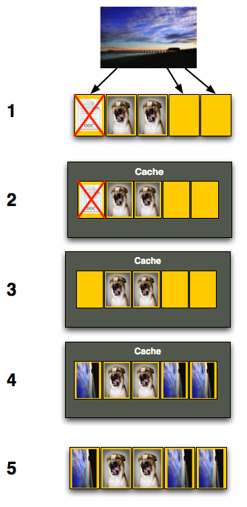
Example Cont.
Step 1: Read block into cache
Step 2: Delete page from cache
Step 3: Write new pic into cache
Step 4: Delete the old block on SSD
Step 5: Write cache to SSD

Slide 28
What’s happening?
The OS only thought it was writing 12 KBs of data when in fact the SSD had to read 12 KBs and then write 20KBs, the entire block.
Since the SSD is quite slow the operation should have taken 12 secs but actually took 26 seconds, resulting in a write speed of .46KB/s not 1KB/s
That’s one hefty cut to the performance of the drive, how could we fix the problem and save SSDs from an early grave?

Slide 29
Trim to the Rescue in 2009
Why not just delete the file when it is deleted from the OS, or a relatively short time afterwards, and clear the page in the block out?
Actually this fixes the problem of running out of space, but what happens when we try to overwrite a file, ie saving an updated word document?
Unfortunately there is no way around having to read the block containing the original file into cache and deleting it, however there is a choice to do it before or after the write. Which is better?

Slide 30
Strange Side Effects
So what happens when I want to do a fresh install of my OS on the HDD?
Should I just follow the standard reformat option and install like normal?

Slide 31
There’s a Command for That
Believe it or not there is actually a command for “trimming” the entire drive so it appears brand new, except for the fact that the life span of each NAND cell has been decreased by one.
Intel and many of the SSD manufactures supports a command called HDD ERASE that permanently deletes the data on the drive.

Slide 32
Additional Food for Thought
Data Recovery?
On a standard HDD data recovery of deleted files is quite easy because the actual bits are still on the HDD since the HDD doesn’t actually delete them.
What happens with TRIM?
Severely reduces the possibility of locating deleted files on the drive, making computer forensics impossible.

Slide 33
Separating the best from the rest
Surprisingly there isn't much difference between the NAND Flash memory used in each SSD since it is all made by 4 different providers, each using the same design.
The true difference in the drive is the controller that is being used, it’s actually the controller that decides which algorithms to use and how to manage memory.

Slide 34
Controllers
Intel:
From the get go in 2007 intel has had the strongest grip on the market of SSDs, they produce their own controller and the NAND Flash Memory.
Garbage:
There were quite a few companies that started up and died quickly trying to create controllers that beat Intel and they all failed except
Sand Force:
Arguable the best controller on the market right now any company that has a SSD that performs well is using a Sand Force controller, except for Intel who is trying to catch up.

Slide 35
Extreme Example: OCZ Vertex 2 vs. OCZ Agility 2
http://www.newegg.com/Product/Productcompare.aspx?Submit=ENE&N=100006519%2050001550%2040000636&IsNodeId=1&srchInDesc=2&page=1&bop=And&ActiveSearchResult=True&CompareItemList=636|20-227-550^20-227-550-TS%2C20-227-542^20-227-542-TS
Both drives are actually identical when it comes to the die, but have different versions of the Sand Force controller on them.
The only real difference between the drives is that the Vertex has the ability to support 50,000 IOPS while the Agility can only support 20,000 IOPS.

Slide 36
What's Coming Down the Pike?
Sand Force has released information about a new controller they have been developing claiming to literally double the output of the current controller and SSD on the market.
Doubling come on, I’ve always believed if something is to good to be true it probably is. Well its true.

Slide 37
OCZ Vertex 3
Storage Capacity: 120GB-360GB
Price: $499.99(240 GB)
Price for storage: 2.08$/GB
Sequential Read: 413.5 MB/s
Sequential Write: 371.4 MB/s
Random Read: 68.8 MB/s
Random Write: 332.5 MB/s
IOps: 60,000

Slide 38
So What?
Lets say the SSD
Saves 10 Mins per day of your computing time
For 7 Days a week
That’s 60 Hours a year
Minimum wage = 7.25$/hr
Total Savings: 440$ a year
Its strange to think about it that way but here’s proof as to how it can work that way.

Slide 39
Demonstration Time
Guess what I have today?
OCZ Revodrive in a computer that actually has the power to use the drive.

Slide 40
Conclusion
Pros:
SSDs are extremely fast
SSDs are easy to use
SSDs are the future of media storage
Cons:
SSDs are expensive
SSDs are constantly upgrading
SSDs are complicated to understand

