Slide 1
High Performance Computing
Andy Neal
CS451

Slide 2
HPC History
Origins in Math and Physics
  Ballistics tables
  Manhattan Project
Not a coincidence that the CSU datacenter is in the basement of Engineering E wing – old Physics/Math wing
FLOPS (Floating point operations per second)
  Our primary measure, other operations are irrelevant

Slide 3
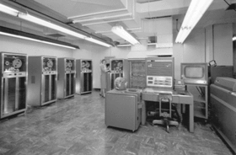
Timeline 60-70's
Mainframes
Seymour Cray
CDC
Burroughs
UNIVAC
DEC
IBM
HP
Notes:
Terminal access, punch cards, wider distribution,

Slide 4
Timeline 80’s
Vector Processors
  Designed for operations on data arrays rather than single elements, first in the 70’s , ended by the 90’s
Scalar Processors
  Personal Computers brought commodity CPUs increased speed and decreased cost
Notes:
Exotic systems, cooling, etc

Slide 5
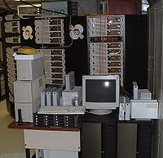
Timeline 90’s
90's-2000's Commodity components / Massively parallel systems
  Beowulf clusters – NASA 1994
"A supercomputer is a device for turning compute-bound problems into I/O-bound problems.“
– Ken Batcher
Notes:
Beowulf is now a common term for compute clusters

Slide 6
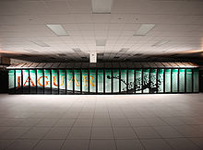
Timeline 2000’s
Jaguar – 2005/2009 Oak Ridge
(224,256 CPU cores 1.75 petaflops)
Our Cray's forefather
Notes:
Petaflops represents theoretical maximum, numbers are post rebuild

Slide 7
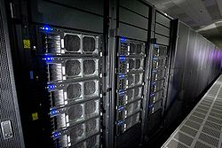
Timeline 2000’s
Roadrunner – 2008 Los Alamos
(13,824 CPU cores, 116,640 Cell cores
= 1.7 petaflops)
Notes:
Prototype was built on PS3s

Slide 8
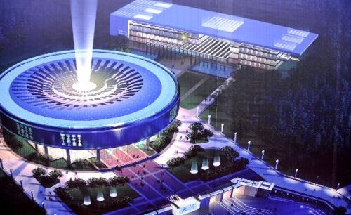
Timeline 2010’s
Tianhe-1A 2010 - NSC-China
(3,211,264 GPU cores, 86,016 CPU cores
= 4.7 Petaflops)
Notes:
Draws 4+ megawatts standing load, 80m construction cost, 20m annual power and maintenance

Slide 9
Caveat of massively Parallel computing
Amdahl's law
  A program can only speed up relative to the parallel portion.
Speedup
  Execution time for a single Processing Element / execution time for a given number of parallel PEs
Parallel efficiency
  Speedup / PEs

Slide 10
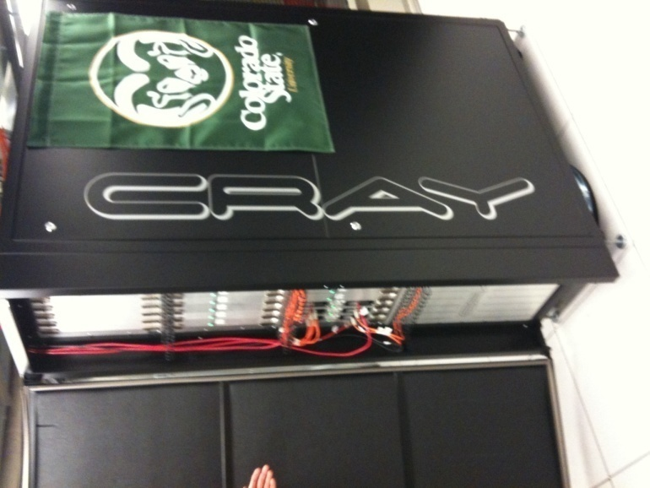
Our Cray XT6m
Our Cray XT6m
(1248 CPU cores, 12 teraflops)
At installation cheapest cost to flops ratio ever built!
Modular system
Will allow for retrofit and
expansion

Slide 11
Cray modular architecture
Cabinets are installed in a 2-d X-Y mesh
1 cabinet contains 3 cages
1 cage contains 8 blades
1 blade contains 4 nodes
1 node contains 24 cores (12 core symmetric CPUs)
Our 1,248 compute cores and all “overhead” nodes represent 2/3 of one cabinet…

Slide 12
Node types
Boot
Lustrefs
Login
Compute
  960 cores devoted to the batch queue
  288 cores devoted to interactive use
  As a “mid-size” supercomputer (m model) our unit maxes at 13,000 cores…

Slide 13
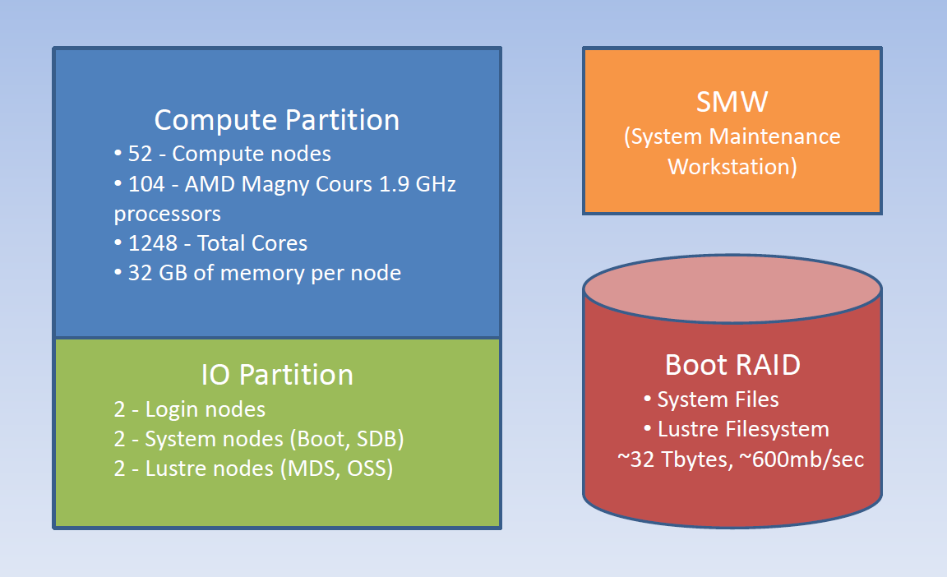
System architecture
Notes:
The only things that matter to us are the login and compute nodes

Slide 14
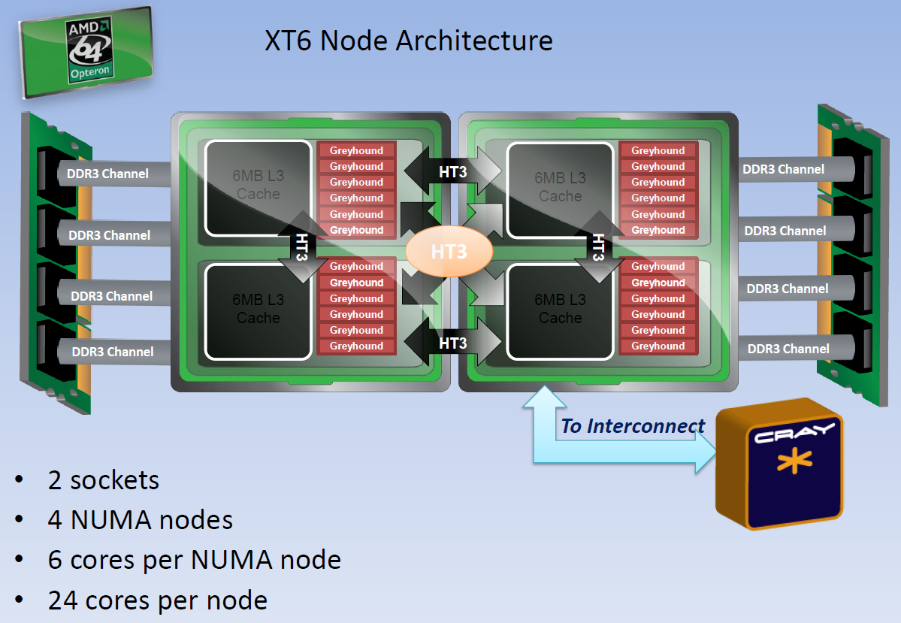
Processor architecture
Notes:
Memory layout is very important for optimization

Slide 15
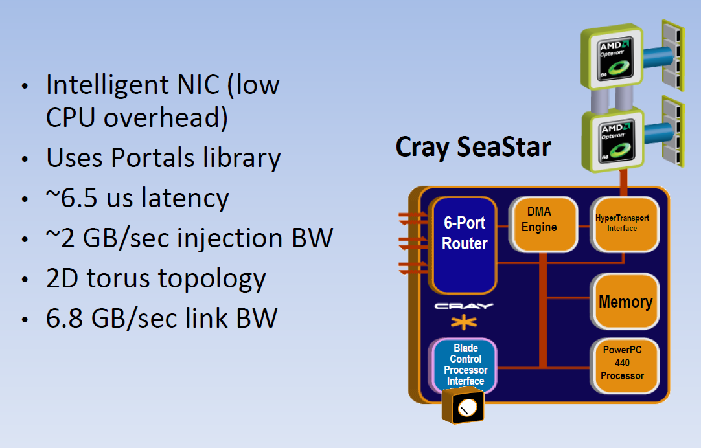
SeaStar2 interconnect
Notes:
This is actually interfacing on the hypertrasport3 memory bus experminetally proven 3+GB/sec

Slide 16
Hypertransport
Open standard
Packet oriented
Replacement for FSB
Multiprocessor interconnect
Common to AMD architecture (modified)
Bus speeds up to 3.2Ghz DDR
A major differentiation between systems like ours and common linux compute clusters (where interconnect happens at the ethernet level).

Slide 17
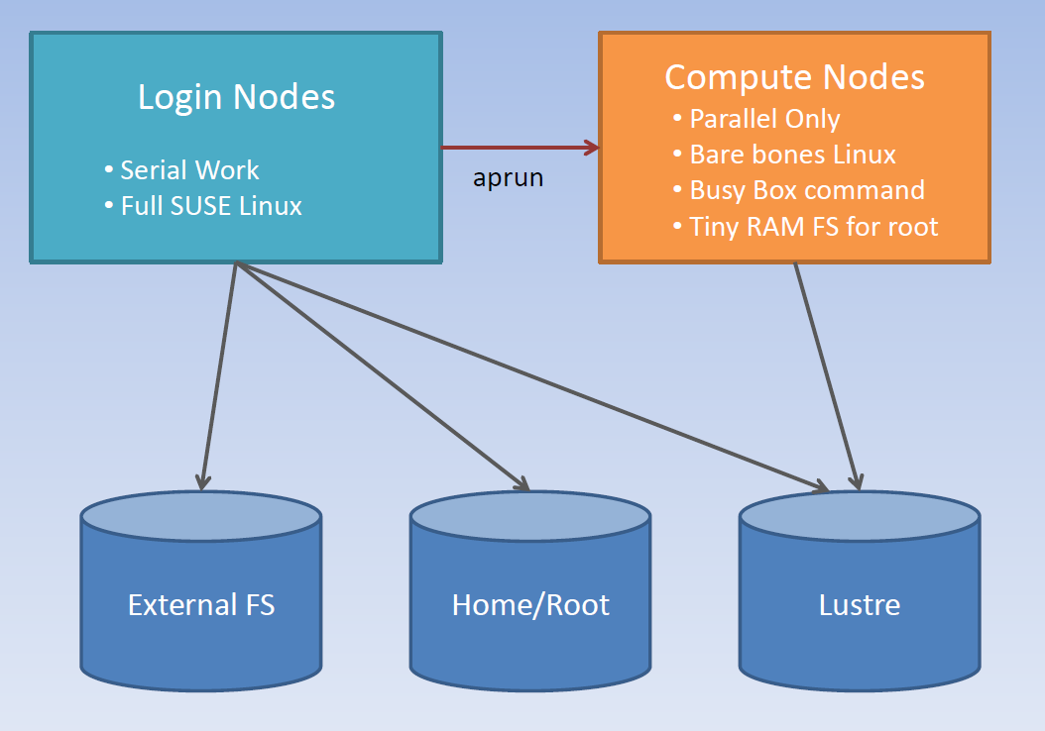
Filesystem Architecture
Notes:
Note the compute node isolation

Slide 18
Lustre Filesystem
Open standard (owned by Sun/Oracle)
True parallel file system
Still requires interface nodes
Functionally similar to ext4
Currently used by 15 of the 30 fastest HPC systems
Notes:
Fear for the future of lustre

Slide 19
Optimized compilers
Uses Cray, PGI, PathScale and GNU
  The crap compilers are the only licensed versions we have installed, they are also notably faster (being used to the specific architecture)
Supports
  C
  C++
  Fortan
  Java (kind of)
  Python (soon)
Notes:
Note the extreme binary bloat for the cray compiler – probably for to lustre compatibility

Slide 20
Performance tools
Craypat
  Command line performance analysis
Apprentice2
  X-window performance analsis
Require instrumented compilation
  (Similar to gdb – which also runs here…)
  Provides detailed analysis of runtime data, cache misses, bandwidth use, loop iterations, etc.
Notes:
Gdb runs but is very difficult to use here

Slide 21
Running a job
Nodes are Linux derived (SUSE)
Compute nodes extremely stripped down, only accessible through aprun
Aprun syntax:
  Aprun –n[cores] –d[threads] –N[PE per node] executable
  (Batch mode requires additional PBS instructions in the file but still uses the aprun syntax to execute the binary)

Slide 22
Scheduling – levels
Interactive
  Designed for building and testing, job will only run if the resources are immediately available
Batch
  Designed for major computation, jobs are allocated in a priority system (normally, we are currently running one queue)
Notes:
Apstat demo!

Slide 23
Scheduling - system
Node allocation
  Other systems differ here but our Cray does not share nodes between jobs, goal is to provide maximum available resources to the currently running job
Compute node time slicing
  The compute nodes do time slice, though it’s difficult to see that from operation as they are only running their own kernel and their current job
Notes:
Can use threads as well as interrupt a job

Slide 24
MPI
Every PE runs the same binary
+ More traditional IPC model
+ IP-style architecture (supports multicast!)
+ Versatile (spans nodes, parallel IO!)
+ MPI code will translate between MPI compatible platforms
- Steeper learning curve
- Will only compile on MPI compatible platforms…

Slide 25
MPI
#include <mpi.h>
using namespace MPI;
main(int argc,char *argv[]) {
int my_rank, nprocs;
Init(argc,argv);
my_rank=COMM_WORLD.Get_rank();
nprocs=COMM_WORLD.Get_size();
if (my_rank == 0) {
...
}
...
}

Slide 26
OpenMP
Essentially pre-built multi-threading
+ Easier learning curve
+ Fantastic timer function
+ Closer to a logical fork operation
+ Runs on anything!
- Limits execution to a single node
- Difficult to tune
- Not yet implemented on GPU based systems (oddly unless you’re running windows…)

Slide 27
OpenMP
#include <omp.h>
...
double wstart = omp_get_wtime();
#pragma omp parallel
{
#pragma omp for reduction(+:variable_name)
for(int i=0;i<N;++i){
...
}
}
double wstop = omp_get_wtime();
cout << "Dot product time (wtime)" << fixed << wstop - wstart << endl;

Slide 28
MPI / OpenMP Hybridization
These are not mutually exclusive
The reason for –N, –n, and –d flags…
  This allows for limiting the number of PEs used on a node, to optimize cache use and keep from overwhelming the interconnect
According to ORNL this is the key to fully utilizing the current Cray architecture
  I just haven’t been able to make this work properly yet :)
  My MPI codes have always been faster

Slide 29
Programming Pitfalls
A little inefficiency goes a long way…
  Given the large number of iterations your code will likely be running in any minor efficiency fault can quickly become overwhelming.
CPU time Vs. Wall Clock time
  Given that these systems have traditionally been “pay for your cycles” don’t instrument your code with CPU time, it returns a cumulative value, even in MPI!

Slide 30
Demo time!
Practices and pitfalls
  Watch your function calls and memory usage, malloc is your friend!
  Loading/writing data sets is a killer that via Amdahl’s law, if you can use parallel IO, do it!
  Synchronization / data dependency is not your friend, every time you will have idle PEs.

Slide 31
Future Trends
“Turnkey” supercomputers
GPUs
APUs
OpenDL
CUDA
PVM

Slide 32
Resources
Requesting access – ISTeC requires faculty sponsor
  http://istec.colostate.edu/istec_cray/
CrayDocs
  http://docs.cray.com/cgi-bin/craydoc.cgi?mode=SiteMap;f=xt3_sitemap
NCSA tutorials
  http://www.citutor.org/login.php
MPI-Forum
  http://www.mpi-forum.org/
Page for this presentation
  http://www.cs.colostate.edu/~neal/
  Cray slides used with permission

