Slide 1
Let’s Vacation
Aislinn Jeske, Caleb Carlson, Cassidy Skorczewski
CS455: Introduction to Distributed Systems
Computer Science Department, Colorado State University

Slide 2

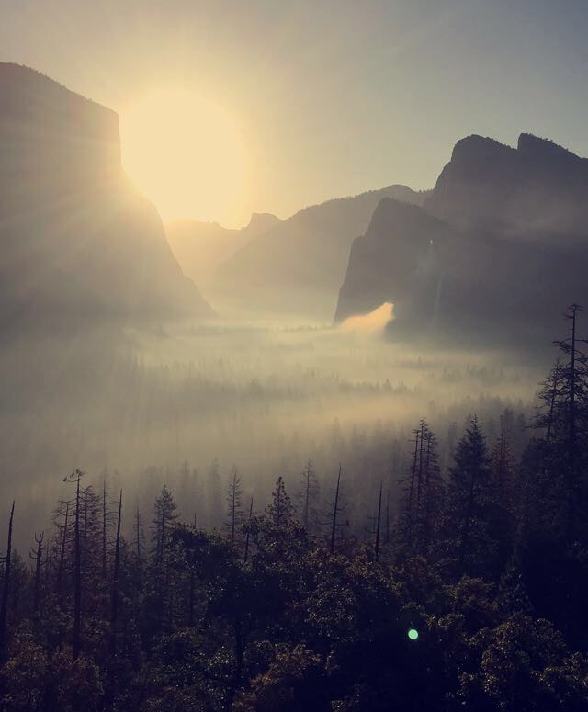
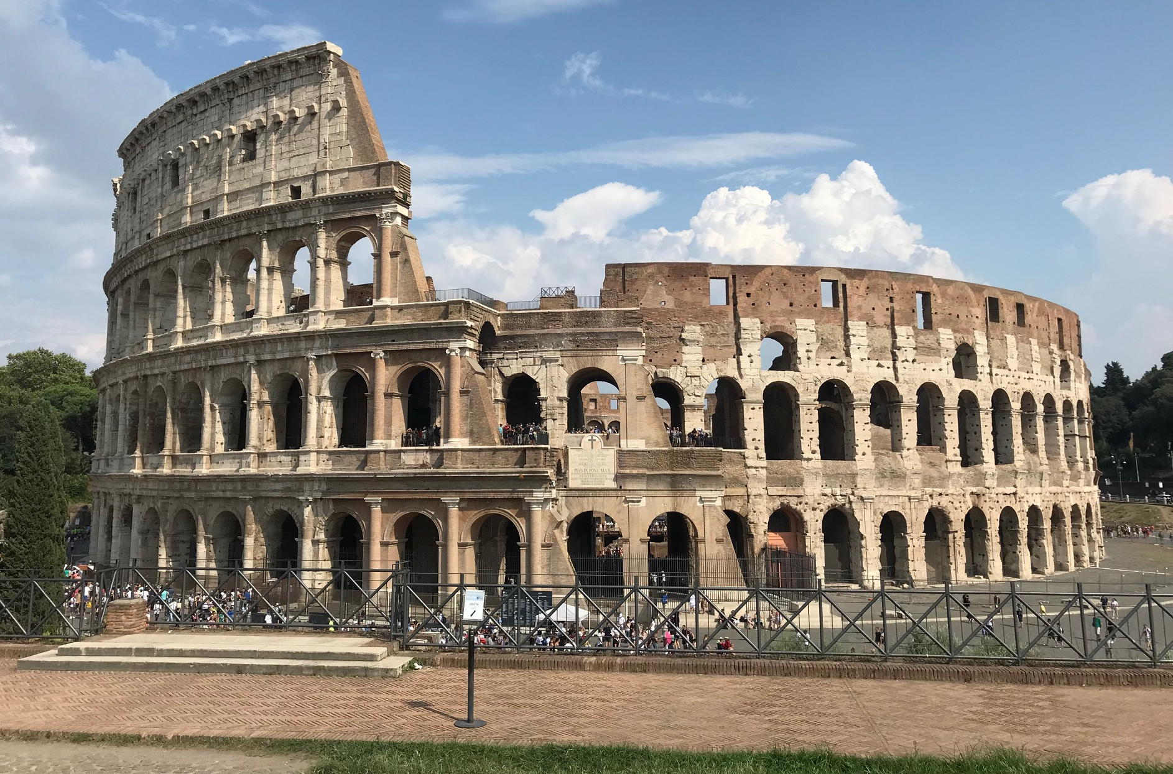
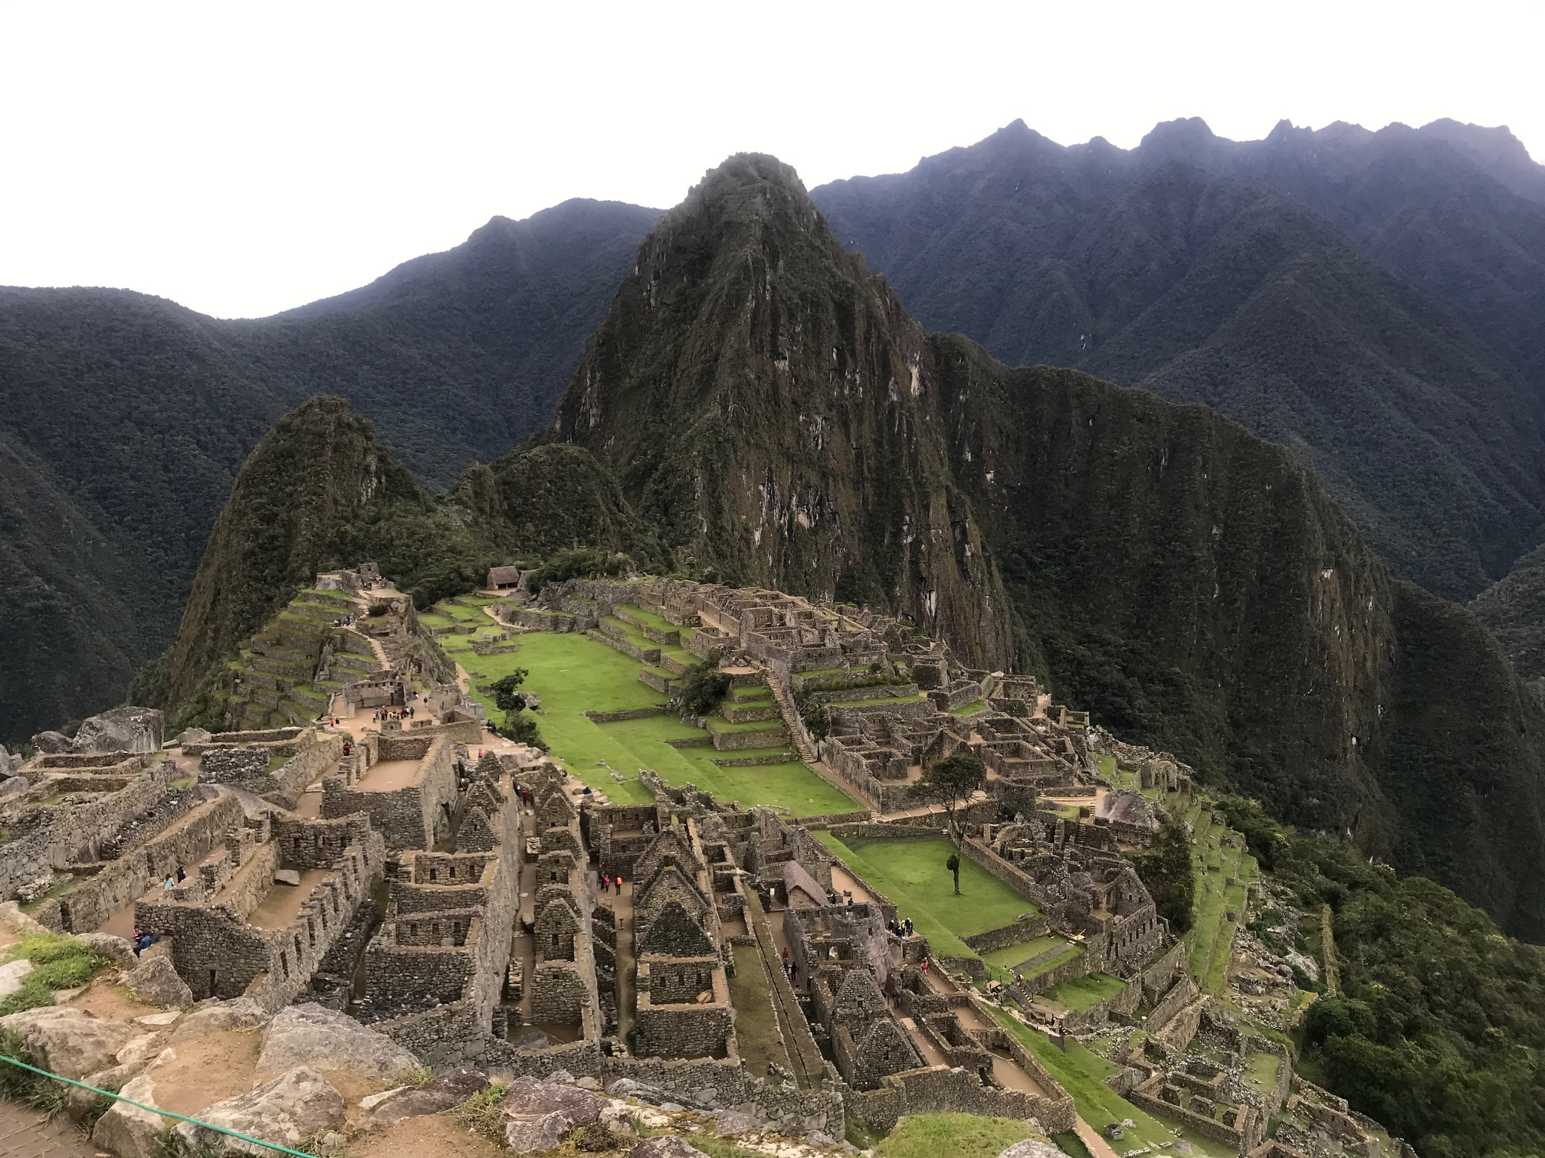
Background Information : Given a budget, where in the world can I travel?
Paris
Rome
Peru
Yosemite
Notes:
Describe why the problem you have chosen matters; how this plays a role in our daily lives, etc.

Slide 3
Problem Characterization
Planning for a trip can be overwhelming. Some of these challenges include:
Where to travel
Too much information on where to stay
Not enough information on how much it will cost once at destination

Slide 4
Methodology -- City Pricing
End goal: To have an average cost-per-day for food and transportation under low, mid, and high budgets
Use Numbeo’s API to create our own dataset:
Send GET request for each city, get a JSON response with cost-of-living data for hundreds of items
Convert JSON object to Java object using Gson, write the fields of the object out to file in CSV format
With the CSV file from above, remove irrelevant columns from the dataframe in Spark
Map the RDD’s columns (i.e. fast food restaurant) to its average price, with the row corresponding to the city

Slide 5
Methodology -- Lodging Pricing
End goal: To have an average cost-per-day lodging and the fees associated with the lodging
Use publicly available Airbnb data from 91 cities around the world:
Remove badly formatted entries
Extract housing, pricing, location, and fee data
Group houses by city and budget level
Calculate average costs and fees

Slide 6
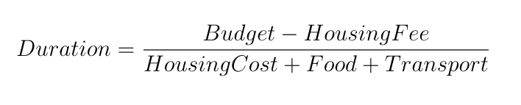
Methodology -- Data Combination
End goal: To combine the Numbeo and Airbnb average data and calculate how long someone could stay in each city with a certain budget
Filter out bad Airbnb data
Join data together
Perform calculation

Slide 7
Performance Benchmarks
Experimental Settings include:
Ran on Linux machines in CSB120
10 machines in our Spark cluster
1.9 GB Airbnb Dataset
45 MB Numbeo Dataset

Slide 8
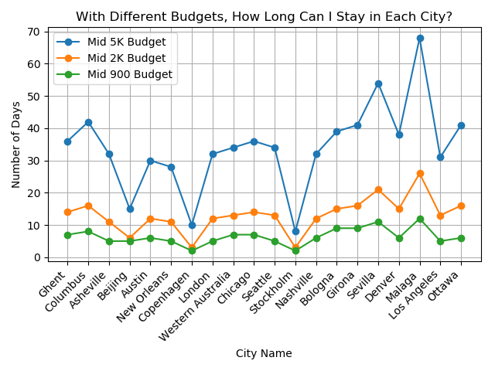
Performance Benchmarks

Slide 9
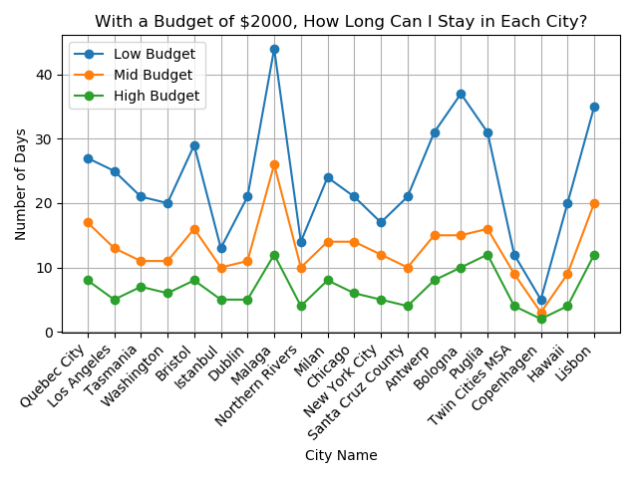
Performance Benchmarks

Slide 10
Insights and Conclusions
Reduces amount of time spent planning a vacation by filtering destinations outside of the user’s budget
Brings destinations to light that would have been overlooked
Increases tourism in less-popular areas?
More work can be done to personalize destination recommendations
Further improvements could be made to remove outliers from pricing data

