Slide 1
Lecture 26
*
Manifest Asynchrony
* Course logo spider web photograph from Morguefile openstock photograph by Gabor Karpati, Hungary.

Slide 2
Plant a Seed
New way to think about a webpage.
Initially, only a ’seed’ is sent from the server to the client browser.
In that seed is the AJAX code to then grow a ‘tree’ – in other words a full page.
Not always the best answer, BUT you should know how to do this for cases where it is appropriate.

Slide 3
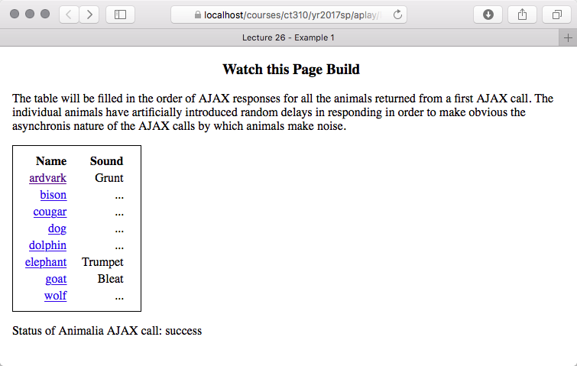
Learn By Example
When loading, the animals make their sounds in some random order with delays between 1 and 10 seconds.

Slide 4
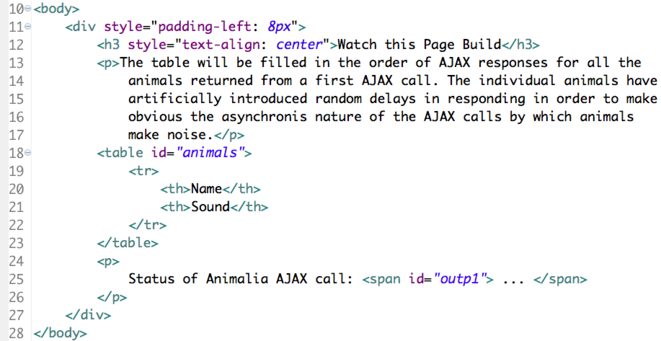
It Starts With a Seed
Table ‘animals’ contains only header

Slide 5
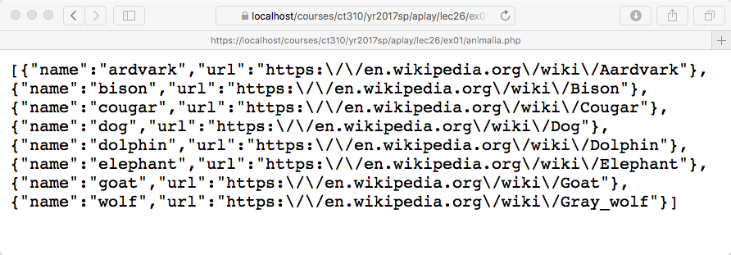
Where Animals Come From
From an AJAX call of course.
Get used to the idea that the seed is general. As in this example, the seed has no idea how many items may be added to the table/page/list etc.

Slide 6
All About the JavaScript
Need a JavaScript function to kickoff the process of ‘growing the tree’.
Here is that function using jQuery

Slide 7
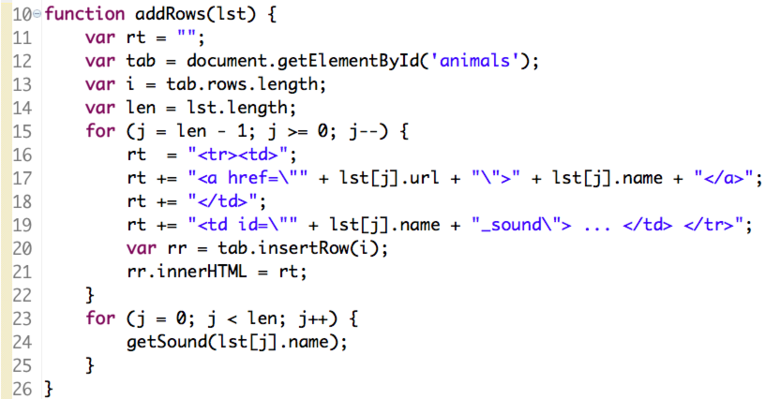
Adding Rows to the Table
Notice something special is going on in order to get sounds for each animal.

Slide 8
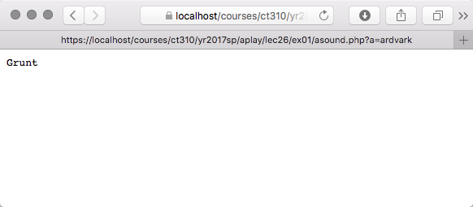
AJAX begets AJAX
AJAX is used to get the list of animals
AJAX to get each animal sound.
Getting used to the result of one AJAX call in turn causing a variable number of additional AJAX calls may take just a little getting used to.

Slide 9
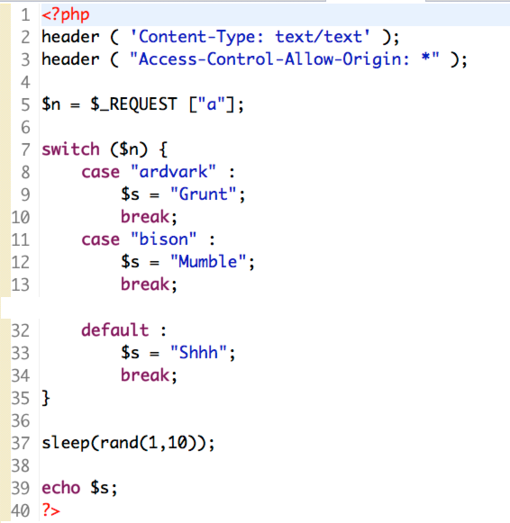
To Return a Sound
Which animal is being passed into the call.
To highlight asynchronous nature of AJAX animal sounds wait a random interval before responding.

Slide 10
Inside AJAX Sound Call
Target is the table data element ID that is updated by AJAX call.

