Slide 1
Lecture 2
Beyond HTML – Into the Server-Side

Slide 2
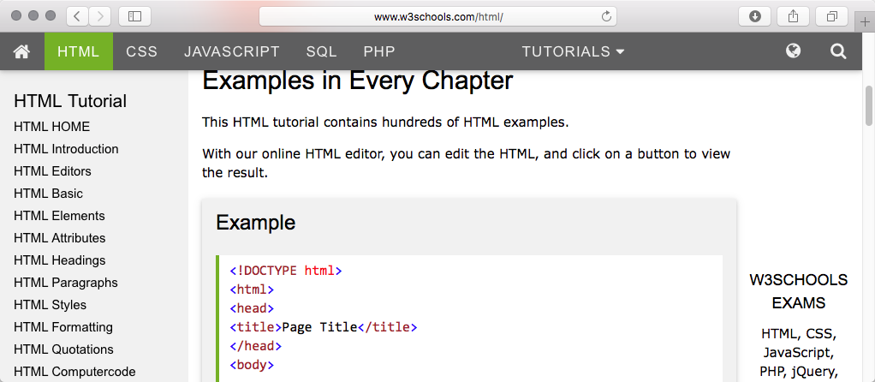
To Learn More HTML …
Few things are easier to learn from the web than the basic language of the web.
W3schools - a just fine place to start.

Slide 3
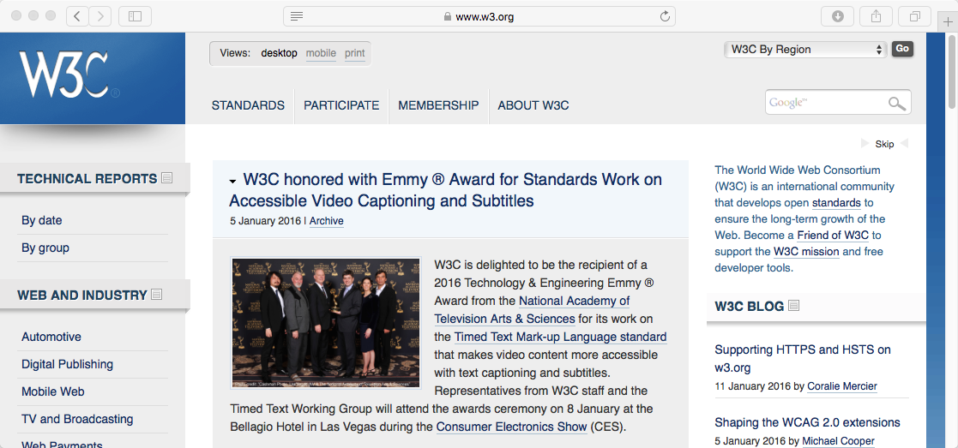
For Deep Documentation
Do not confuse w3schools and W3C. Very different organizations with very different roles to play. Definitive information generally a W3C.

Slide 4
CT 310 - Welcome Musings : Ancient History
When I took office, only high energy physicists had ever heard of what is called the Worldwide Web.... Now even my cat has its own page. Bill Clinton, 1996*
The Internet is just a world passing around notes in a classroom. Jon Stewart**
… and bring me a hard copy of the Internet so I can do some serious surfing. Scott Adams**
* Source, The Quotations Page.
** Source, The Quote Garden

Slide 5
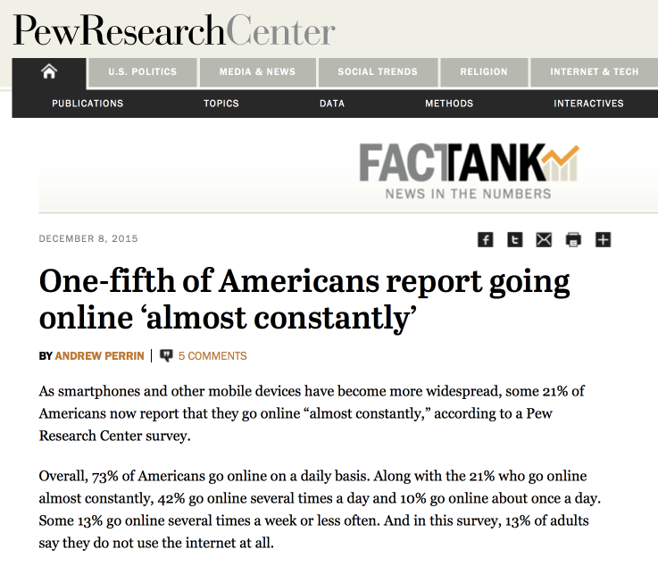
CT 310 2019 – Welcome! Is the Web Important?
Ok, I guess there are stupid questions!

Slide 6
CT 310 - Why?
CT 310 is a one semester course on web development. Emphasis is placed on the essentials needed to create fully functional websites including rich graphical content and dynamic content. The course will cover HTML, Cascading Style Sheets and graphical content. Dynamic web pages will be developed using PHP and JavaScript. MySQL and SQLite are introduced for website data management. Asynchronous JavaScript (AJAX) is introduced for fine-grained client-server interaction. Students will develop their own dynamic websites able to manage authentication, transactions and user updates.

Slide 7
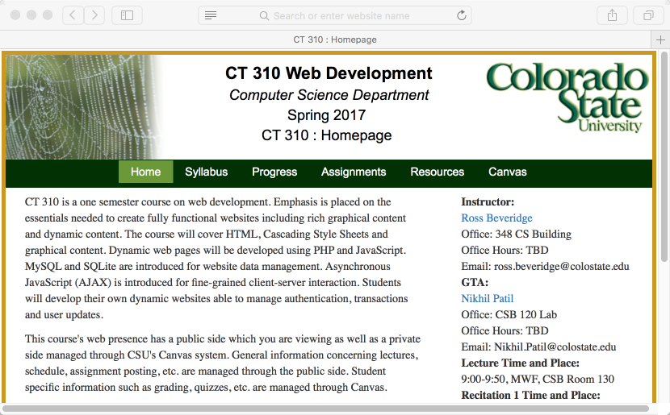
CT 310 – Start Here

Slide 8
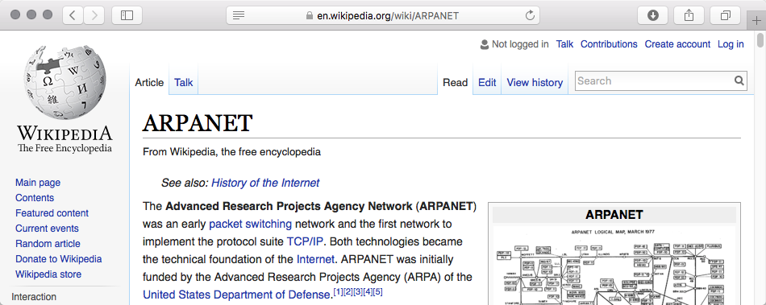
History of the Internet
Resources:
Wikipedia – yes this is a great resource
Computer History Museum

Slide 9
History of the Internet At a minimum, know …

Slide 10
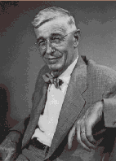
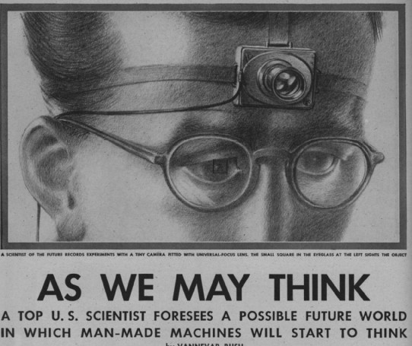
Vannevar Bush
Director of Us Office of Science Research and Development throughout World War II.
1945 article “As We May Think” in The Atlantic inspires computer scientists to present day
Personal Computer
Tiny, low cost library storage
Commerce with automatic inventory control and billing
Digital cameras
Speech interfaces
Hypertext-links
Goal was to augment human intellect

Slide 11
Memex
“A memex is a device in which an individual stores all his books, records, and communications, and which is mechanized so that it may be consulted with exceeding speed and flexibility”
Full-text search, text & audio annotations, and hyperlinks
Proposes associative links between content
Dual display setup!
Direct annotation of stored content
Proposes direct connection to nervous system

Slide 12
Networks

Slide 13
Networks
LAN
(CS Dept.)
CSU WAN
LAN
(Math Dept.)
LAN
(Psychology)

Slide 14
Networks
LAN
(CS Dept.)
CSU WAN
And it goes on and on …
WAN
LAN
(Math Dept.)
LAN
(Psychology)
LAN
(CS Dept.)
LAN
(Ft. Collins)
UC WAN
HP
LAN
(Math Dept.)
LAN
(Physics)
LAN
(Palo Alto
LAN
(Research)
If it is not obvious, the particulars are made up.

Slide 15
A Worked Example (2009)
Consider loading the Moscow State University website.

Slide 16
Uniform Resource Locator
http://www.msu.ru/en
Protocol
HTTP
Domain Name
Server Name
Web pages
(entry point)

Slide 17
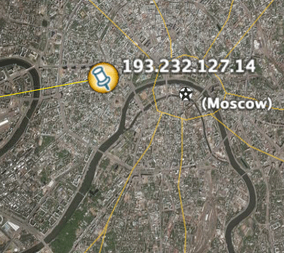
Servers and Clients
Client on my desk.
Server in Moscow, Russia
*

Slide 18
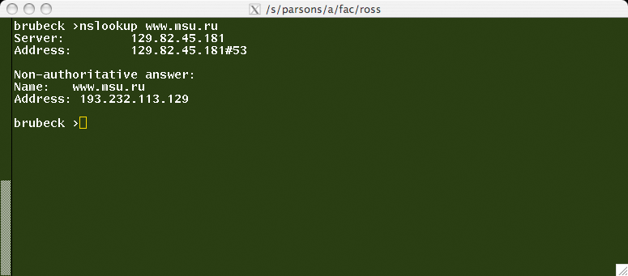
Domain Name System DNS
www.msu.ru maps to
193.232.113.129
Browser on client requests IP address from DNS server, then requests page from server (193.232.113.129)

Slide 19
TCP IP Packet Routing.
Browser initiates a TCP connection
From 67.166.55.44 to 193.232.113.129
Packets flow from server to client.
Packets include header plus data.
Dropped packets will be resent.
Route can make your head spin.

Slide 20
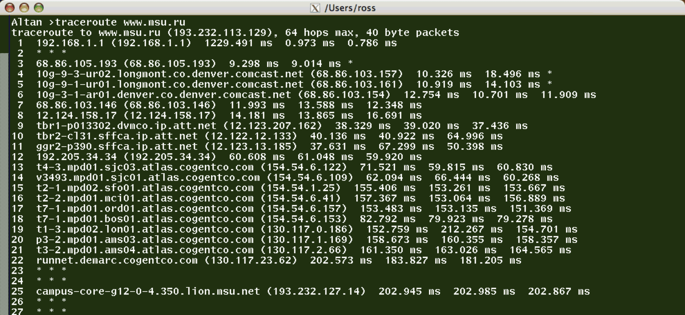
Unix Utility traceroute

Slide 21
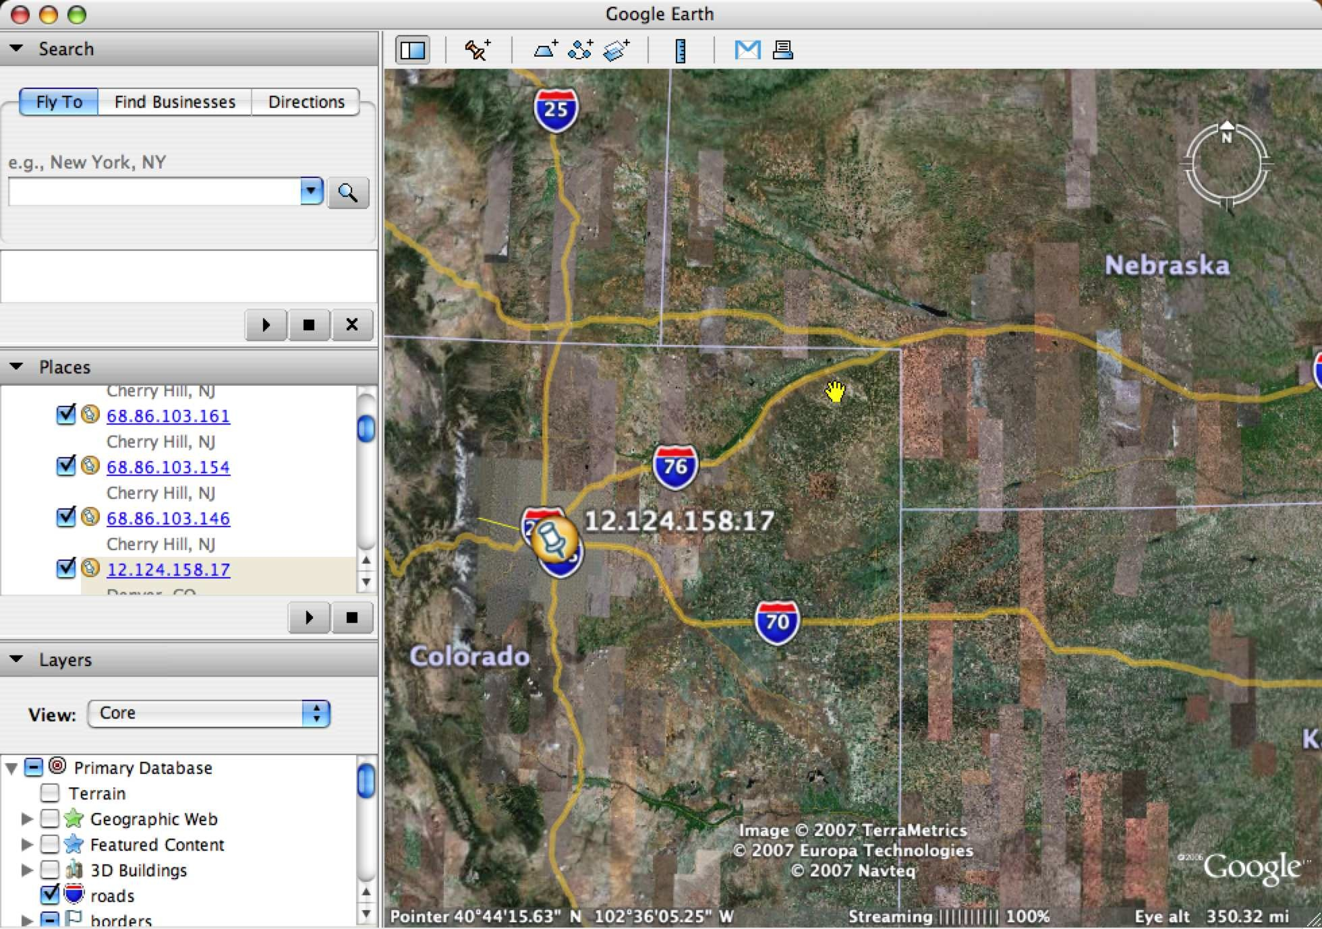
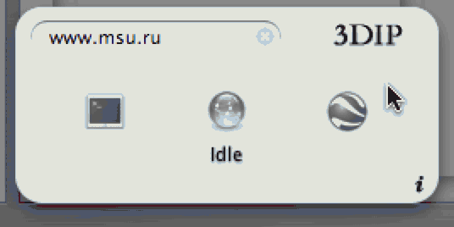
Routing Example Takeoff point - Denver
Route generated by 3DIP dashboard widget.
Claudio Procida
(http://www.emeraldion.it/)

Slide 22
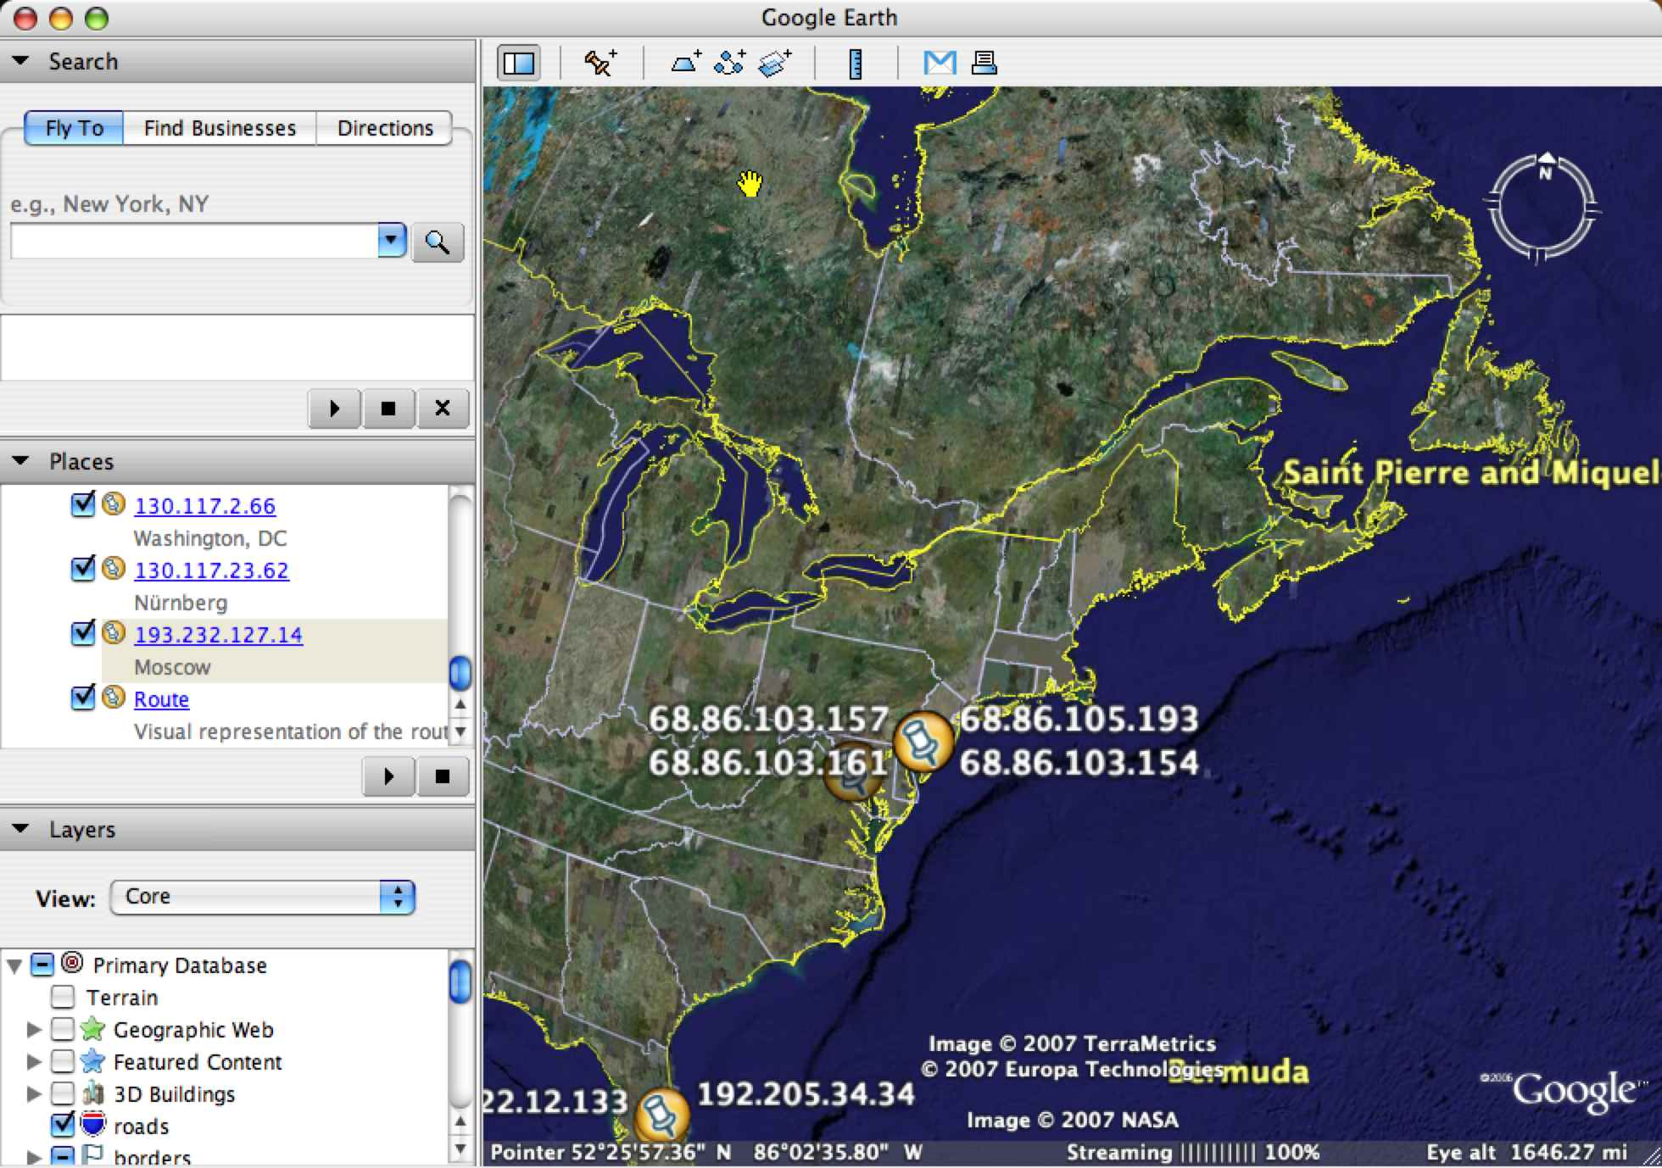
Routing Example Through East Coast

Slide 23
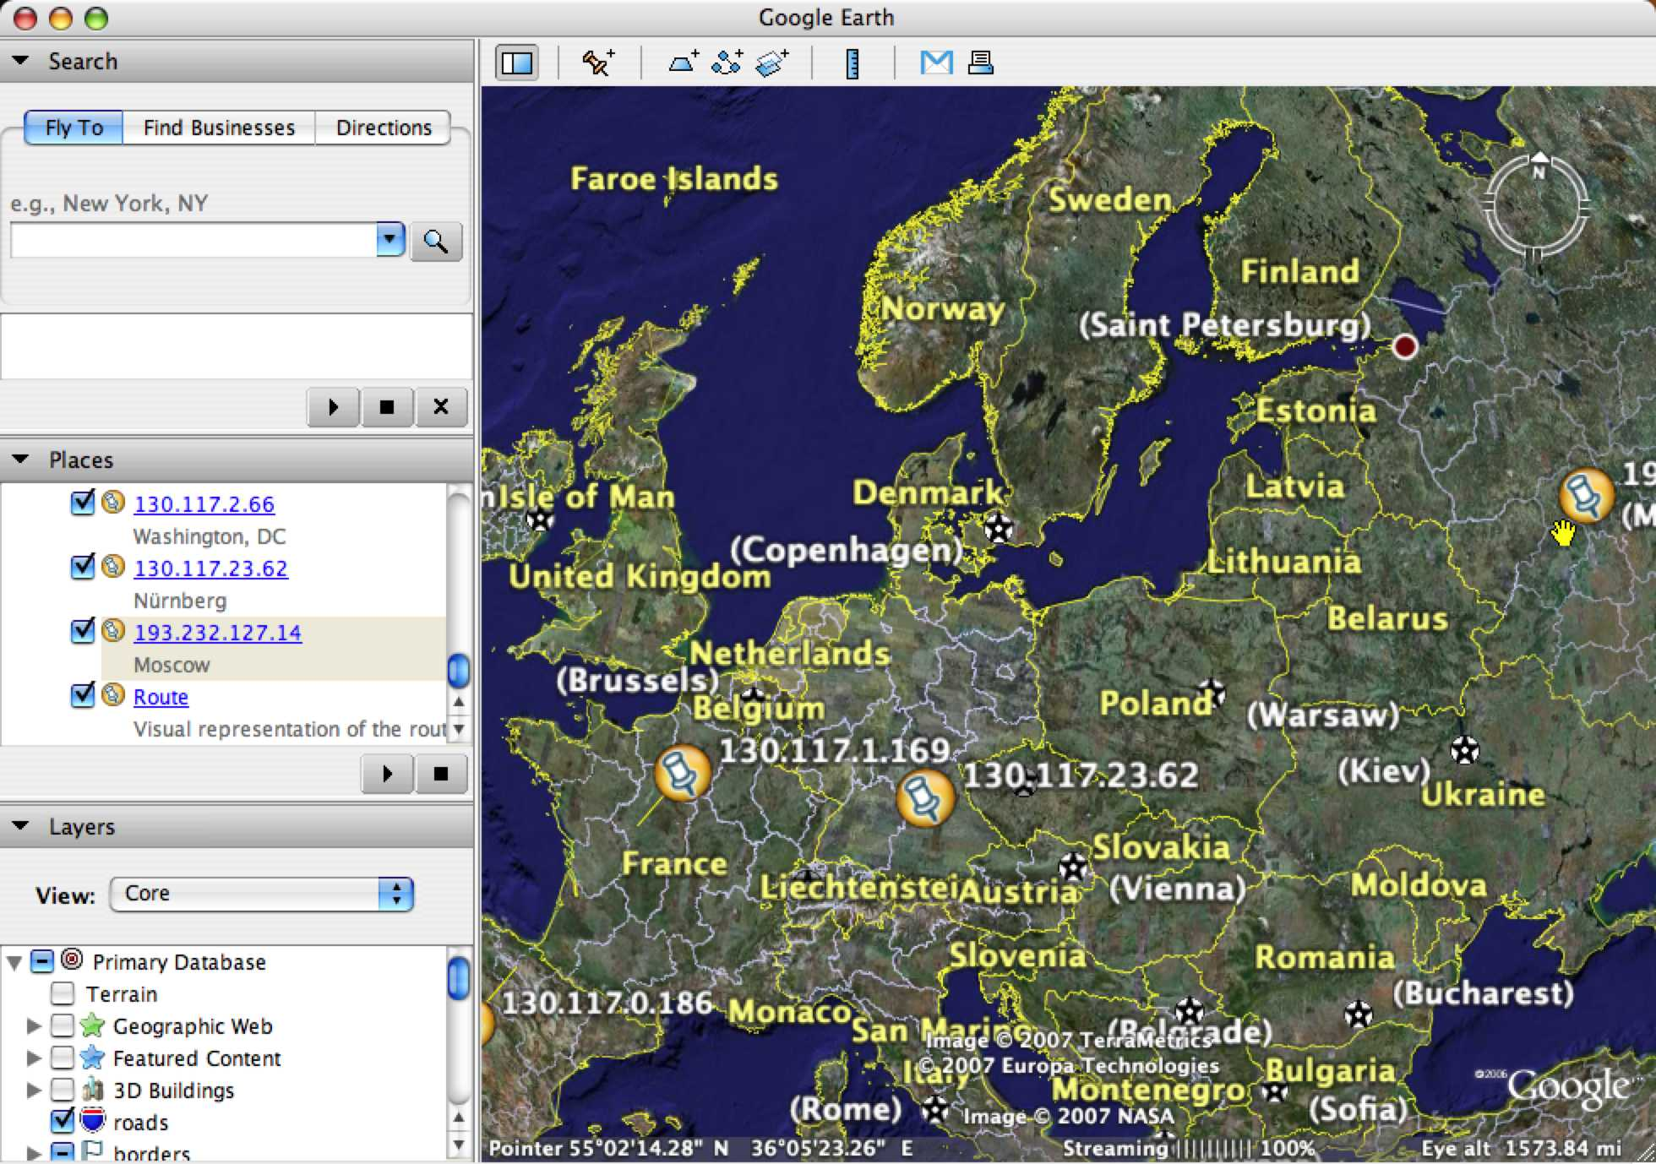
Routing Example Across Europe

Slide 24
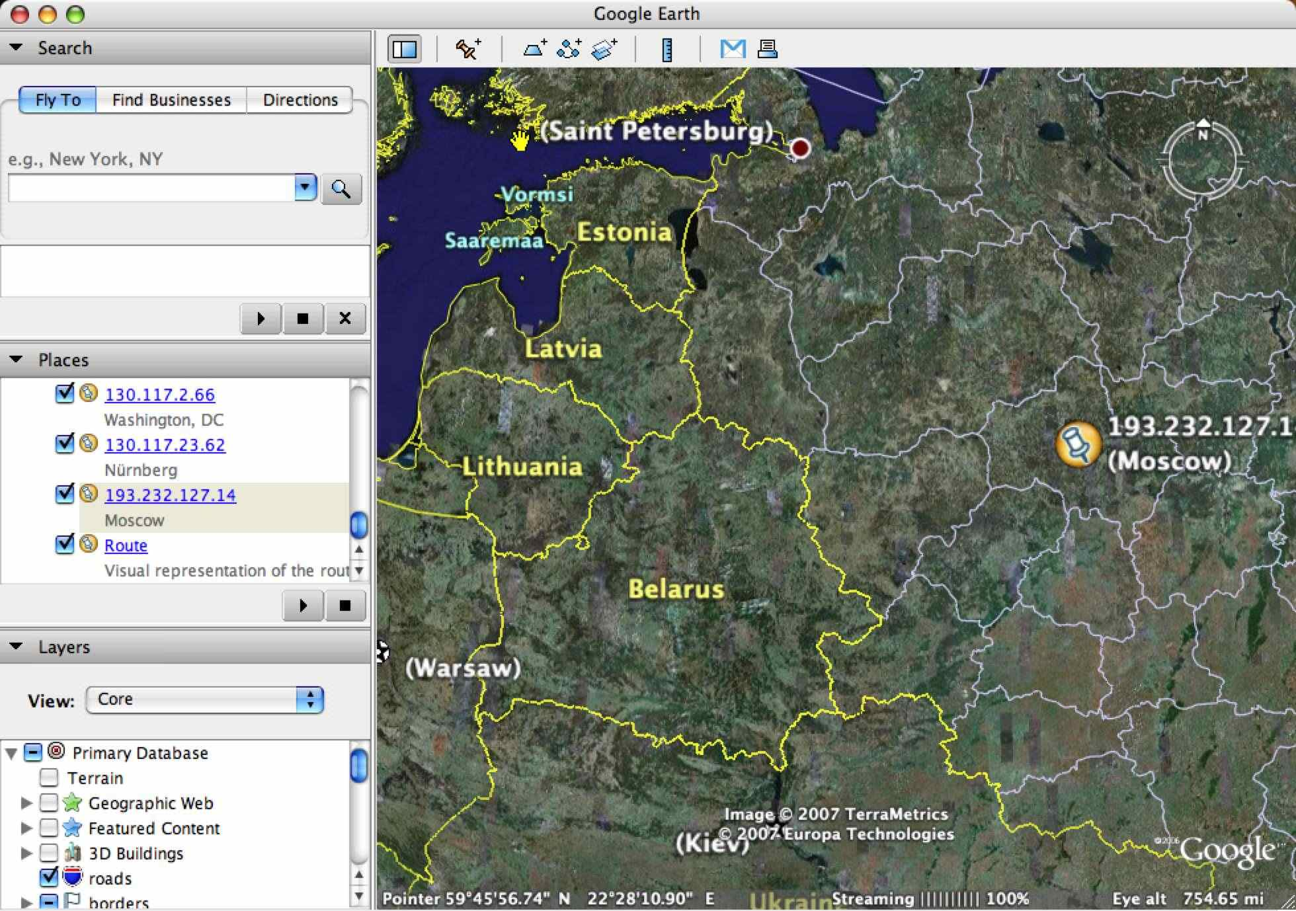
Routing Example … and into Russia

Slide 25
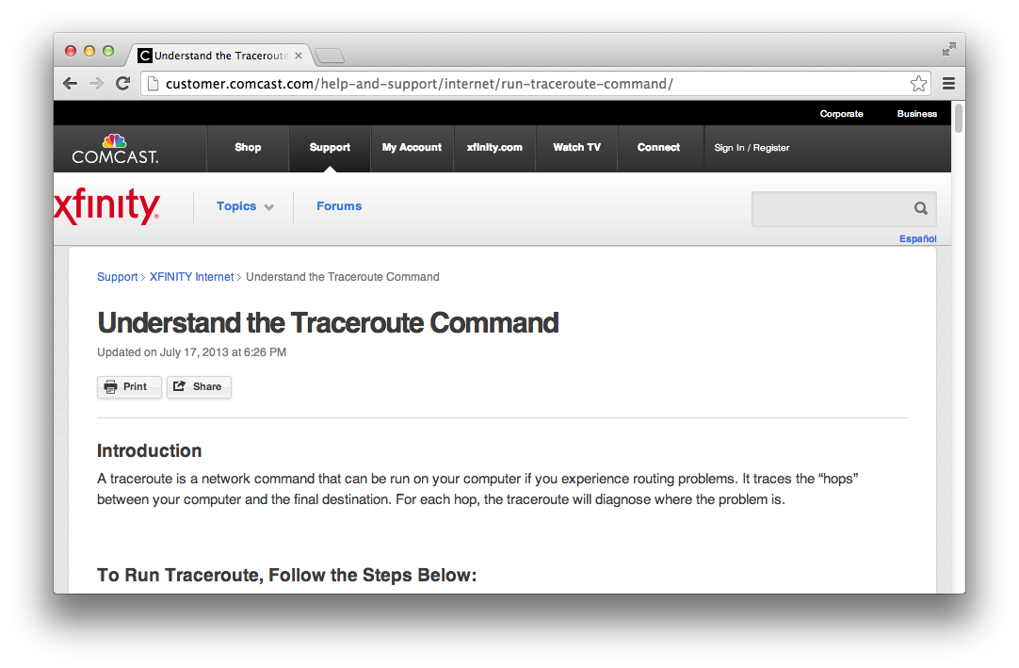
Traceroute Goes Mainstream

Slide 26
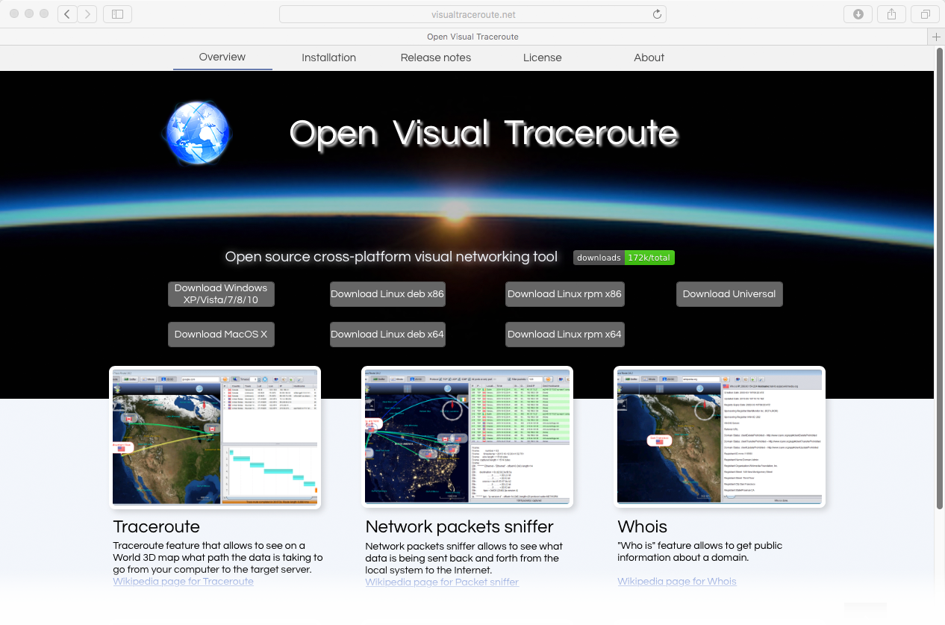
New Visual Traceroute

Slide 27
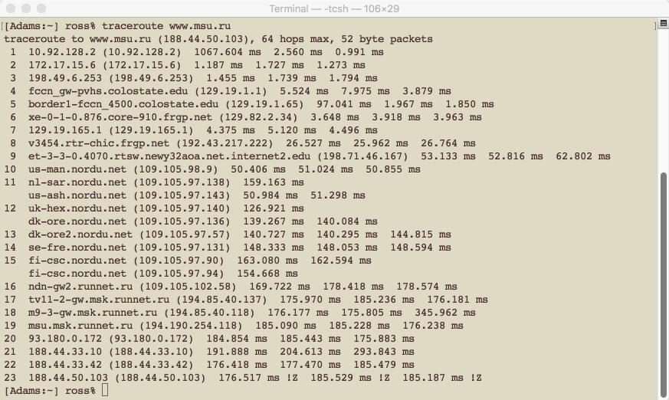
Tidbit 1/12/17 – Go CSU
This traceroute was initiated from PVH; note how CSU is acting as a conduit for the Hospital. Specifically, hops 4 and 5 include:
fccn_gw-pvhs.colostate.edu

Slide 28
Law, Privacy, security
A few comments about being a resident on the web

Slide 29
Law & Ethics
What happens to material you post?
What material can you post?
What can you do with stuff you see?
Are you comfortable explaining your actions to a reporter for a major newspaper?
(remember Newspapers?)

Slide 30
Want to Know a Secret …
… there aren’t any.
Good rule of thumb … what you say and do on the web is public.
And you leave permanent footprints.
Search, web mail, Netflix, …
What rights transfer, example …
Section 11 of Google terms of service
Compare April 16 2007 to current.

Slide 31
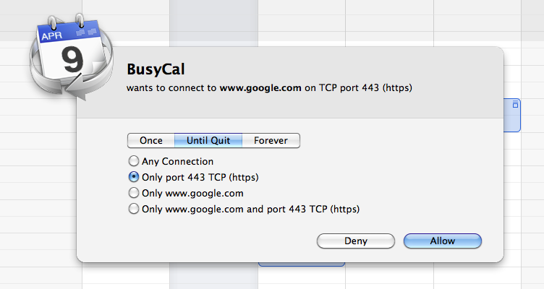
Privacy / Security
With whom is your computer conversing?
What’d it say?
Have you noticed?

Slide 32
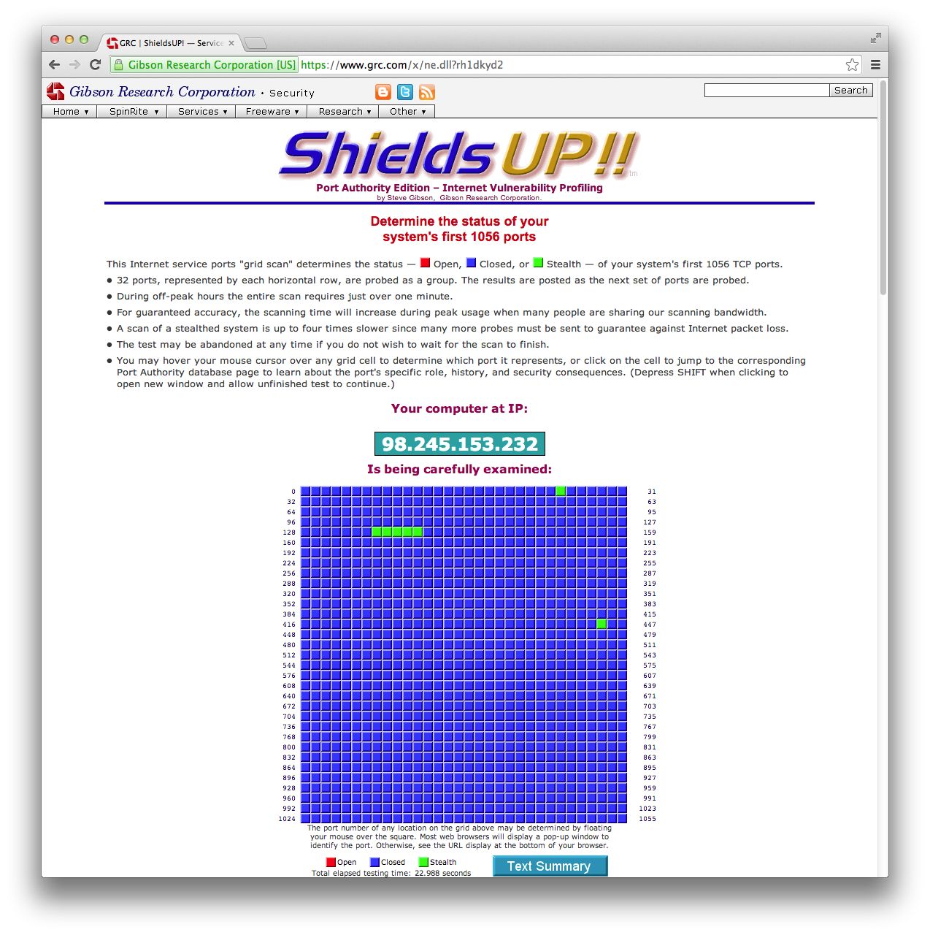
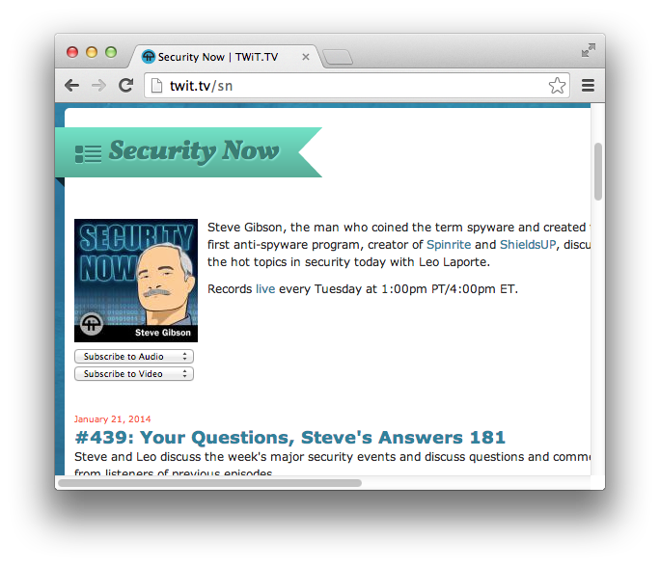
Much to Learn
Much to Check

Slide 33
Lecture Wrapup
Programming, elements and what comes next …

Slide 34
Dynamic Content
Once upon a time …
index.html was a text file.
With the advent of Web 2.0, page content is created on the fly.
With ubiquitous mobile the Site vs. Apps distinction is blurred.
Punchline! Building moderns Sites and Apps equals client/server interactive web programming.

Slide 35
Characters in this Drama
Browser – pretty obvious.
Renders HTML + CSS.
Network – TCP/IP etc.
Server (Apache) – behind the scenes.
Server Programming – PHP, .net, …
Persistent information – MySQL, …
Browser (again) – a machine
GUI plus language - JavaScript

Slide 36
Where to Next?
How fast can you learn HTML?
What do you have to help you?
A world wide web, truly, of examples.
What do you have going for you?
Most all of it is designed to be obvious.
… basic html is NOT rocket science.
What about CSS? …
There is more to CSS, next week.

