Slide 1
Lecture 4
Cascading Style Sheep

Slide 2
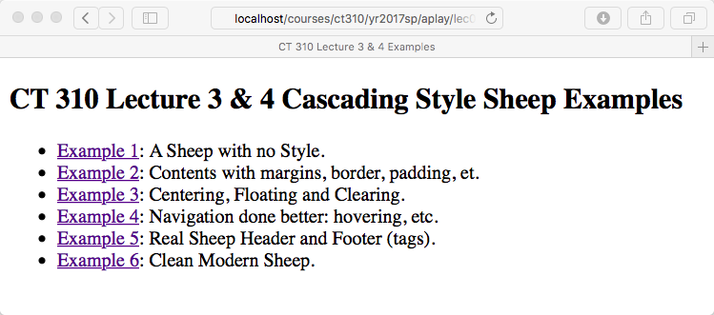
Six Sheep Pages
Each Example Exists to Illustrate one or more aspect of HTML / CSS interaction.

Slide 3
Sheep 01
Default flow of elements, layout
Link to external style sheets
HTML div elements – use often
Hyperlinks
Creating and using CSS Style Classes
Use of “target” with a link
Open stock images - Morguefile

Slide 4
Sheep 01

Slide 5
Sheep 02
Background Colors
Framing elements
Borders – very useful
Margins and spacing – a first glimpse
First introduction to Margins
Text color
Text size
Start thinking about color

Slide 6
Sheep 02

Slide 7
Sheep 03
Centering of major page elements
Arrived at in a very indirect fashion
Floating elements, figures
Strange dance between float and clear
Visually distinct headers
Caution:
You will at first confuse centering elements (div) with centering text.

Slide 8
Sheep 03

Slide 9
Sheep 04
Navigation - Styling Links
Text Decoration – or lack thereof
Psuedo Classes
Link
Visited
Hover
Active
Implements ‘rollover’ behavior

Slide 10
Sheep 04

Slide 11
Sheep 05
Moving up to HTML5
The header, nav and footer elements
What you saw built from scratch is so common it became part of the spec.
Shadowing on text
A slightly cleaner integration of navigation with header.

Slide 12
Sheep 05

Slide 13
Sheep 06
Structural Changes
Unique ‘id’ elements where appropriate
Look and feel changes
Shift to a cleaning less block look
External font links – Google Fonts
Color choice by someone with talent
Another chance to think about colors

Slide 14
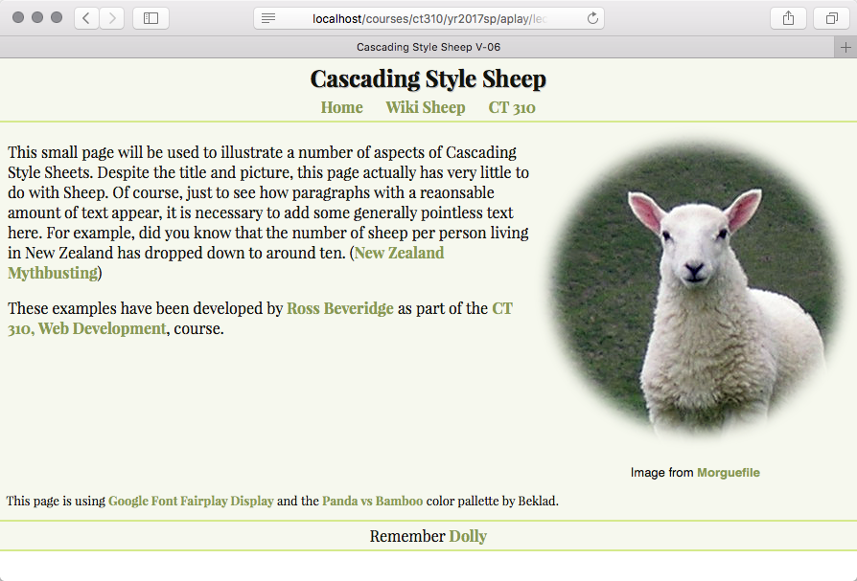
Sheep 06

