Slide 1
Model View Controller
MVC Framework, in general.

Slide 2
HTTP Request/Response
Server
Browser
HTTP

Slide 3
PHP Processing on the Server
What happens in the server black box?
Server
Browser
HTTP

Slide 4
Diagram of overall flow, client/server
S E R V E R
HTML File
<html>
…
</html>
HTML File
<html>
…
</html>
PHP Files are processed through the PHP Hypertext Processor
Static HTML files are not.
No processing
PHP File
1,2,3,4,5
PHP
Hypertext Processor
PHP File
<?=$data; ?>

Slide 5
Now, what happens on the server?
S E R V E R
But what if that PHP file is complex…
It can include other PHP files
Those can do lots of interesting things
Yay dynamic content!
PHP File
1,2,3,4,5
PHP
Hypertext Processor
PHP File
<?=$data; ?>

Slide 6
Inside that black box…
Request comes in
Server processes the request
Sets up state
Gets the data to use
Processes data
Formats results
Lays out results
Page is returned to the browser
Browser renders the page
Server

Slide 7
Set up State
Specific code that knows where the state is and what format it is in.
Parses out the URL, parameters, etc…
Includes the desired other classes that might be used
Though not many, most of the logic in one file

Slide 8
Get Data to Use
Grabs the data, knowing:
Exactly where the data are stored
Exactly how the data are stored
Opens files, connects to DB, etc…
Maybe even put some data right in the code!

Slide 9
Process Data
<!DOCTYPE html>
<?php
//All of the above…
//plus
//lots of code to process data
(several lines later)
<html>
…

Slide 10
Format Results
Not much to do here, variables are already declared local to the file.
Hopefully, we didn’t make too big of a mess.
We needed to make variables for everything
Not so much automatic getting by calling a method
Maybe stored in an object, but not necessarily

Slide 11
Lay out results
<html>
…
<div class=“productWidget”>
…
</div>
Even If in a loop, the code lives in potentially multiple places.

Slide 12
Doing this with MVC

Slide 13
Back to our flow…
Sets up state
Gets the data to use
Processes data
Formats results
Lays out results

Slide 14
With MVC
Controller
Sets up state
Gets the data to use
Processes data
Formats results
Lays out results
Datebase
Model
View

Slide 15
Set up State
Controller
Grab state
Get context
Start processing
The controller knowns what it needs to accomplish the task
Datebase
Model
View

Slide 16
Get Data to Use
Controller
The controller knows which data it needs.
The model knows how to get that data.
The model links to the DB
Does the controller care what the DB looks like?
Datebase
Model
View

Slide 17
Process Data
Controller
Processing of Data can happen two places, the Model or the Controller
Depends on what is being processed.
Is the processing specific to the Data, then Model.
Is the processing specific to the action, then Controller
Datebase
Model
View

Slide 18
Format Result
Controller
Once the data is processed, it is made into a format to be read by the View.
Remember the earlier lecture… Lots of formats to choose from!
Arrays of Model objects are very common.
Datebase
Model
View

Slide 19
Lay Out Results
Controller
How is the data presented to the user?
The Model doesn’t care.
The Controller doesn’t care.
Only the View cares!
The view knows the format it expects and how the data should look.
Datebase
Model
View

Slide 20
Then back to the controller…
Controller
Datebase
User
Model
View

Slide 21
More on Controllers
Where to keep the business logic?
Controller?
Very specific to a certain page in the application
What if we want that logic to be “universal”?

Slide 22
More on Controllers
Code re-use using components
Enables code re-use between models
Really just a class, we can import and use
Almost a model, but doesn’t connect to the DB
Might use models, though, to do this.

Slide 23
More on Models
Supported data sources…
Files
Formal Databases (MySQL, for example)
Other web services (NCBI, for example)
Anywhere else you can think of!

Slide 24
More on Models
Models often use ORM
Object Relational Mapping
Each instance represents one entry of that model’s type of data
Create the model, make changes:
Save those changes
Delete the record
Give the record to a view
The work has been done, treat the model like a property list

Slide 25
More on Views
Views can easily be swapped out for other ways to present the same data.
We don’t want to process the data again or change that logic
Different data visualizations can often tell a different story with the same data

Slide 26
More on Views
Views can call other views
Makes a view a type of “widget”
Highly useful for things that repeat on a page.
Can call from within a loop
Maybe looping over models
Maybe looping over User IDs
Maybe looping over whatever you want!

Slide 27
Other useful pieces…
Layouts & Templates
Presenters
Routers

Slide 28
Layouts
We’ve seen including a header/footer…
What about:

Slide 29
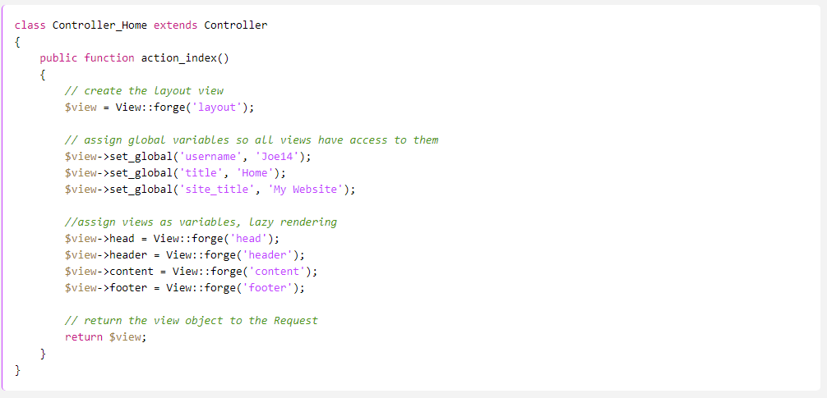
The downside…

Slide 30
Much Better:

Slide 31
Presenters
A combination of Controllers and Actions
Thinks “Elements”
Amazon uses these a LOT
…So do lots of other large sites
News sites
Facebook
Twitter
…and integration for all of the above.

Slide 32
Routers
Translate a URL into which controller to call
We’ll look at how Fuel PHP Handles this…
Benefit:
From the URL, you know exactly which controller and method was called
From the URL, you know exactly which view file was called
Nice!
Don’t have to worry about directory structure when generating URLs
Can easily link between pages
Also, it’s intuitive to the programmer AND the user!

