Slide 1
PHP
Loops and Conditionals
Generating Email,
Reading files.

Slide 2
Loops & Conditionals
foreach, for, if/elseif/else, while, do…while, switch
Same syntax as in Java and C
foreach is for looping through arrays completely
Case switching with switch() can be more effective than if/elseif/else nesting

Slide 3
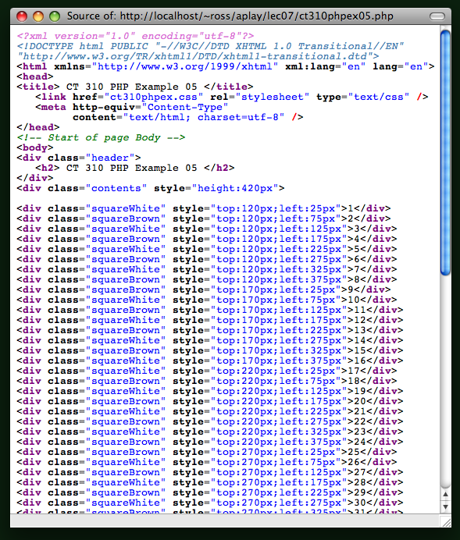
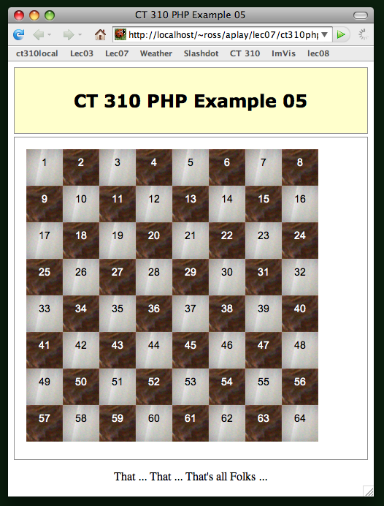
PHP Example 05
Don’t write this by hand.

Slide 4
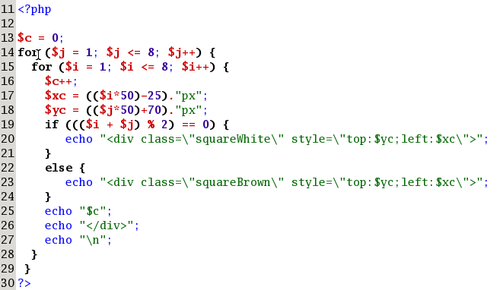
PHP Example 05

Slide 5
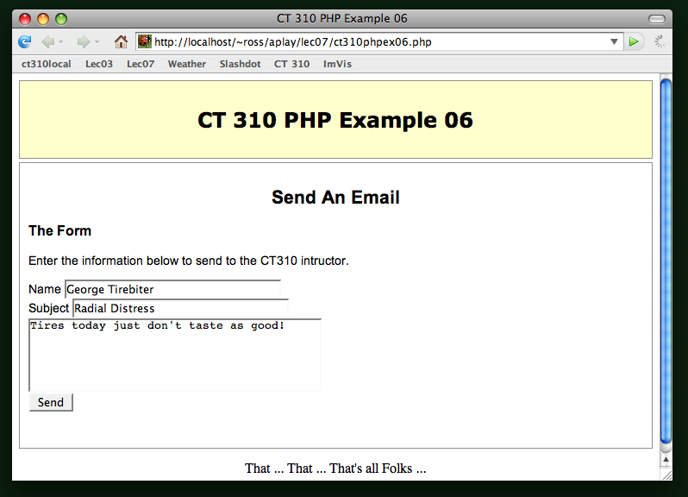
PHP Example 06

Slide 6
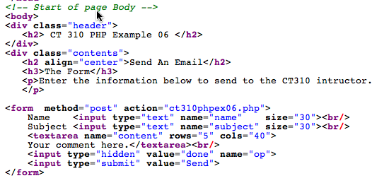
PHP Example 06

Slide 7
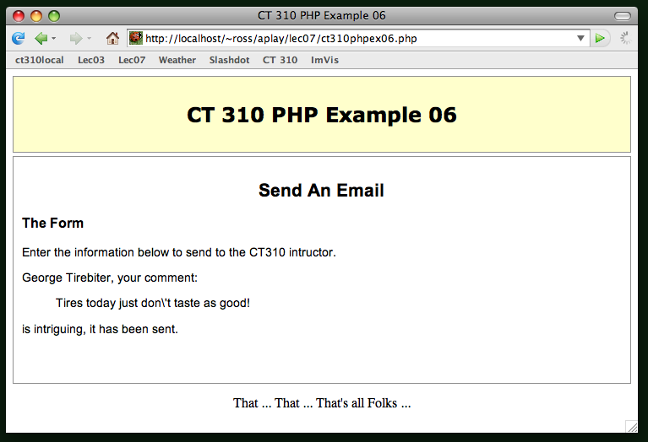
PHP Example 06

Slide 8
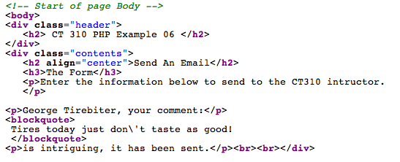
PHP Example 06
Remember, html is being created by PHP!

Slide 9
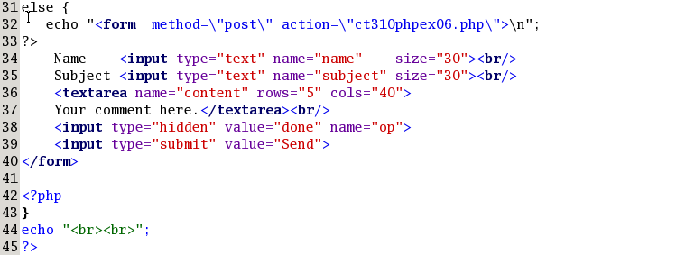
PHP Example 06
First things second … if “op” is not set.

Slide 10
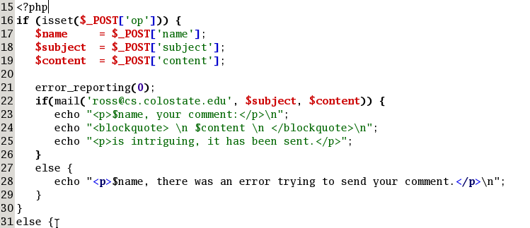
PHP Example 06
Second things first … if “op” is set.

Slide 11
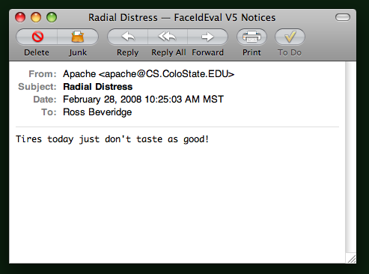
Yes, it did send email.

Slide 12
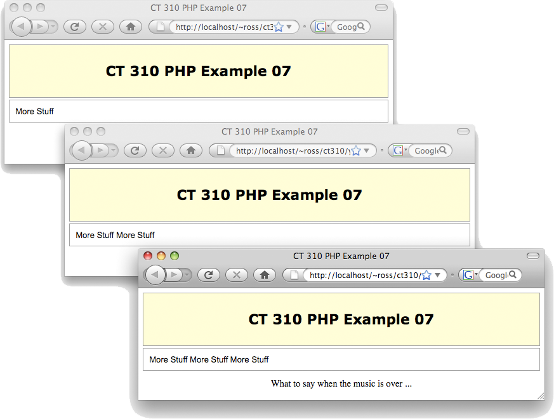
File I/O – Very Simple

Slide 13
PHP Tables from Arrays
*
Tables from Arrays of Objects
Exploding Strings
* Course logo spider web photograph from Morguefile openstock photograph by Gabor Karpati, Hungary.

Slide 14
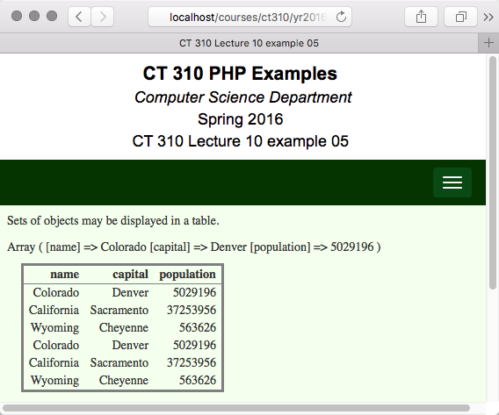
Example 5 combines:
Objects
Arrays
HTML Tables

Slide 15
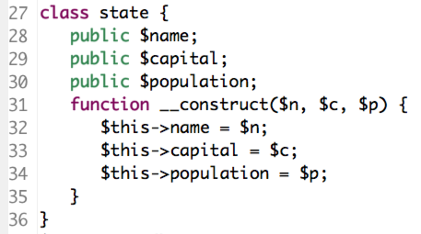
Example 05
Use objects to manage information
A state is a singular thing with 3 related data items:

Slide 16
Punchline: Transform an array of objects to a table

Slide 17
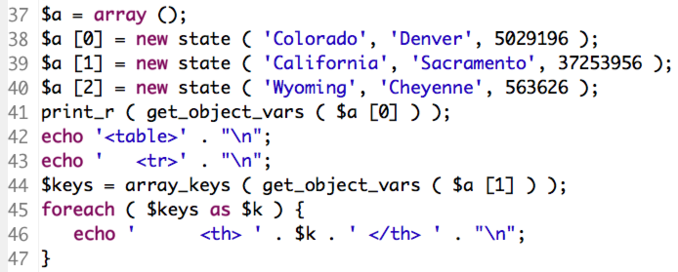
An Array of States
Create three states in an array
Note line 41: array holds all the member data for the first state.

Slide 18
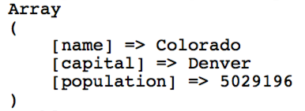
More about get_object_vars
With one function you can fully equate object member data with a keyword style array.
Access to the keys is very handy.

Slide 19
Keys Are Column Headers
Here again is a part of the code.
Line 44: Object member data to an array
Line 44: Retrieve keywords from array
Line 45: Iterate through keys
Line 46: One table column header per key.

Slide 20
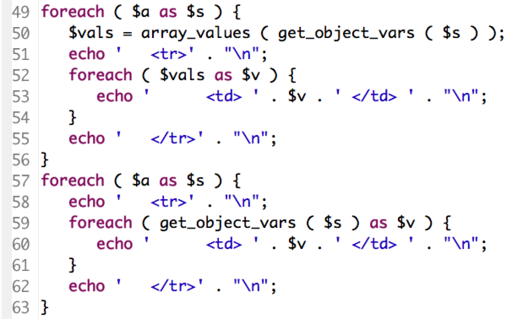
Filling in the Table
Enumerate the values in the table
Upper and lower versions function the same. Lower avoids intermediate variable

Slide 21
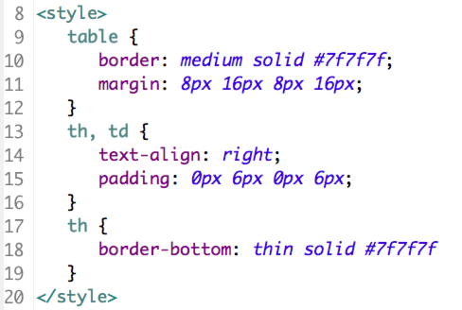
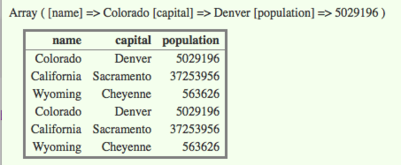
Style

Slide 22
Now Without Loops
Same goal, build a table from an array of objects.
But, no loops, just array reduction
  Nested array reduction at that.
Many ways this could be done.
In this example, table header and table data rows first built as strings.
Then sent to the client, i.e. a succinct echo command inside table tags.

Slide 23
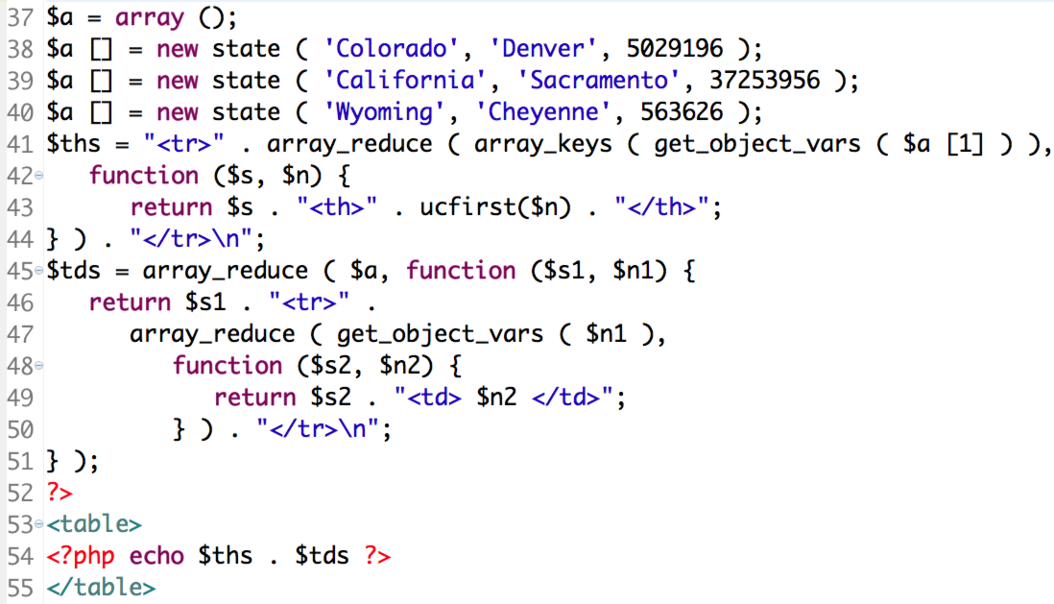
Example 6 Code

Slide 24
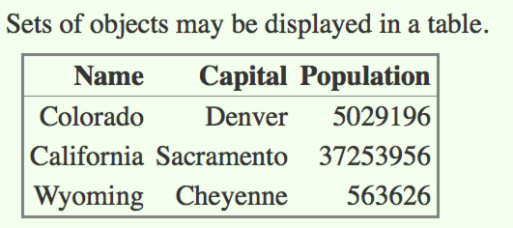
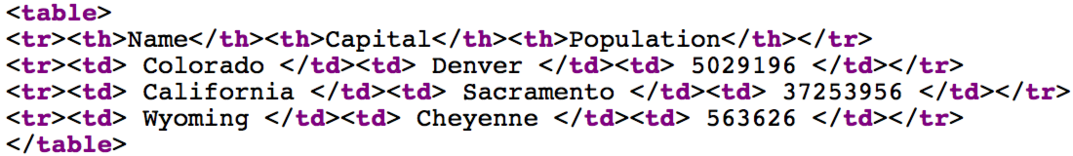
Example 06 on Client
Think of it this way. Map reduce can be very good at constructing repeated patterns from arrays.

Slide 25
Example 06 Observations
Example 06 may be a bit extreme
  OK to ask, who finds this more readable?
On the plus side
  Highly functional limits side-effects.
  Internal function easy to modify.
Punchline for CT 310
  Study and understand Example 06!
  For now avoid loops when you can.
  Once you master both styles, then you will be able to make informed choices.

Slide 26
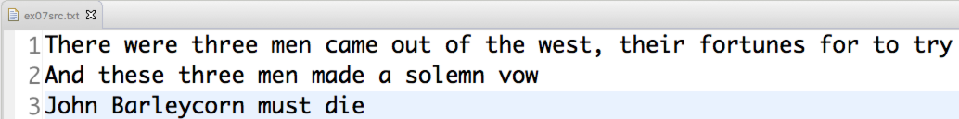
Manipulating Files/Strings
Here is a plain text file:
As a text file, it has three lines
What about if we want to
  Count words?
  Change newlines into HTML newlines?
  Group by words or lines?

Slide 27
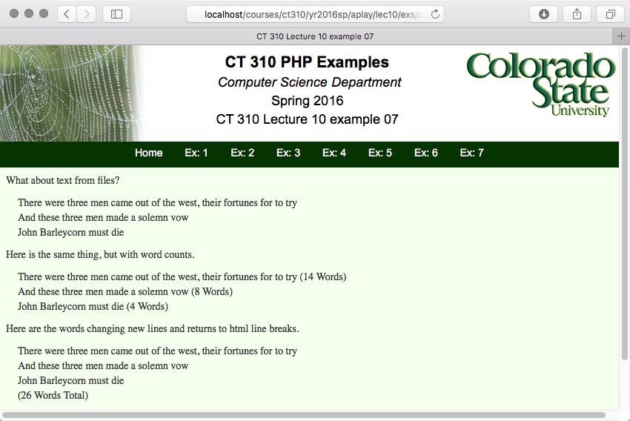

Slide 28
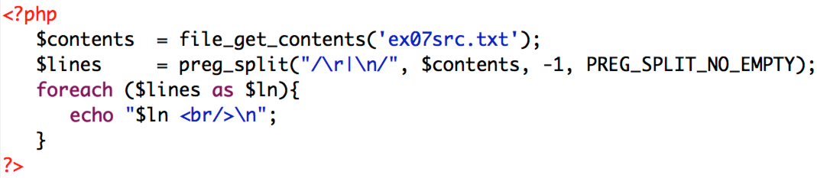
First Part – Split on Newlines
First, note one command reads file.
Now, one command builds an array, one array entry per line.
preg_split well worth studying!

Slide 29
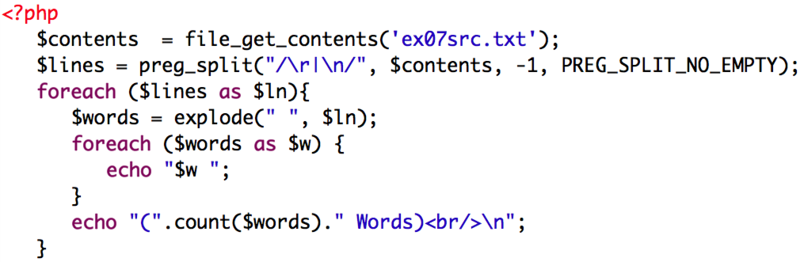
Second Part – Word Counts
Ever explode a string?
Similar to preg_split, but simpler, and better if there is only one delimiter.
Pay attention to the ease of word counting.

Slide 30
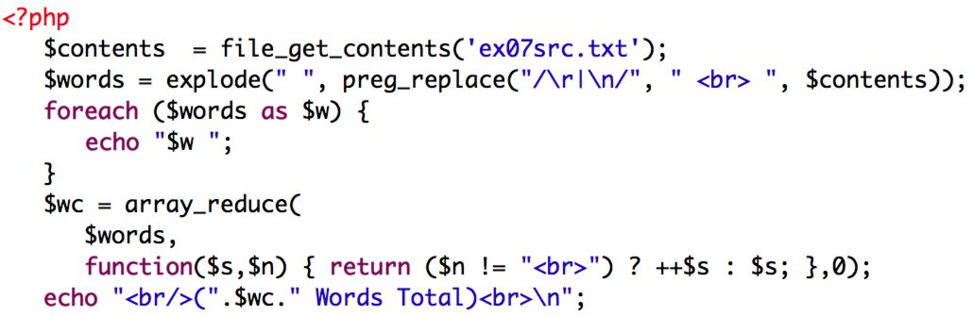
Third Part - Substitution
Explicitly convert ASCII newlines to line break tags.
Note need to avoid counting <br> tags.

